Slide 1
Defining, Evaluating, & Supporting Teaching Excellence — Portfolio Edition
Dr. Kristina Bross, Dr. Kim Illingworth, Dr. Lindsey Payne, Dr. Ada Uche

Slide 2
TEACHING EXCELLENCE at PURDUE UNIVERSITY
A Deliberate, Intentional Research Process
2019: Provost’s Road Map & Teaching Academy
Charged with “defining teaching excellence and creating a cultural shift such that it is understood, supported and valued across campus.”
2019: Road Map Advisory Committee
Marcos Fernandez (AG); Rachael Kenney (ED/SCI); Larry Nies (ENGR); Lindsey Payne (ENGR); David Rollock (HHS); Kris Bross (HONRS/CLA); Charlene Sullivan (KRAN); Kim Plake (PHARM); Greg Strimel (PPI); Dave Nelson (CIE); Shamila Janakiraman (Research Assistant/ED)
2019 to 2020: Defining, documenting, evaluating, and recognizing excellent teaching at a R1 institution (#IRB-2019-484), Payne and Janakiraman
Extensive literature review, external university websites
Qualitative analysis of Purdue landscape (faculty, staff, students, administration)
Email interviews, university documents, and digital artifacts (in-person interviews, observation notes from several listening sessions, and student reflections)
CIE’s multidimensional scaling data
Notes:
In 2019 the Provost charged the Teaching Academy with…
Formed a sub-committee…
Then conducted a deliberate, intentional research study. We qualitatively analyzed Purdue-centric documents—Provost listening sessions, teaching awards, student reflections on teaching excellence. We also grounded this work in an extensive literature review. Finally, we compared our results with CIE’s multi-dimensional scaling data and validated our results and process with the sub-committee.
We have also shared this with Jay and Jenna and this is endorsed by the Provost’s Office.

Slide 3
TEACHING EXCELLENCE at PURDUE UNIVERSITY
An excellent teacher demonstrates that they are an Enthusiast, Experimenter, Educator, Exemplar, and Explorer. Descriptors for each dimension are provided below, as well as recommended evaluation approaches for this multi-dimensional, developmental framework.
Increase both internal and external funding opportunities
Revitalize Service Engagement Advisory Board
Support policies to value the scholarship of engagement as a promotion and tenure platform across colleges
EXPLORER
Contributes to undergraduate educational experience
Creates scholarly contributions to teaching & learning
Shares teaching effectiveness
Engages in professional development
Initiates educational development opportunities
Applies knowledge to societal challenges
EXPERIMENTER
Continuously improves course instruction & pedagogy
Implements innovative instructional methods to improve the process of learning, e.g., to enhance instruction via instructional strategies, activities, use of technology, applying learning theories, interdisciplinary collaborations, assessment & collaborative learning
EDUCATOR
Communicates learning goals
Sets realistic expectations
Connects to real world
Engages & challenges learners
Promotes creativity, critical thinking & problem- solving
Uses evidence-based instructional strategies
Relates theory to practice
Provides constructive feedback
Open to feedback
ENTHUSIAST
Subject matter expert
Passionate about subject & student learning
Enjoys teaching
Inspires life-long learning
Provides career guidance
Engages in trans-/interdisciplinary collaborations
EXEMPLAR
Caring
Approachable
Personable
Empathetic
Motivator
Mentor (personal)
Listener
Trustworthy
Accessible
Respectful of diversity
Humorous
Empowers students
Academic honesty
Integrity
TEACHING PORTFOLIOS
PEER OBSERVATIONS
STUDENT RATINGS
ALUMNI FEEDBACK
Payne and Janakiraman (2021), Under Review
Notes:
From this work, the 5 E’s of teaching excellence emerged
To date, this has been displayed as the 5 pillars, i.e., 5 elements of excellence and descriptors, as well as recommended evaluation tools of for each element
As a reminder, our task, from the Provost, was
“defining teaching excellence and creating a cultural shift such that it is understood, supported and valued across campus.”
That lead us to a developmental framework and thinking about how we can operationalize this work.

Slide 4
Framework for Teaching Excellence
Excellent teachers create an environment and adopt pedagogies that allow students to meet learning outcomes and achieve their full potential as learners. All instructors strive for excellence as Exemplars, Enthusiasts, and Educators. Instructors whose research encompasses teaching and learning should additionally strive for excellence as Experimenters and Explorers.
An Explorer is a scholar of teaching and learning and a mentor/role model for other academics.
EXPLORER
EXPERIMENTER
Experimenters are instructors who are ready to adapt to changes in audience, instructional methods, and educational content. They proactively incorporate innovative instructional strategies and technologies using a variety of perspectives.
EDUCATOR
Educators are instructors who engage learners using a variety of learner-centered activities that are inclusive, motivating, relevant to the real world, application-based, and that which promotes creativity, critical thinking, and collaboration.
Teaching Portfolios
Student Ratings, Peer Observations, Alumni Reviews
ENTHUSIAST
Enthusiasts are instructors who are subject matter experts, passionate about their teaching and discipline, and who want to transfer that passion to their students, whether in the classroom or as a mentor. They prepare students for future careers and collaborate actively with colleagues to improve their instruction.
EXEMPLAR
Exemplars are instructors who demonstrate a caring, approachable, and personable relationship with students and are empathetic to student needs. They establish a respectful learning environment and support, motivate, and mentor students.

Slide 5
TEACHING EXCELLENCE at PURDUE UNIVERSITY
Provost Teaching Fellow
Teaching Academy Fellow
Charge: to serve as a conduit for information about teaching excellence between faculty/units and the Teaching Academy/Provost’s office
Focus groups/Listening sessions
Educational Policy Committee (EPC)
Faculty Affairs Committee (FAC)
Teaching Academy
Butler Center
Department Heads
Other groups/units (PIRE, Colleges, Departments)
Next Phase: Working toward implementation in localized ways (i.e. at the departmental level), including conversations about assessment and evaluation.
Notes:
Kris Bross is serving at the Teaching Academy Teaching Excellence Fellow
Next phase: TA Endorsement, presentation to Faculty Senate EPC, FAC and focus groups targeting implementation in localized ways, i.e., at the department level
Working with an advisory committee

Slide 6
TEACHING EXCELLENCE at PURDUE UNIVERSITY
Teaching Excellence Advisory Committee
Responsibilities:
Assist with focus groups convened by the Fellow
Beta test structures of teaching development/evaluation as needed, e.g., create a teaching portfolio and dossier or pilot mentorship programs. ​
Serve as “teaching excellence champions” in their home colleges and across the university
Offer feedback to the Fellow on other initiatives as needed.
Members:
Natasha Duncan (HONR)
Marcos Fernandez (Ag)
Jenn Hall (CLA)
Heather Howard (ILS-Libraries)
Rachael Kenney (ED)
Dave Nelson (CIE)
Larry Nies (ENGR)
Kathy Salisbury (VET)
Greg Strimel (PPI)
Charlene Sullivan (KRAN)
Marcy Towns (SCI)
Zach Weber (PHARM)
Kris Bross (Teaching Academy Teaching Excellence Fellow, HONR), Ex Officio
Kim Illingworth (Teaching Academy Chair, PHARM), Ex Officio
Lindsey Payne (Past Teaching Academy Chair, ENGR), Ex Officio
Signe Kastberg (Committee Chair Senate Faculty Affairs), Ex Officio

Slide 7
Next Steps:
TEACHING EXCELLENCE at PURDUE UNIVERSITY
Provost Teaching Fellow
Teaching Academy Fellow
Endorsement
Teaching Academy
Senate EPC
Senate Faculty Affairs

Slide 9
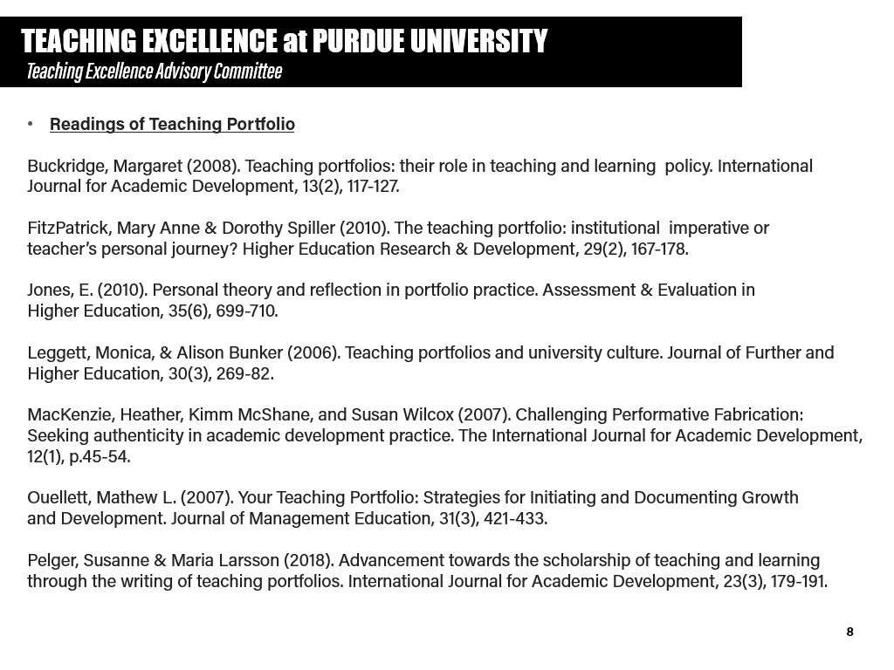
Next Steps:
TEACHING EXCELLENCE at PURDUE UNIVERSITY
Provost Teaching Fellow
Teaching Academy Fellow
Endorsement
Teaching Academy
Senate EPC
Senate Faculty Affairs

