Slide 1
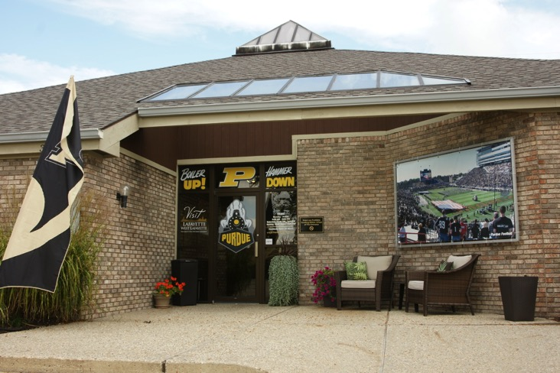

Visit
Lafayette-West Lafayette
A destination marketing organization
Market and promote the community
Community involvement
Free services!

Slide 2

Attractions - Wolf Park

Slide 3

Prophetstown State Park

Slide 4
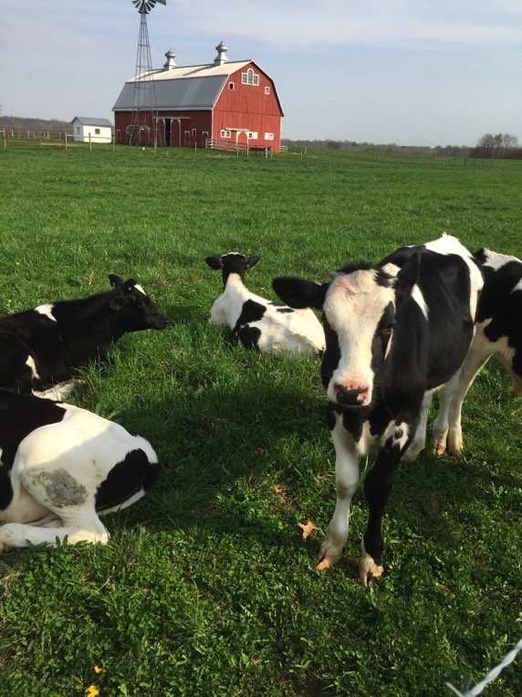
The Farm at Prophetstown

Slide 5
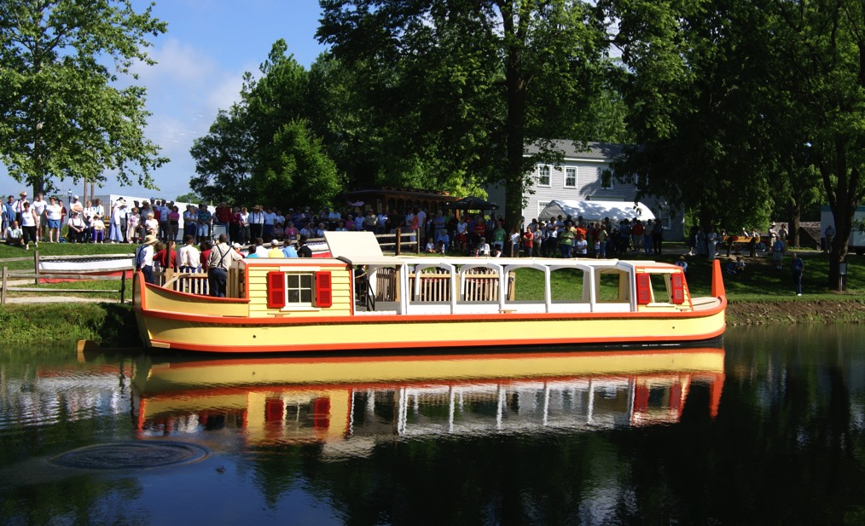
Wabash & Erie Canal Interpretive Center

Slide 6
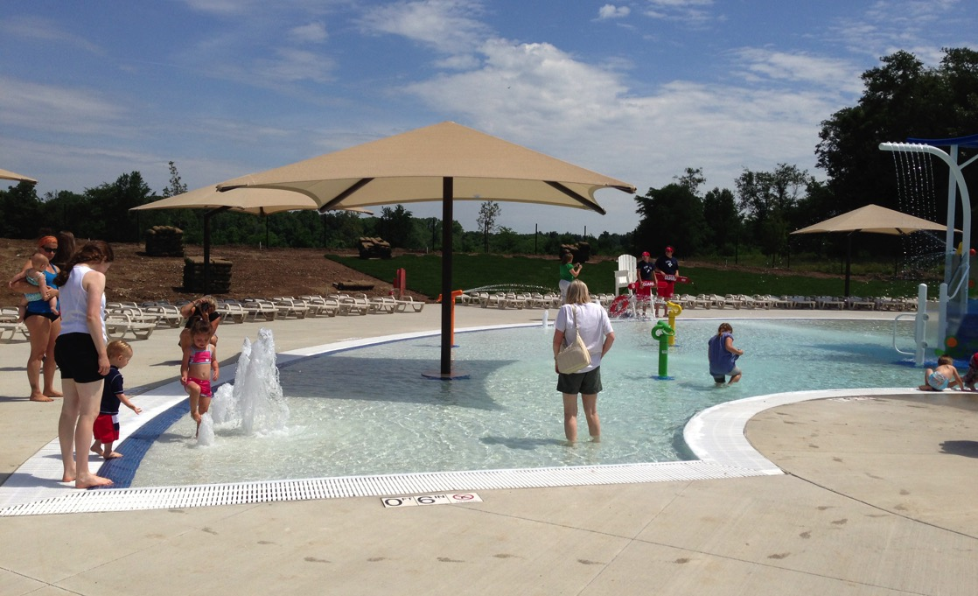
Prophetstown State Park
Aquatic Center

Slide 7
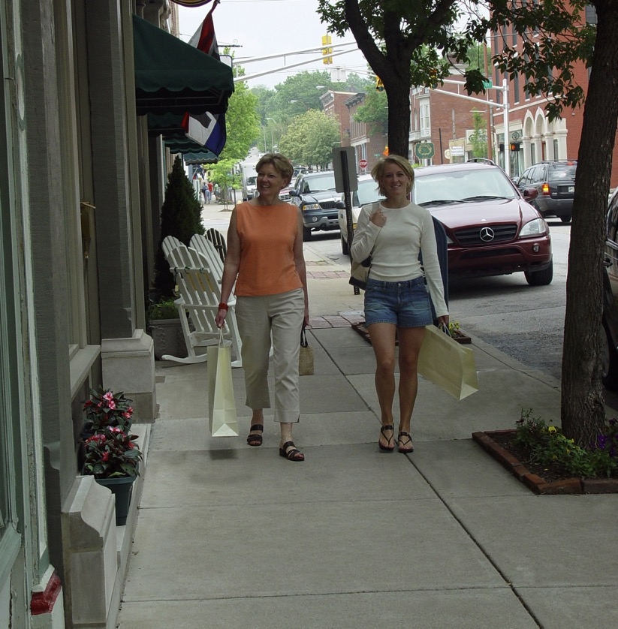
Downtown Lafayette
  Historic Architecture
  Shopping & Dining
  Art Galleries
  Courthouse Tours
  Long Center
  Civic Theater
  Art Museum of Greater Lafayette
  Farmers Market
  Tapawingo Park
  Wabash Heritage Trail

Slide 8
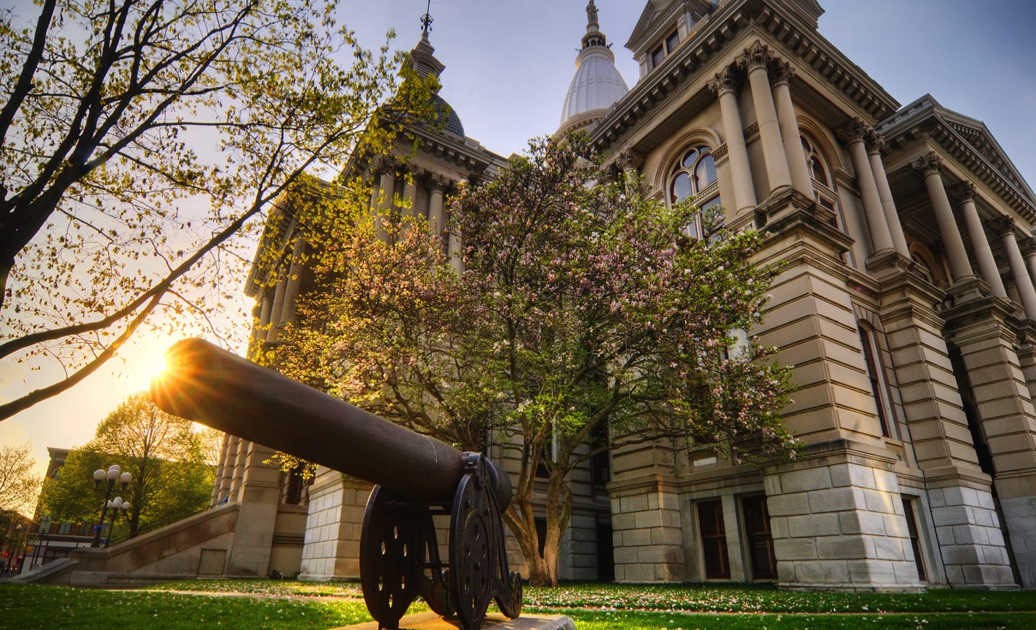
Tippecanoe County Courthouse

Slide 9
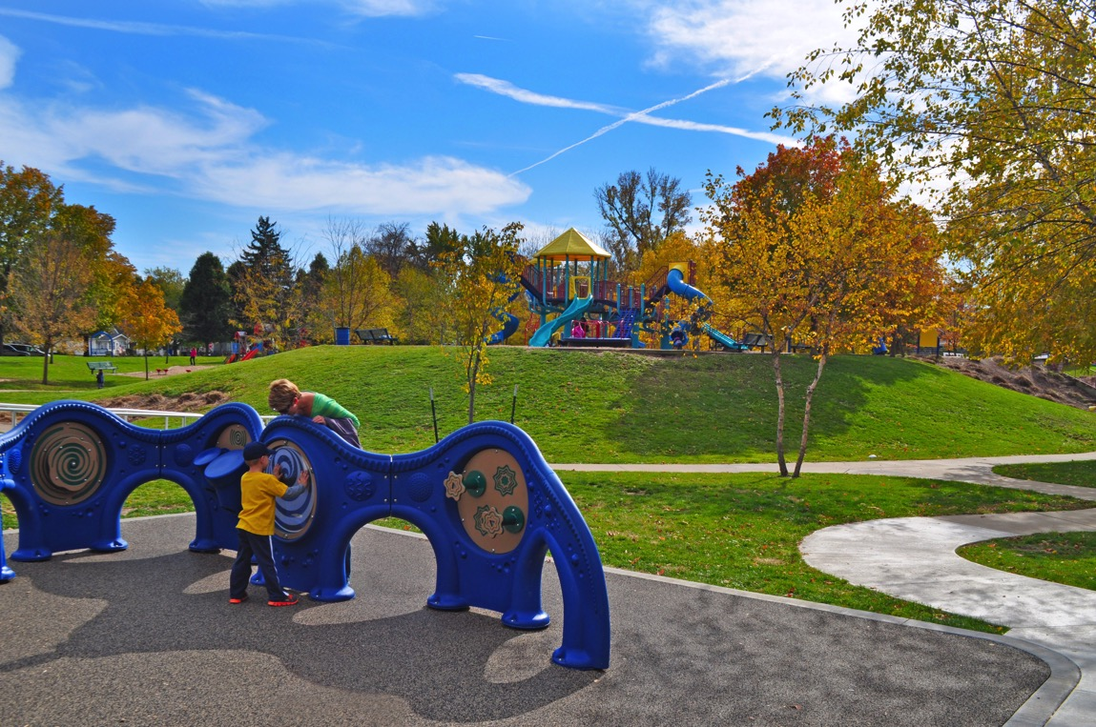
Columbian Park & Zoo

Slide 10
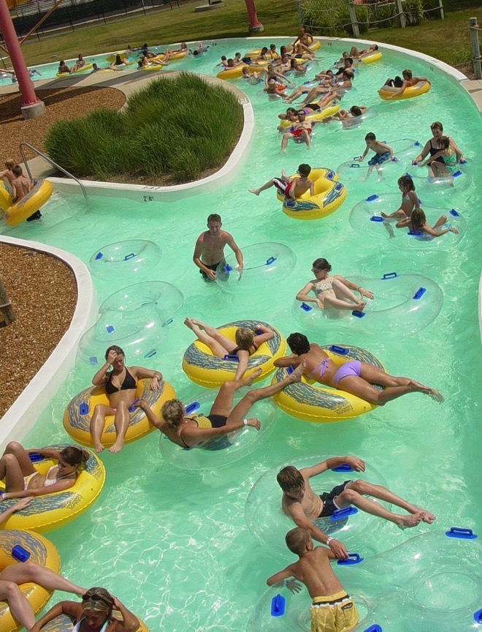
Tropicanoe
Cove

Slide 11
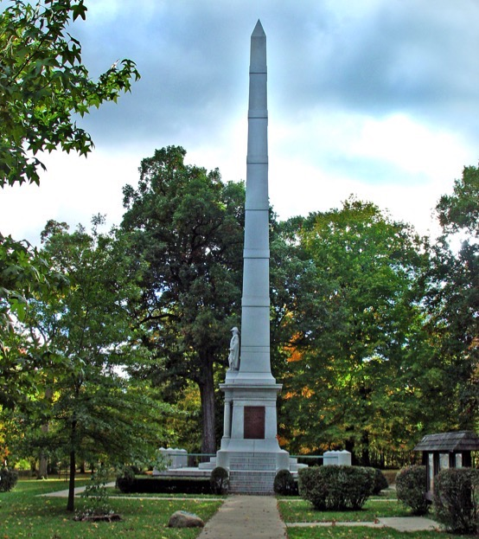
Tippecanoe Battlefield
& Museum

Slide 12
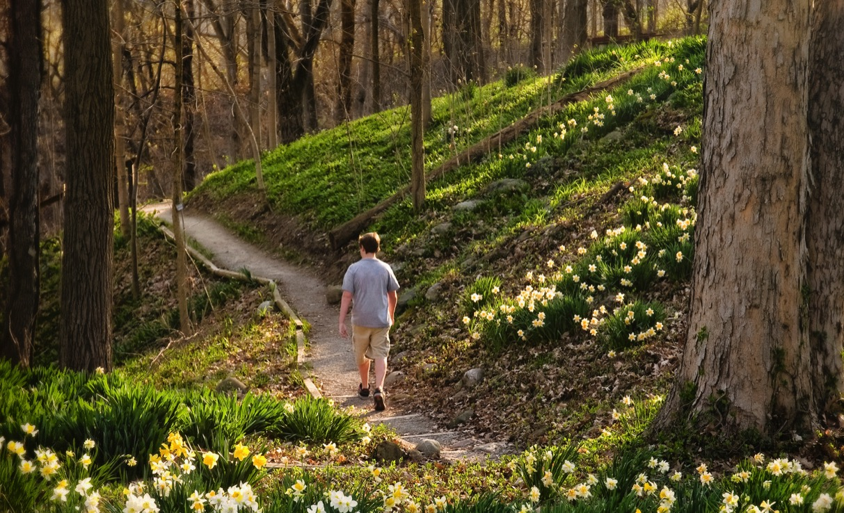
Clegg Memorial Gardens

Slide 13
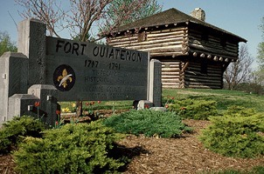
Fort Ouiatenon

Slide 14
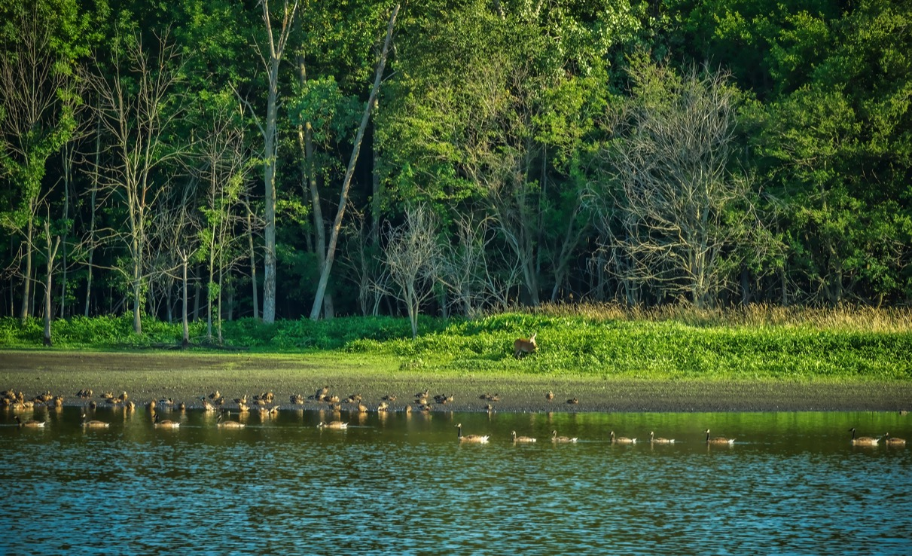
Celery Bog Nature Area

Slide 15
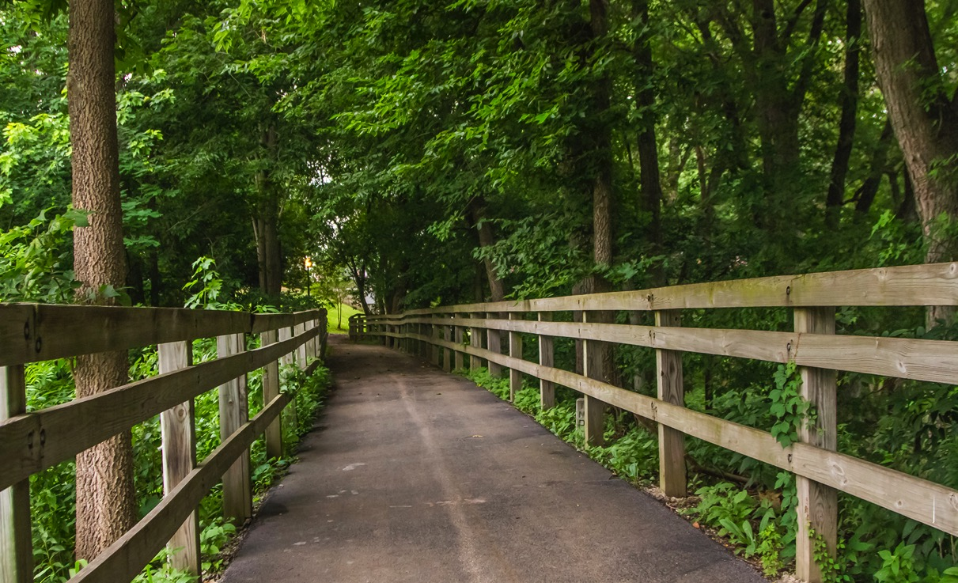
Wabash Heritage Trail

Slide 16
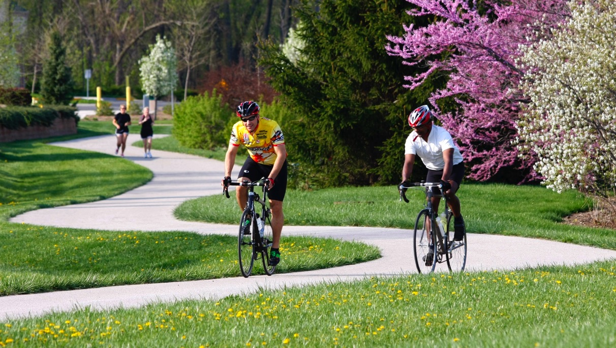
Biking Trails

Slide 17
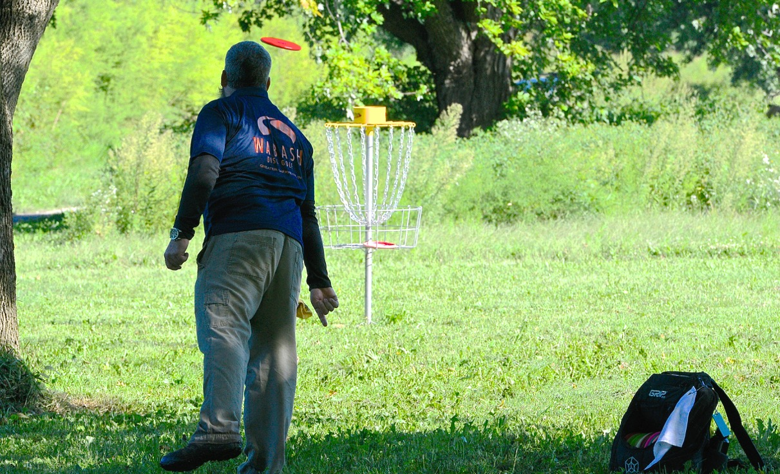
Disc Golf

Slide 18
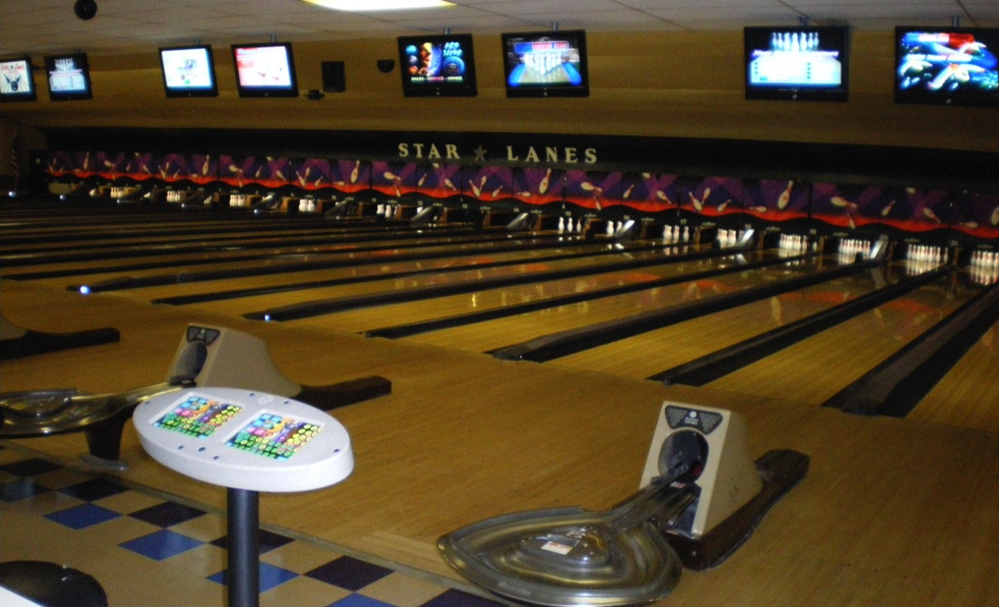
Bowling Alleys

Slide 19
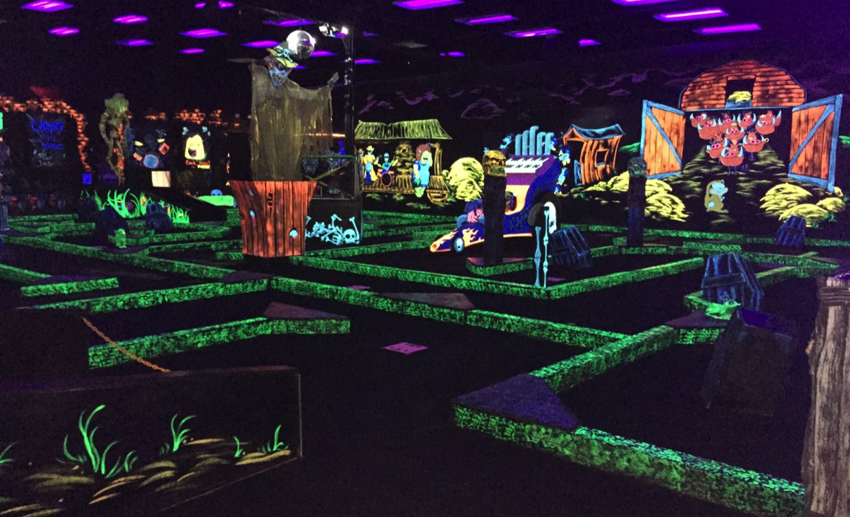
Miniature Golf
– Monster Mini-Golf

Slide 20
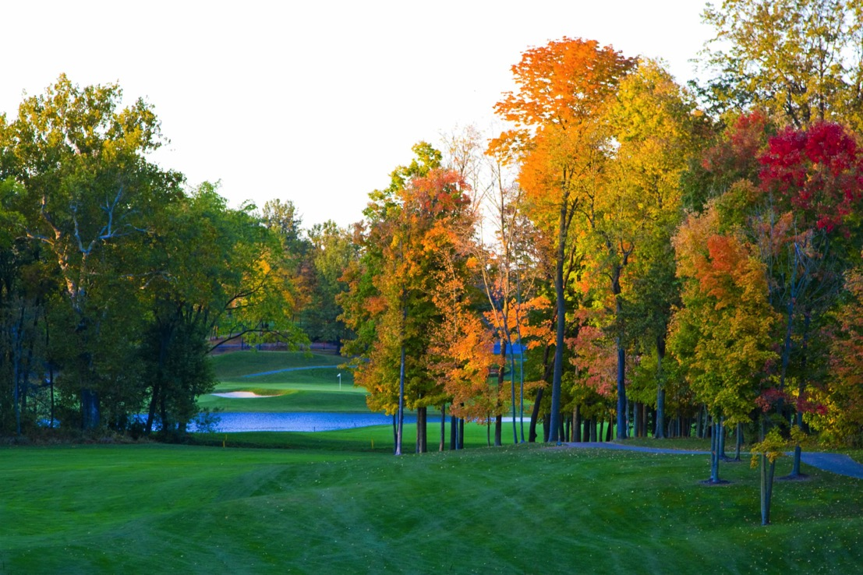
Golf Courses

Slide 21
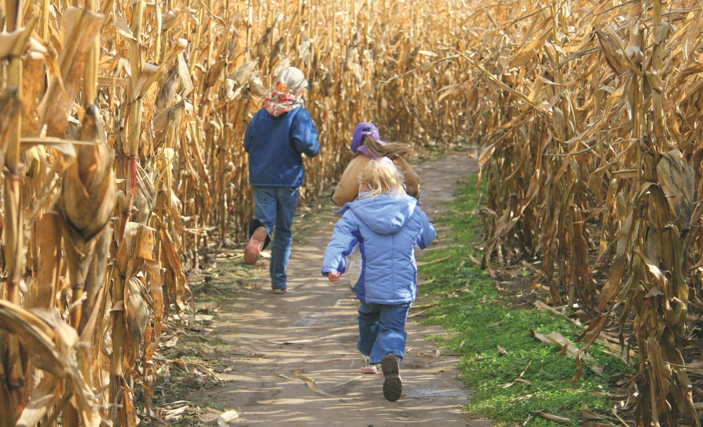
Exploration Acres

Slide 22
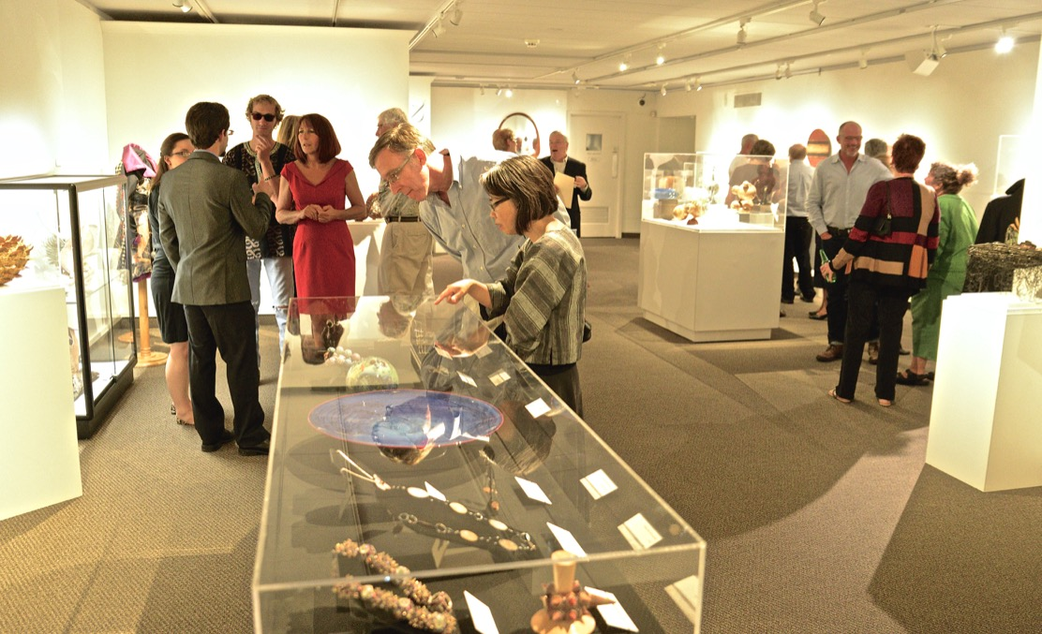
Art Museum of
Greater Lafayette

Slide 23
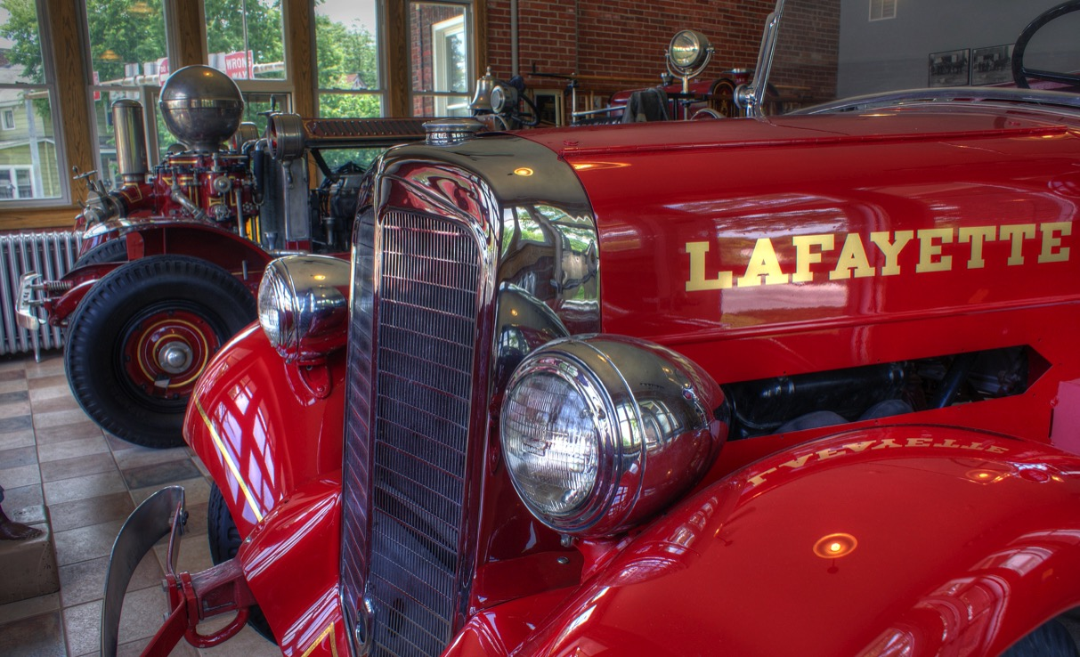
Historic Five Points
Fire Station Museum

Slide 24
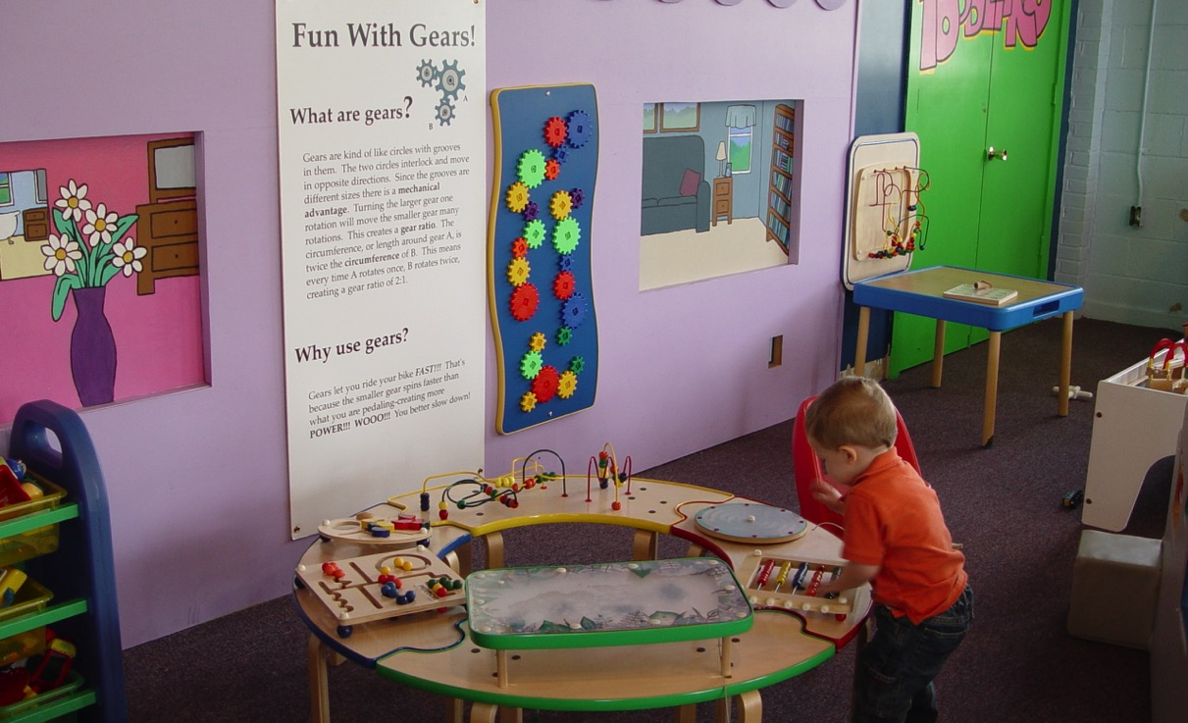
Imagination Station

Slide 25
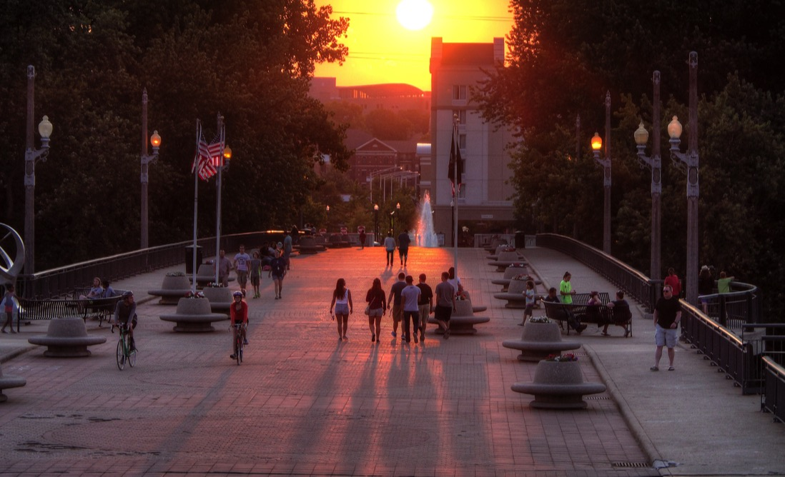
John T. Myers
Pedestrian Bridge

Slide 26
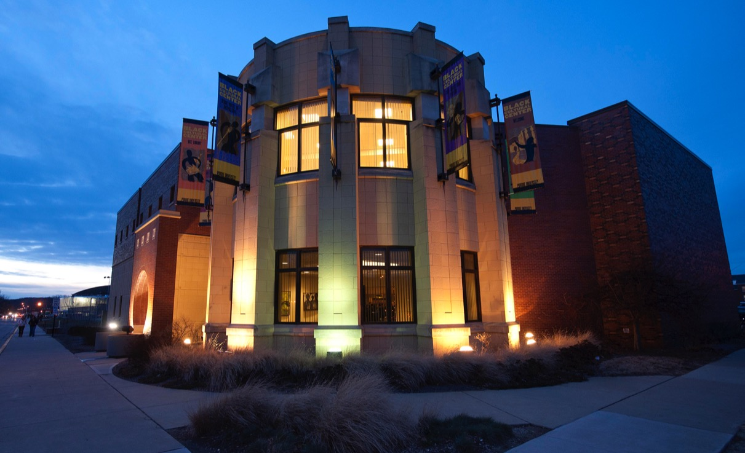
Black Cultural Center

Slide 27
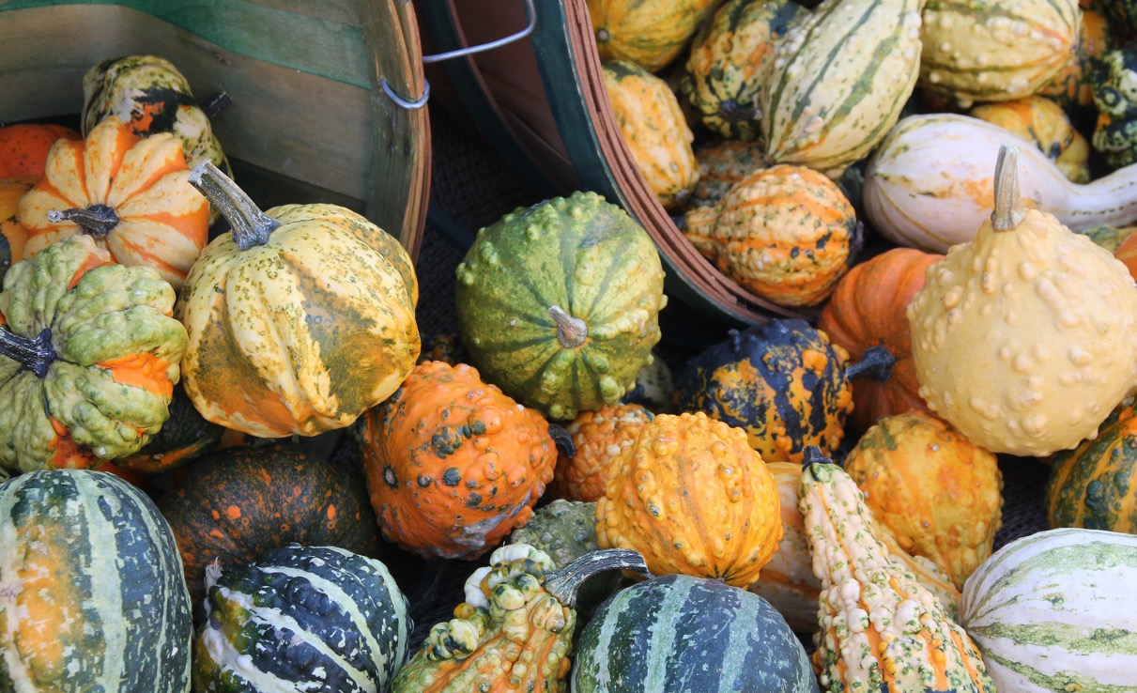
Farmers Markets

Slide 28
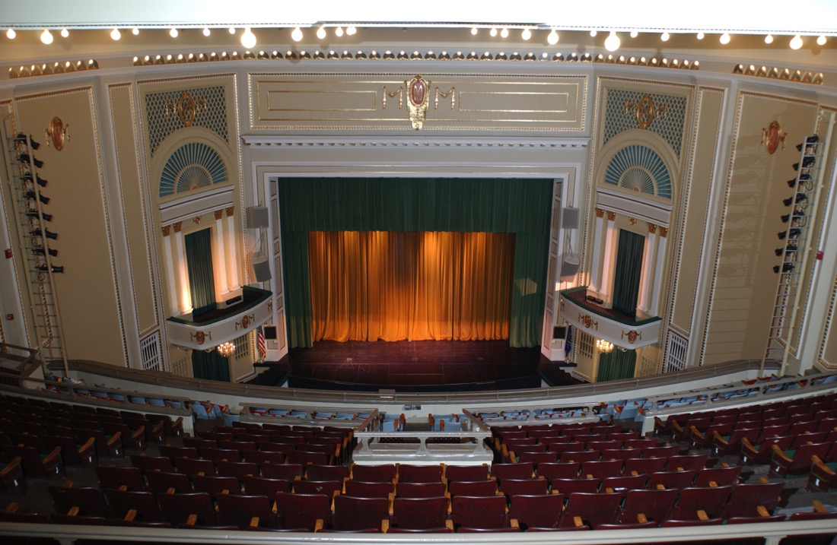
Long Center for the Performing Arts

Slide 29
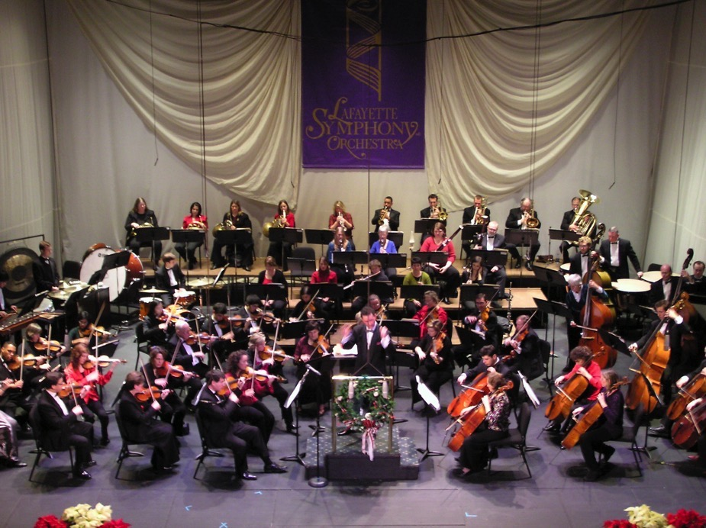
Lafayette Symphony Orchestra

Slide 30
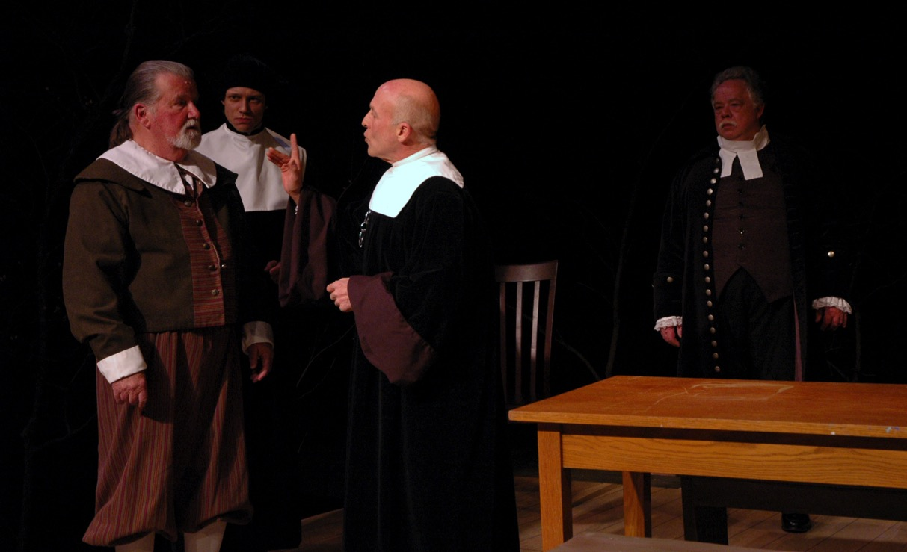
Civic Theatre of Greater Lafayette

Slide 31
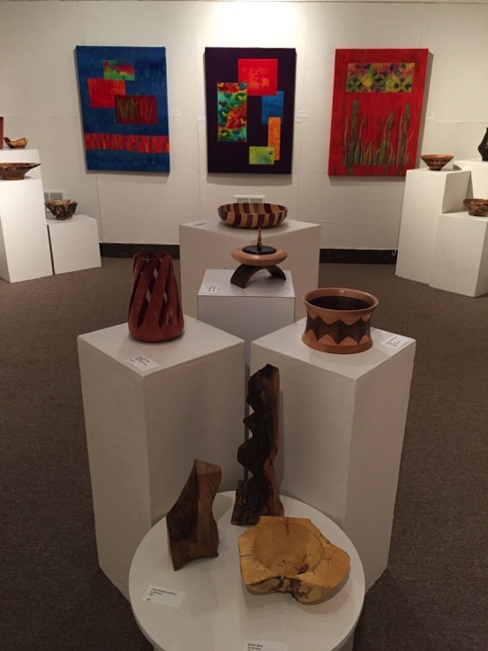
Art Galleries

Slide 32

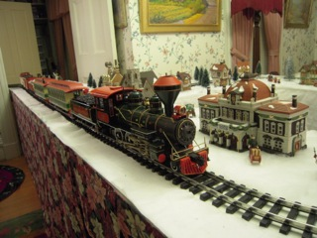
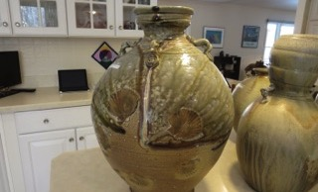
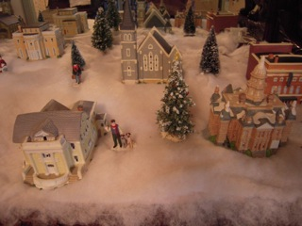
Haan Mansion Museum of Indiana Art

Slide 34
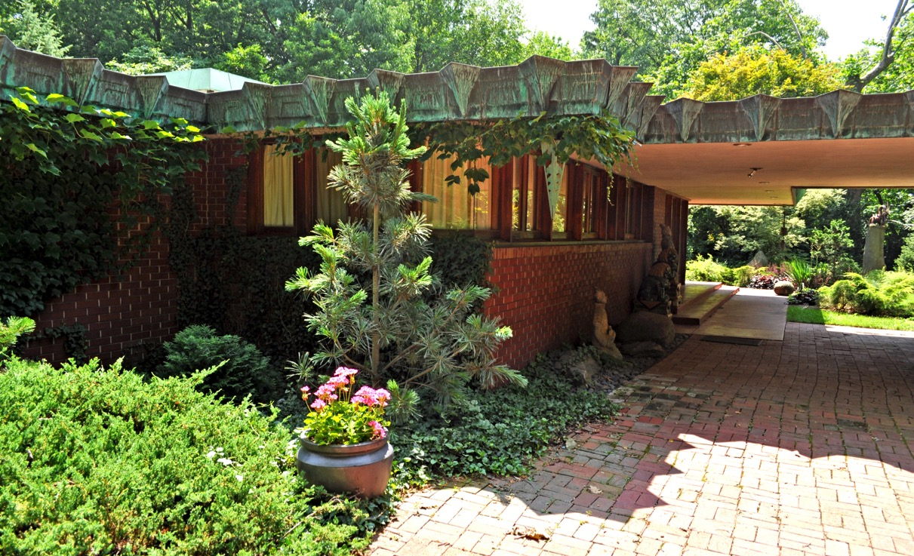
Samara House

Slide 35
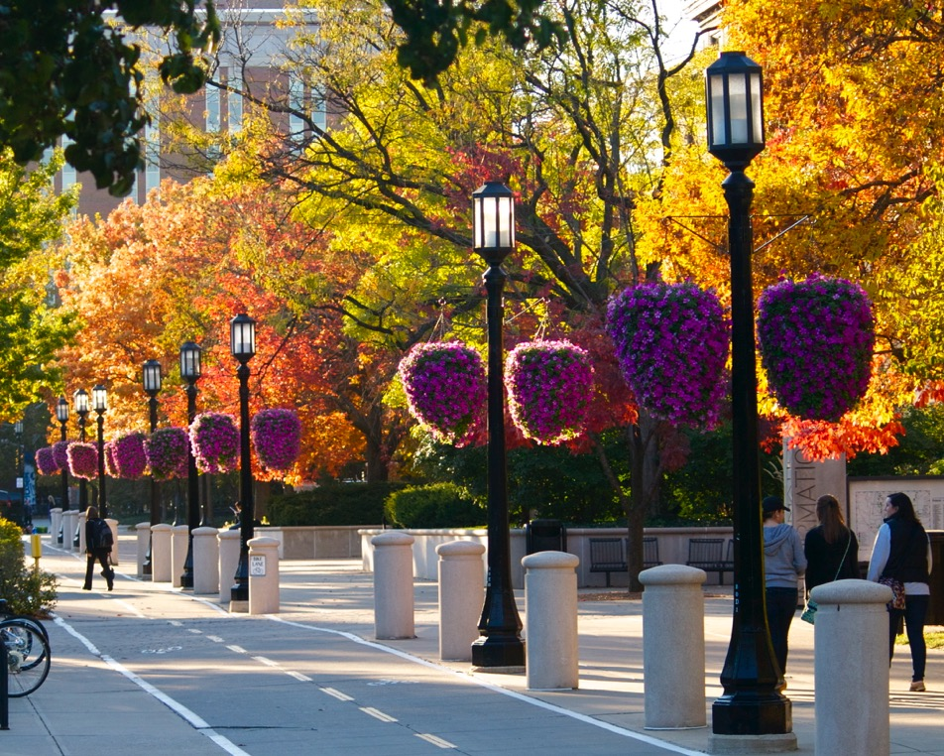
Purdue University

Slide 36
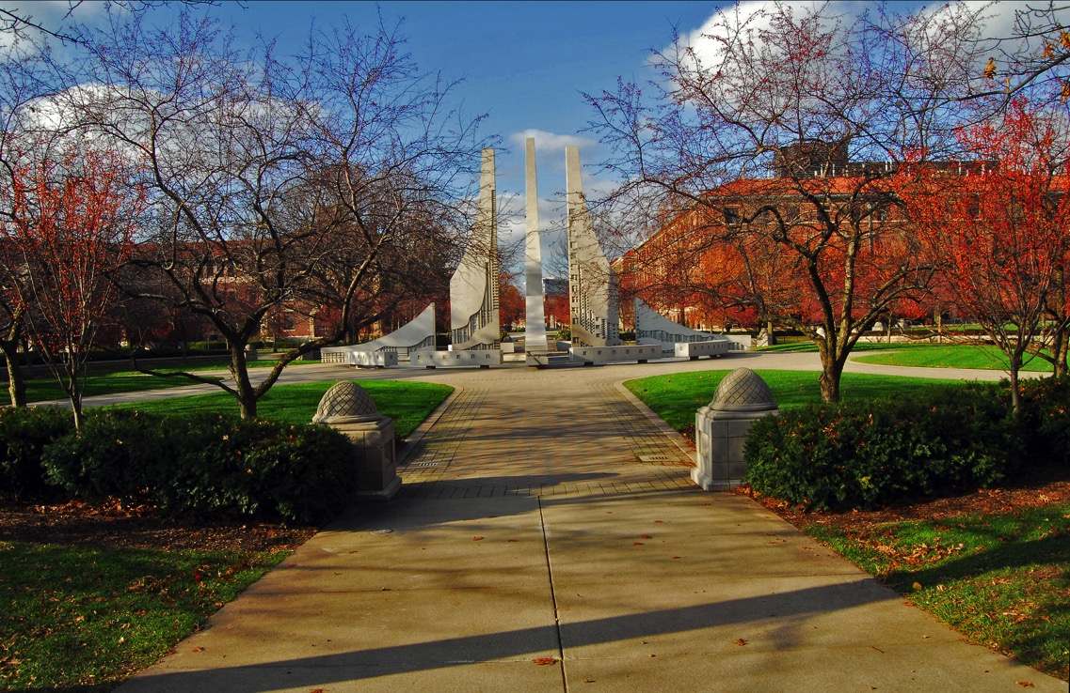
Purdue Engineering Fountain

Slide 37
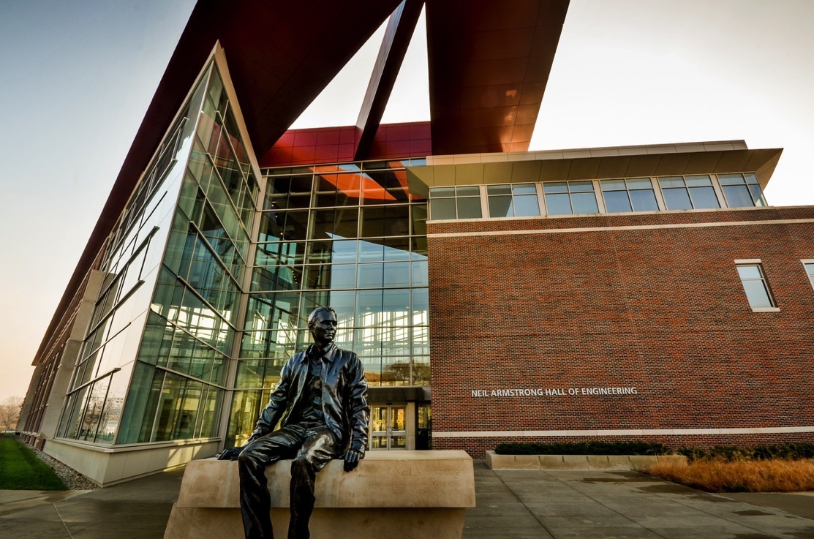
Armstrong Hall

Slide 38
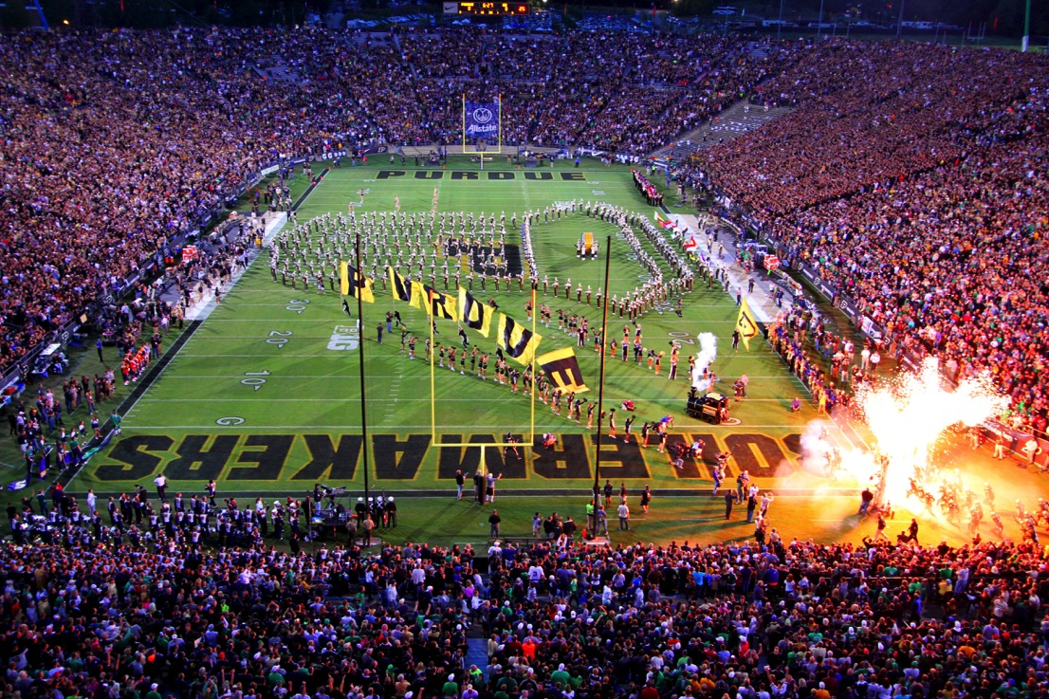
Boilermaker Sports

Slide 39
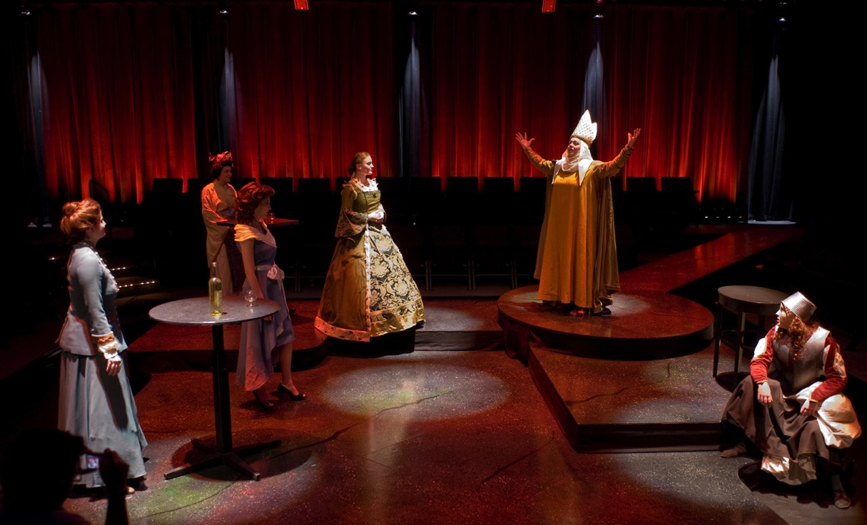
Purdue Theater

Slide 40

People’s Brewing Company

Slide 41
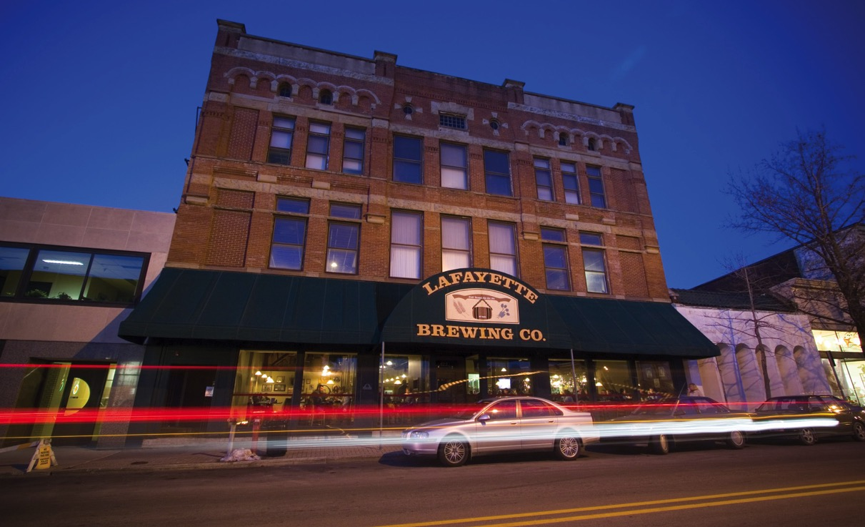
Lafayette Brewing Company

Slide 42
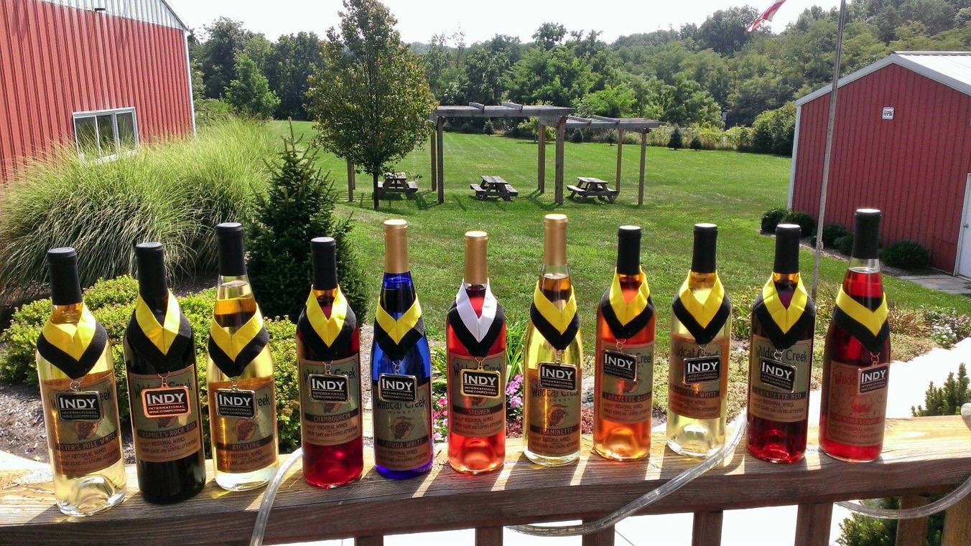
Wildcat Creek Winery

Slide 43
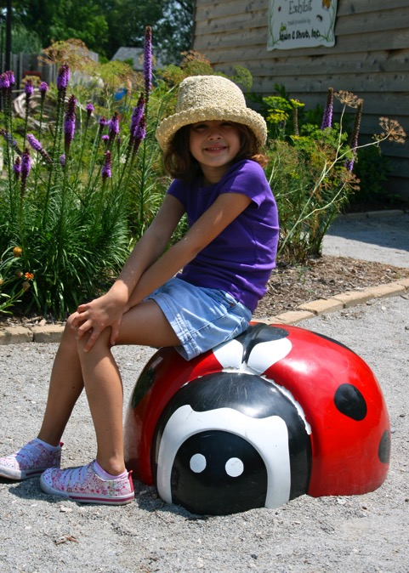
Kid-Friendly Activities
All Fired Up
Buccaneer Bay
Tropicanoe Cove
The Farm at Prophetstown
Columbian Park Zoo
Wabash & Erie Canal Center
Exploration Acres
Wolf Park

Slide 44
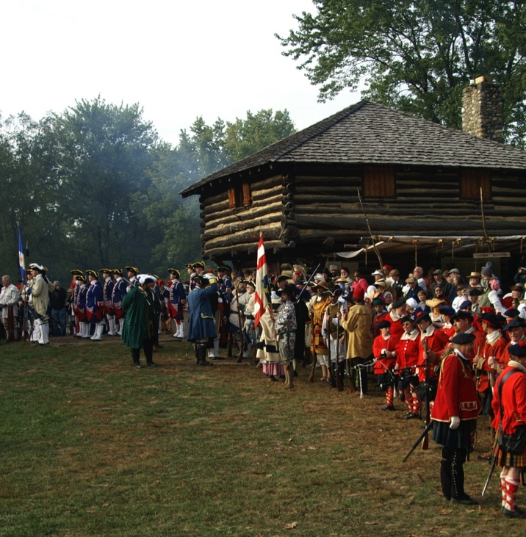
Festivals & Events -Feast of the Hunters’ Moon

Slide 45
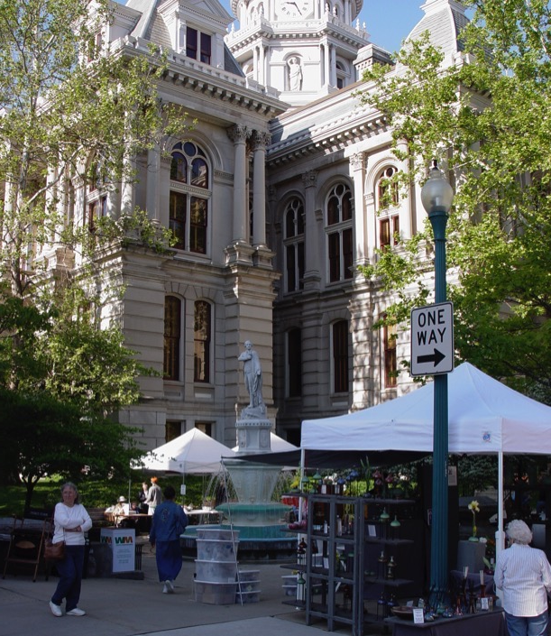
Round the Fountain Art Fair

Slide 46
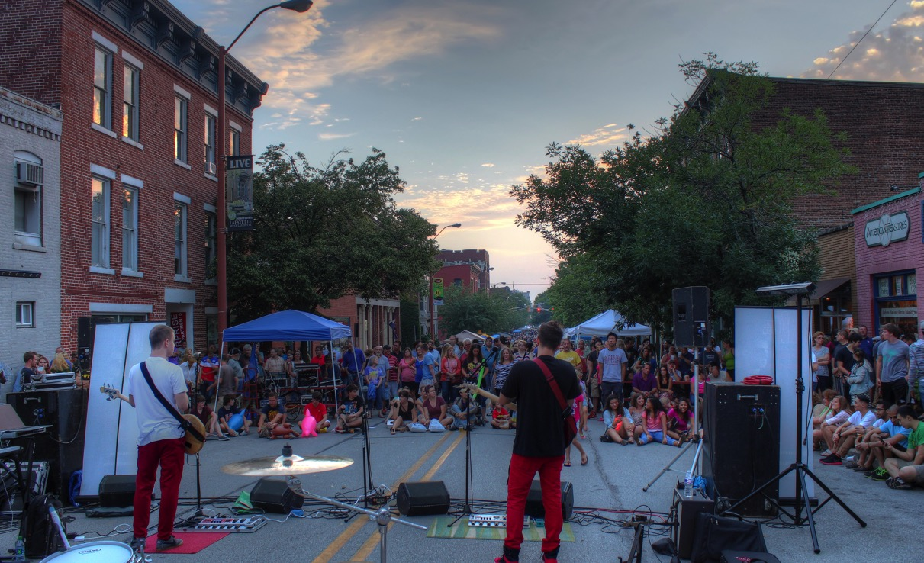
Mosey Down Main Street

Slide 47
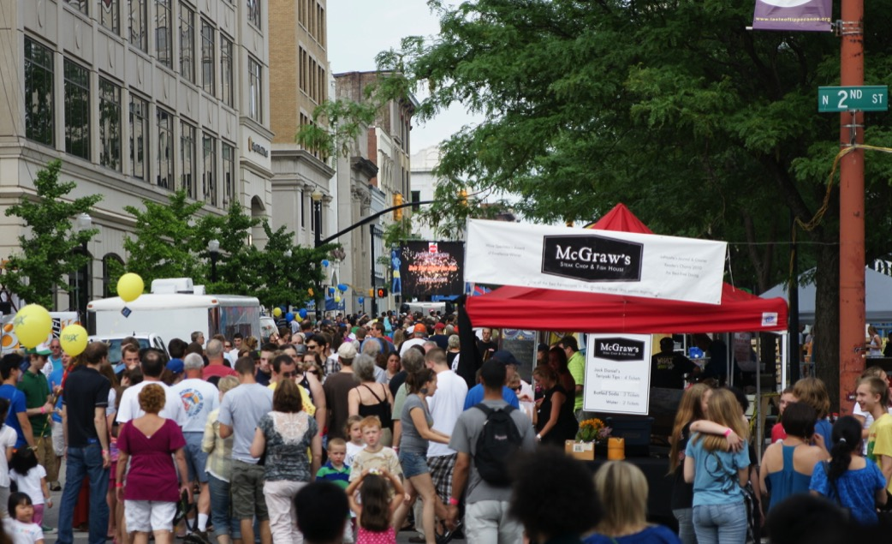
Taste of Tippecanoe

Slide 48
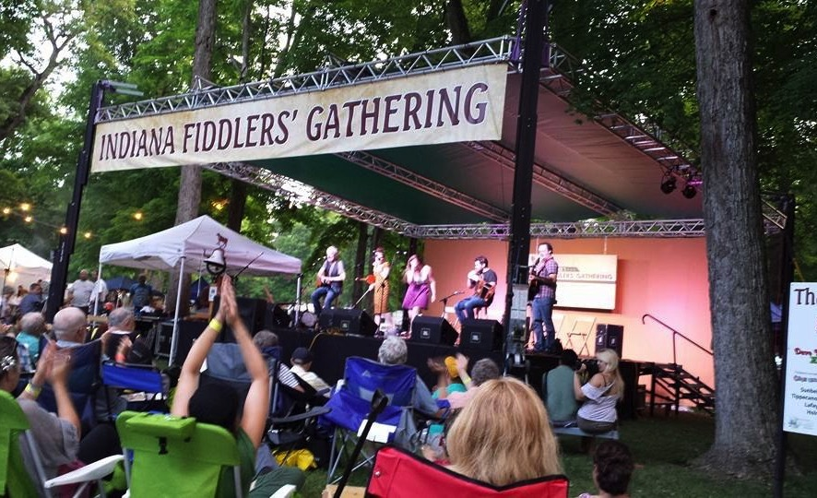
Indiana Fiddlers’ Gathering

Slide 49
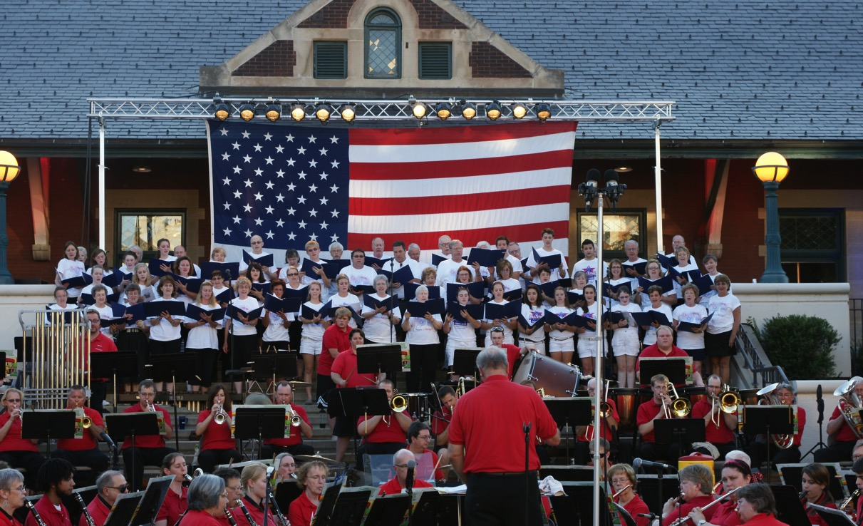
Stars & Stripes Celebration

Slide 50
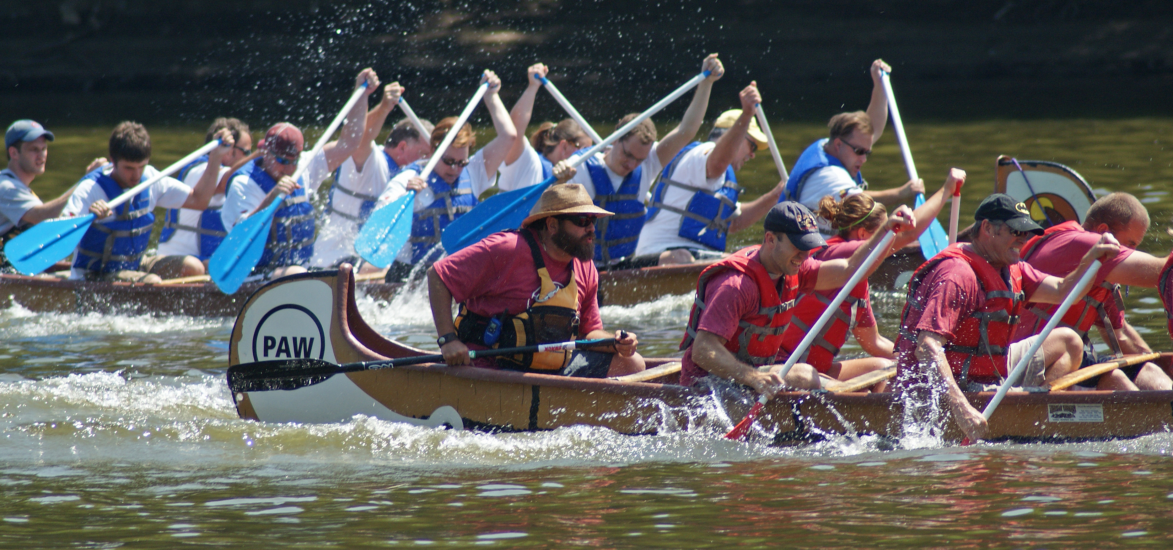
Wabash Riverfest

Slide 51
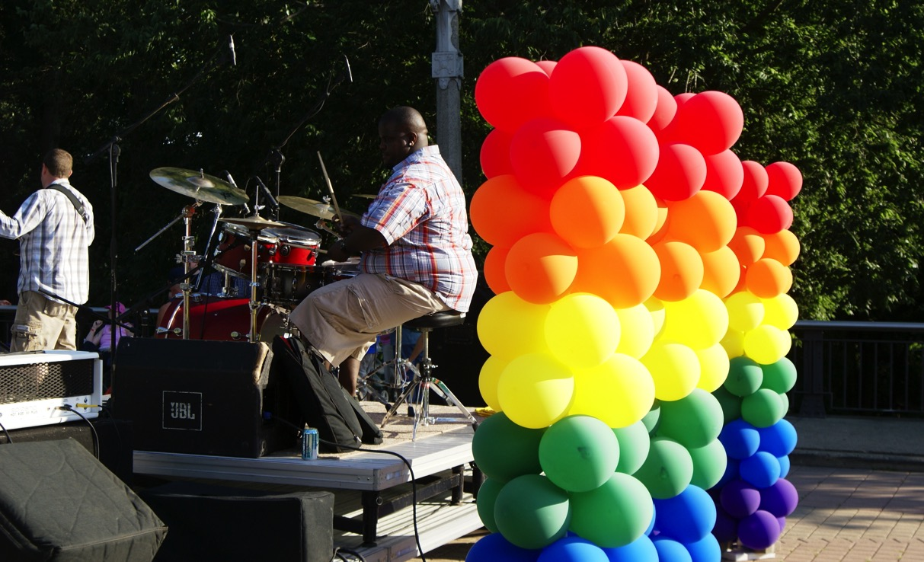
Outfest

Slide 52
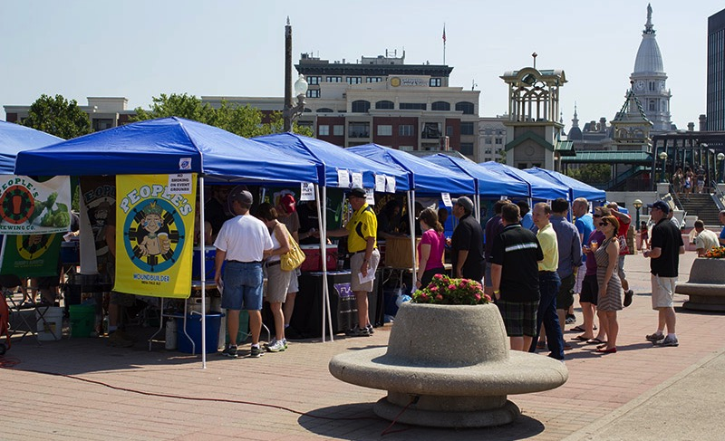
Beers Across the Wabash

Slide 53

Starry Night Festival

Slide 54

Purdue Boilermaker
Half Marathon

Slide 55

Global Fest

Slide 56

Germanfest

Slide 57

Art on the Wabash

Slide 58

Greater Lafayette
Christmas Parade

Slide 59

Purdue Music Organization Christmas Show

Slide 60

Tours
The Farm @ Prophetstown plus the State Park
Winery & Breweries
Benton & White Co Wind Farms
Clay Critters
Inspired Fire
Subaru IN Automotive
Fair Oaks Dairy
Samara House

Slide 61

Community Brand

Slide 62
Jo Wade, President
Visit Lafayette - West Lafayette
301 Frontage Road
Lafayette, IN 47905
765-447-9999
jwade@HomeOfPurdue.com
www.HomeOfPurdue.com

