Slide 2

Network with alumni
Professional development training
Serve as a leader on the PASE Board of Directors
15% off apparel and 10% off textbooks at Follett’s
Jacket for signing up and a new T-shirt and pint glass each year

Slide 3
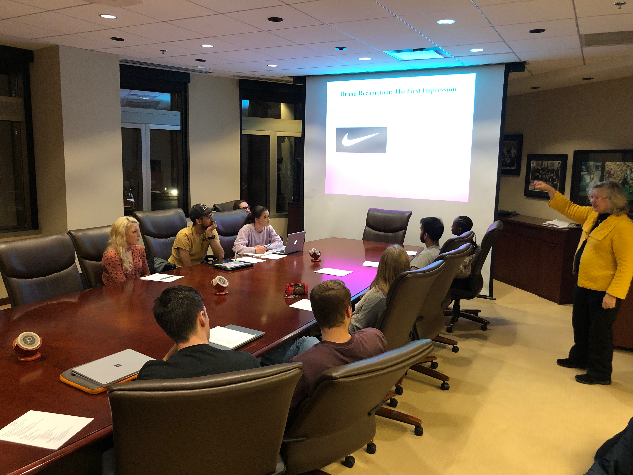
How to join?
Only for students that study on campus at West Lafayette.
$125 for your entire time as a graduate student
Join at www.purdueforlife.org/PASE

Slide 4
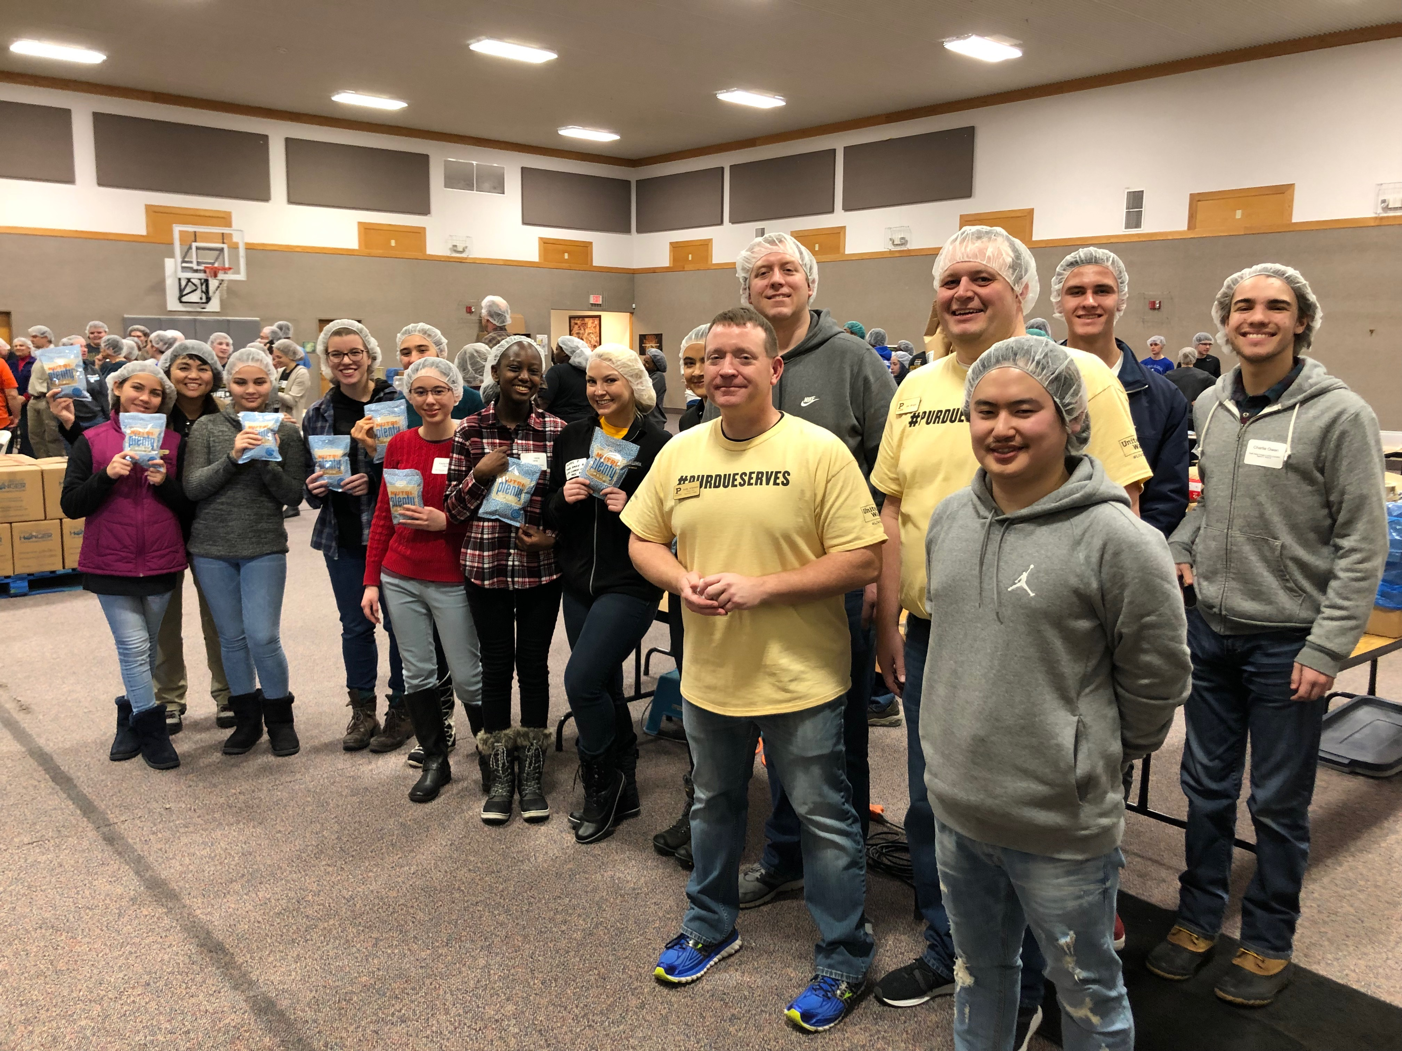
What comes next?
No time commitment!
After you join, we’ll email you when events take place.
There is no requirement to attend – you attend when it fits your schedule.
We typically offer 30-40 programs a year, both in person and virtually.
Applications to serve on the board are released in October/November.

