Slide 1
League of Women Voters of Greater Lafayette
August 1, 2020
Non-Partisan Political Organization
Empowering Voters. Defending Democracy.
www.leaguelafayette.org

Slide 2
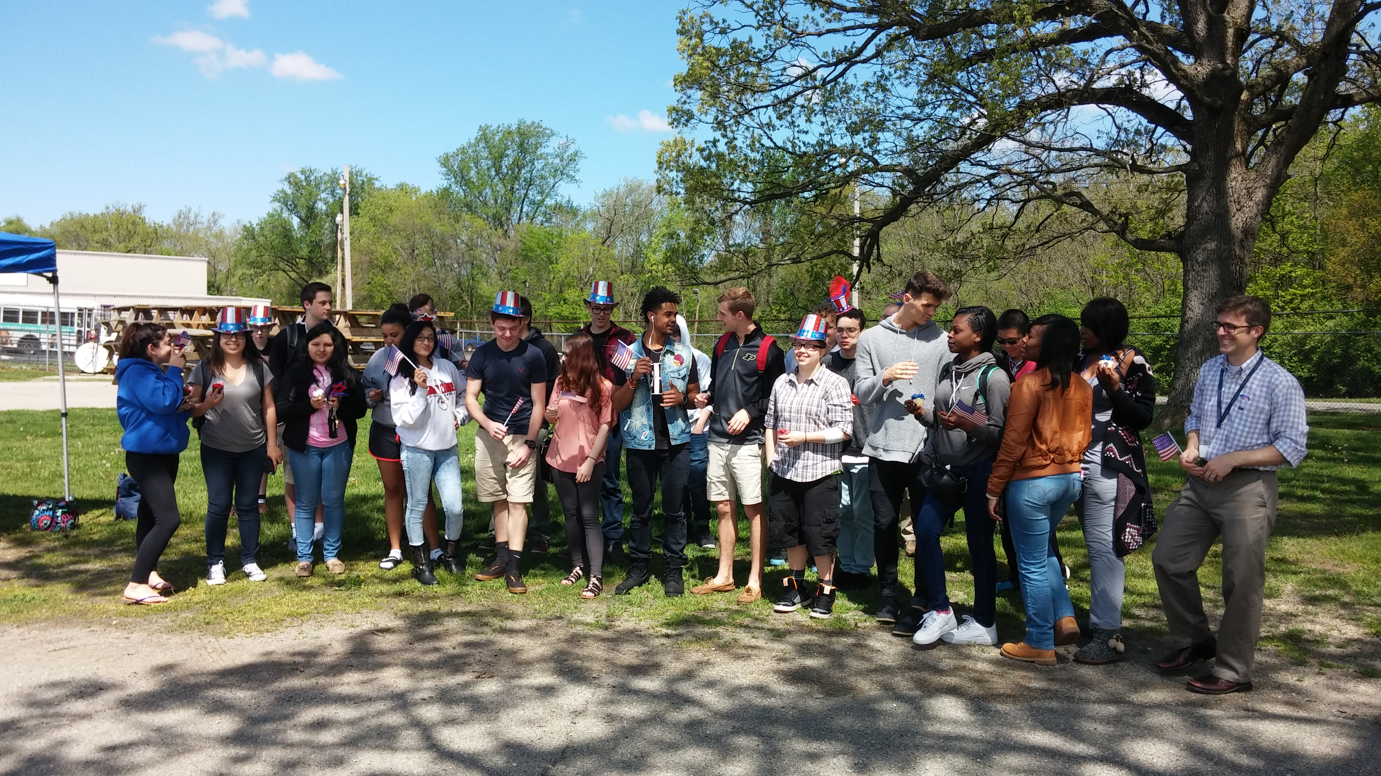
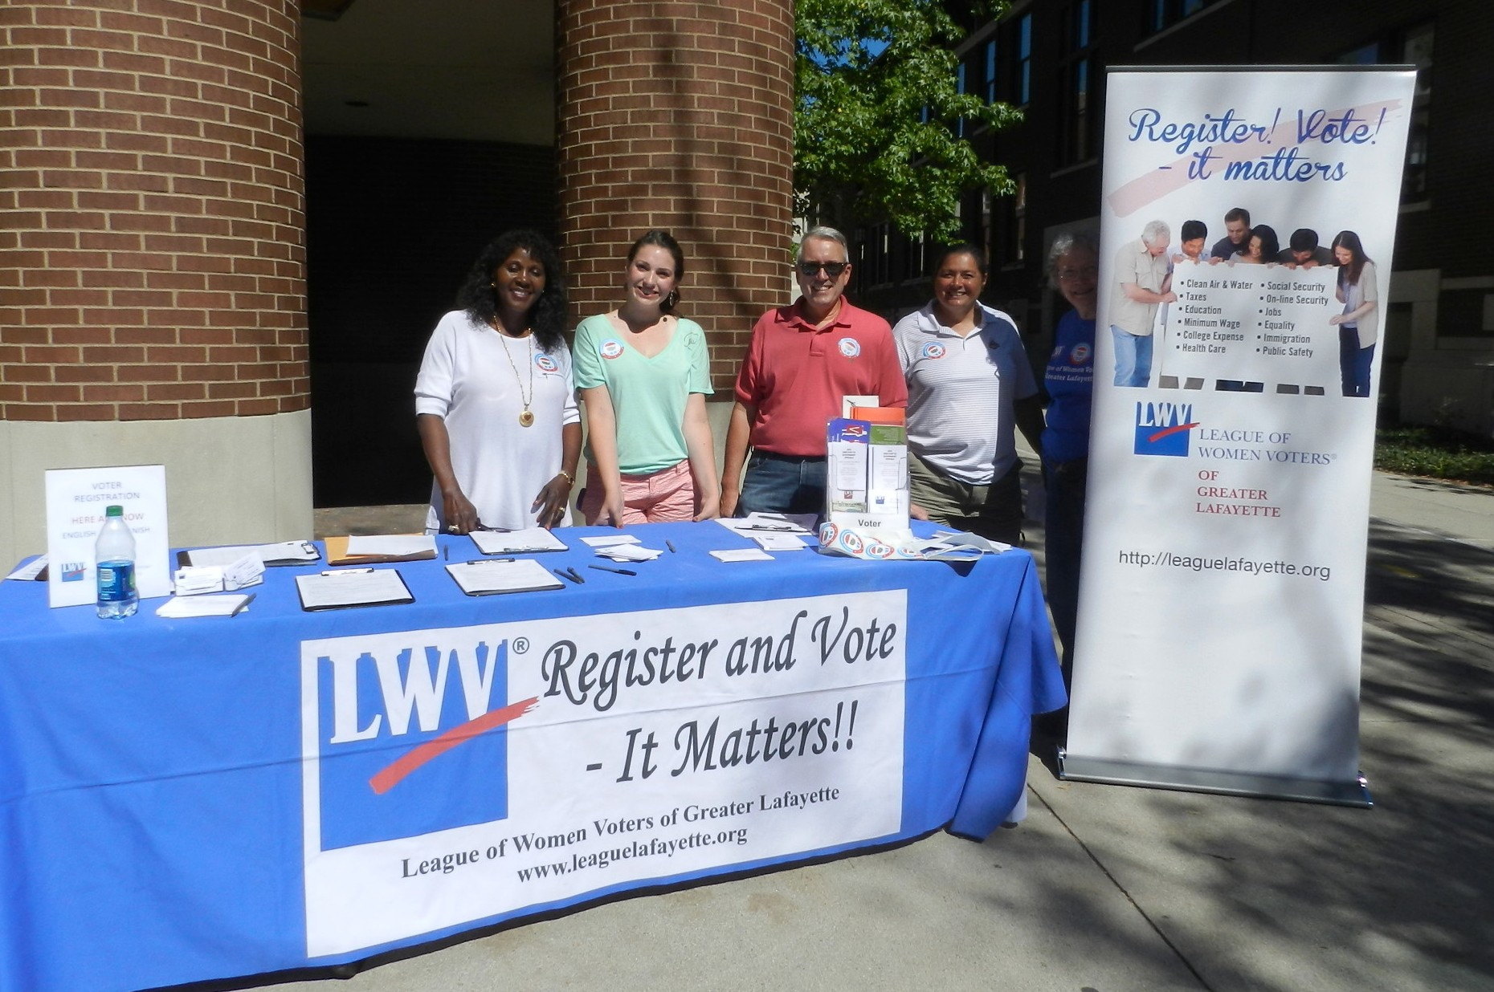
What is the League?
The League of Women Voters is a non-partisan organization of men and women that believes that an informed and involved citizenry is essential for a strong democracy.

Slide 3
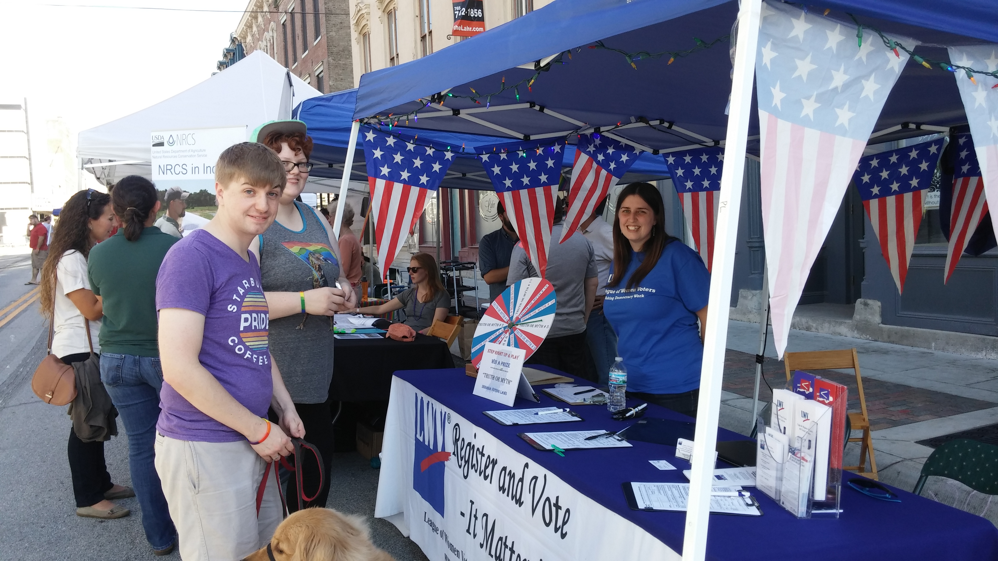
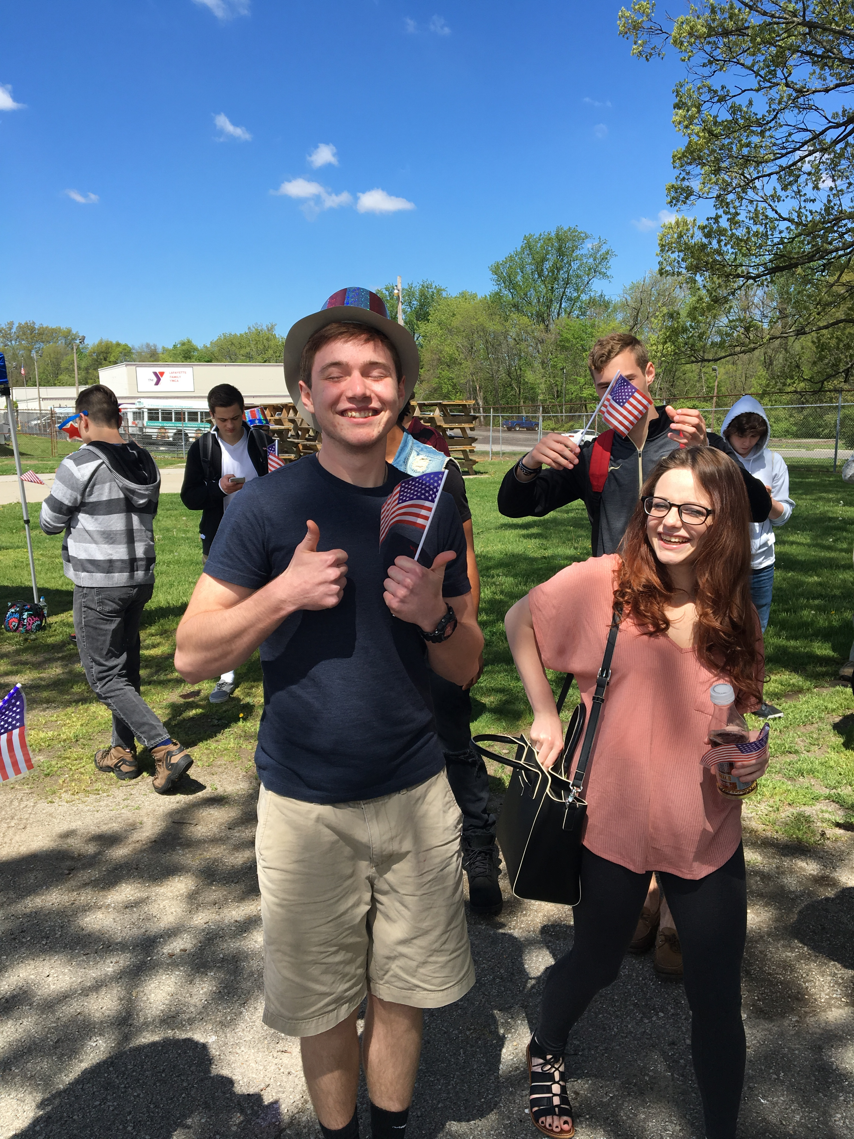
We register new voters, help voters obtain absentee ballots, hold candidate forums, educate on voting, develop voter guides, monitor the activities of our local election board, and act as poll observers.
Consider joining and working with our Voter Services Committee.

Slide 4
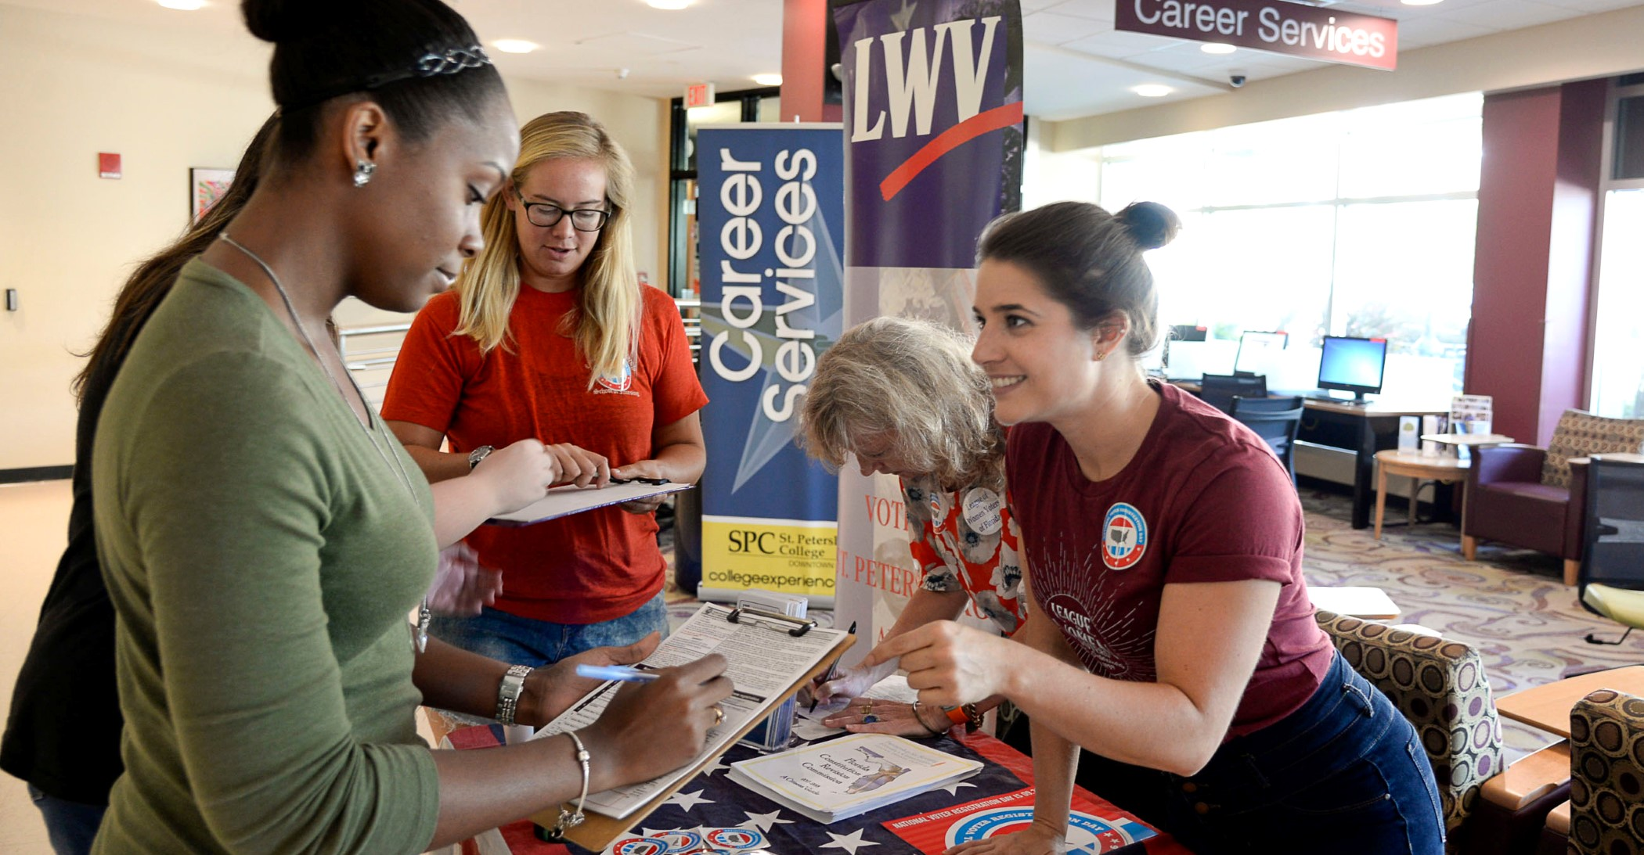
www.vote411.org
Nationwide candidate info
Absentee ballot info
Polling place locations
Ballot measure info
Online voter registration tool
Early voting options
ID requirements
Election dates

Slide 5
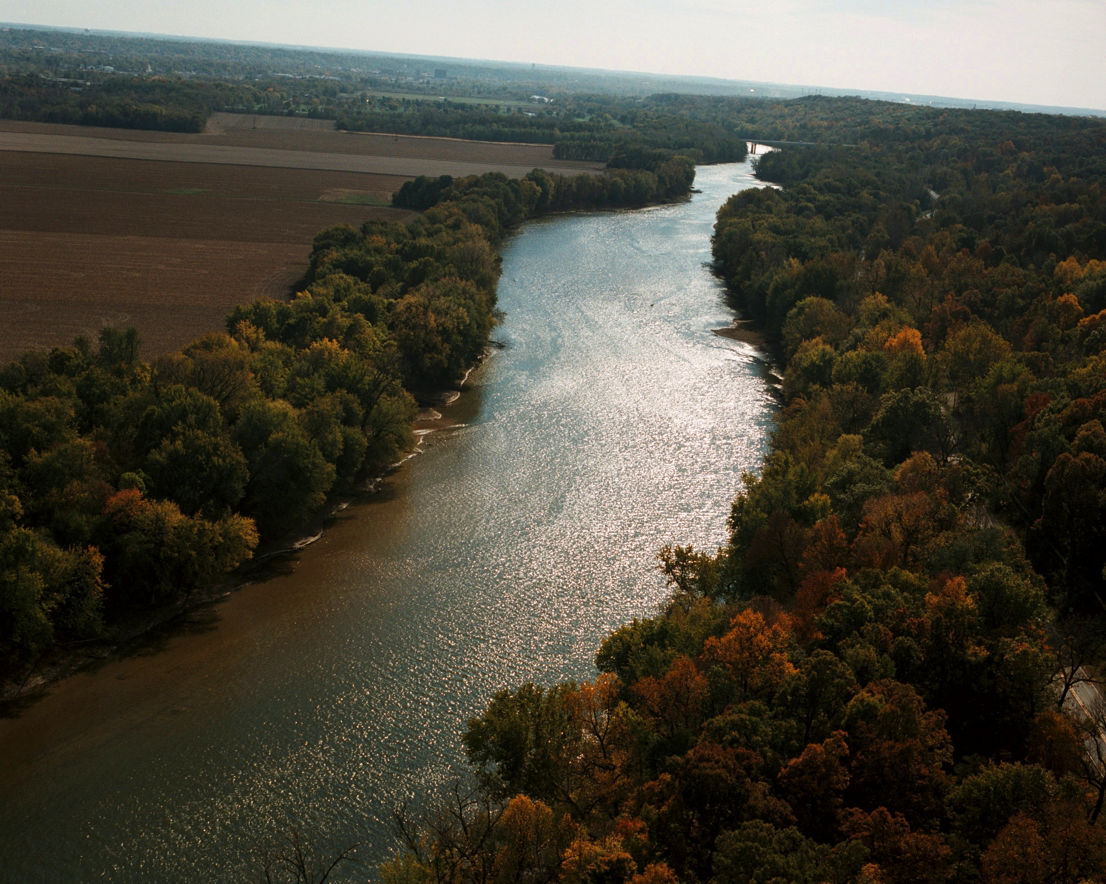
We educate and advocate on environmental issues such as • recycling, • water quality, • sustainable use of the Wabash River, • climate change, • renewable energy, and more!
Consider joining and working with our Environment & Sustainability Committee

Slide 6
Want to explore joining the League and contribute to your new community?
Purdue students are welcome.
(765) 268-0817
Contact us today for more information about the League:
P.O. Box 2085, West Lafayette, IN 47996
Phone: (765) 268-0817
Email: League@leaguelafayette.org

