Slide 1
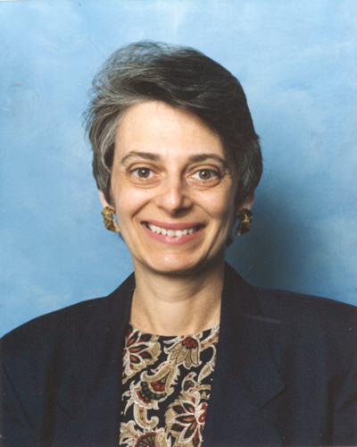
Faculty Advancement, Success and Tenure (FAST)
Barbara Clark
BarbClark@purdue.edu
September 13, 2011
Notes:
Formerly the Mentoring Institute
Contact me with questions or concerns

Slide 2
ADVANCE-Purdue Goals
NSF Grant started in October 2008
$3.92 M over 5 years
Goal 1 – Recruit STEM faculty women, especially women of color
Goal 2 – Ensure the success of all faculty especially women in STEM
Goal 3 – Engage all faculty in transforming the institution
Notes:
Welcome and thanks for attending
Introductions
Barb
Chris, Executive Director
Tricia, Secretary
LT Members, if present
Senior Faculty
ADVANCE has many initiatives
Check our website for many different activities
FAST is part of Goal #2
Mentoring and Professional Development has shown to be effective for retention
FAST format
Meet once/month
Same day and time
Different rooms and topics
All newly hired professors
Second year faculty who requested
One or more senior faculty per College/School
Confidentiality

Slide 3
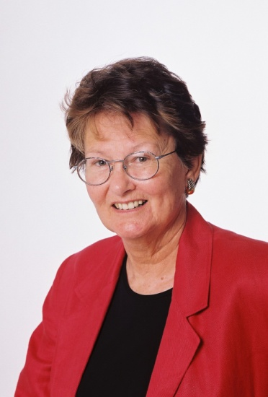
FAST Materials
Demystifying the Profession: Helping Junior Faculty Succeed by JoAnn Moody
ADVANCE Postcards from ADVANCE-Purdue
Summary of Guides on Mentoring compiled by Barb Clark
Notes:
Flyer
Agenda
Moody is on the ADVANCE External Advisory Board and comes to campus occasionally.
Different sections apply to different participants in the mentoring relationship
Other Moody publications are available
Post Cards
More information is available on ADVANCE website
Summary refers to the following three publications.

Slide 4
Materials Continued
Giving and Getting Career Advice: A guide for Junior and Senior Faculty by ADVANCE at University of Michigan
Mentoring Guide, A Guide for Mentors, Center for Health Leadership & Practice, Public Health Institute, Oakland, CA
Mentoring Guide, A Guide for Protégés, Center for Health Leadership & Practice, Public Health Institute, Oakland, CA
Notes:
One copy per group
Available on line and the link is in the Summary document at the end.

Slide 5
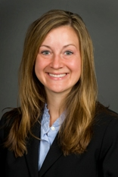
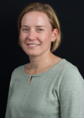
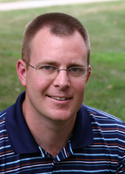
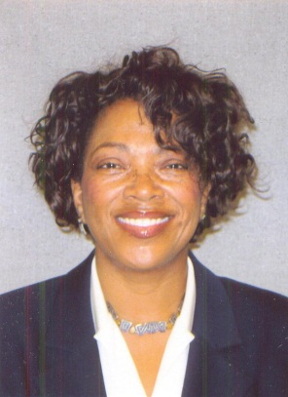
Panel of Assistant Professors
Cheryl Cooky, Health and Kinesiology, College of Health and Human Sciences
Nancy Emery, Botany and Plant Pathology, College of Agriculture and Biology, College of Science
Aaron Patton, Agronomy, College of Agriculture
Sandra Sydnor-Bousso, Hospitality & Tourism Management, College of Health and Human Sciences

Slide 6
Questions for the Panel
Introduce yourself.
What is your experience with mentoring at Purdue?
What do you know now that you wish you had known when you first started at Purdue?
Questions and Answers

Slide 7
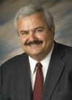
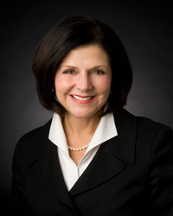
Upcoming Events
Promotion and Tenure
October 18th, STEW 314
Klod Kokini, Associate Dean for Academic Affairs, Professor of Mechanical Engineering, College of Engineering
Beverly Davenport Sypher, Vice-Provost for Faculty Affairs, Susan Bulkeley Butler Chair for Leadership Excellence, Professor of Communication
Notes:
You will get to pick the other topics

Slide 8
Wrap Up
FAST will meet monthly
Use Common Free Hour to meet with mentor
Future topics will be generated by you
ADVANCE materials are on website
Please complete the evaluations
Notes:
See flyer for FAST dates and rooms
Other activities might happen during this time in your College/School
Mentor might be assigned in your unit

