Slide 1
Faculty Advancement, Success and Tenure (FAST)
In Collaboration with
ADVANCE Purdue Center for Faculty Success
Office of the Provost

Slide 2
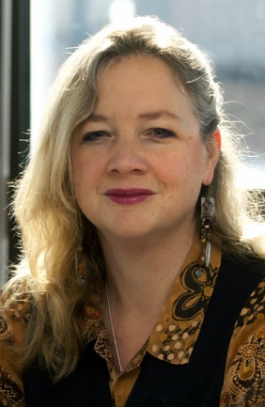
Agenda – October 15, 2013
9:00 – 9:10 Welcome and Introductions
9:10 – 9:50 Promotion and Tenure
George McCabe, Associate Dean for Academic Affairs, College of Science
S. Laurel Weldon, Interim Vice-Provost for Faculty Affairs
9:50 – 10:10 Facilitated Small Group Discussion
10:10 – 10:15 Wrap Up

Slide 3
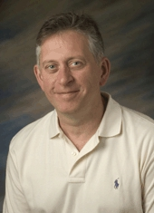
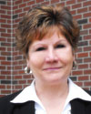
Agenda – November 12, 2013
9:00 – 9:10 Welcome and Introductions
9:10 – 9:55 Work/Life Integration
Clint Chapple, Head, Biochemistry, Agriculture
Pam Nesbitt, Director, Academic Units, VPHR
Tammy Synesael, Leave of Absence Administrator, VPHR
9:55– 10:10 Facilitated Small Group Discussion
10:10 – 10:15 Wrap Up

