Slide 1
Faculty Advancement, Success and Tenure (FAST)
In Collaboration with
ADVANCE Purdue Center for Faculty Success
Office of the Provost

Slide 2
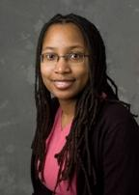
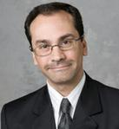
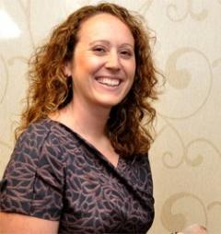
Agenda – April 22, 2014
9:00 – 9:10 Welcome and Introductions
9:10 – 10:10 Panel of Recently Tenured Associate Professors
Brandeis Marshall, Associate Professor, Computer and Information Technology, College of Technology
Oana Malis, Associate Professor, Physics and Astronomy, College of Science
Pablo Zavattieri, Associate Professor, Civil Engineering, College of Engineering
Jenny Daugherty, Associate Professor, Technology Leadership & Innovation, College of Technology

Slide 3
Questions?
Introduce yourself
What has been your experience with mentoring at Purdue?
What advice can you give to new faculty members?
Questions from the audience.

Slide 4
Thank You
This will be the last FAST for ADVANCE-Purdue but it will be taken over by the
Office of the Provost
We will contact you about staying on the list
for next year.

