Slide 1
Faculty Advancement, Success and Tenure (FAST)
In Collaboration with
ADVANCE Purdue Center for Faculty Success
Office of the Provost

Slide 2
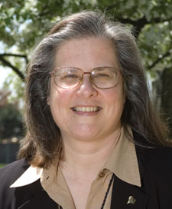
Agenda – February 25, 2014
9:00 – 9:10 Welcome and Introductions
9:10 – 9:50 Grant Writing
Sally Bond, Head, Assistant Director of Research Development Services, OVPR
Shelly MacDermid Wadsworth, Professor, Department of Human Development and Family Studies, Director, Center for Families and Military Family Research Institute, HHS
9:50 – 10:10 Facilitated Small Group Discussion
10:10 – 10:15 Wrap Up

Slide 3
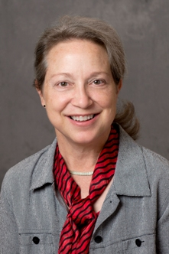
Agenda – March 25, 2014
9:00 – 9:10 Welcome and Introductions
9:10 – 9:55 Department Heads’ Expectations for Faculty
Bernie Engel, Head and Professor, Agricultural and Biological Engineering, Colleges of Agriculture and Engineering
Suzanne Nielsen, Former Head and Professor, Food Science, College of Agriculture
9:55– 10:10 Facilitated Small Group Discussion
10:10 – 10:15 Wrap Up

