Slide 1
Faculty Advancement, Success and Tenure (FAST)
In Collaboration with
ADVANCE Purdue Center for Faculty Success
Office of the Provost

Slide 2
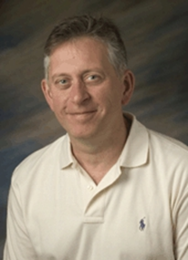
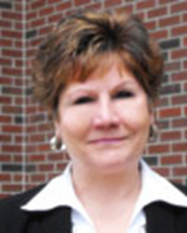
Agenda – November 12, 2013
9:00 – 9:10 Welcome and Introductions
9:10 – 9:50 Work/Life Integration
Clint Chapple, Head, Biochemistry, College of Agriculture
Pam Nesbitt, Director, Academic Units, VPHR
Tammy Synesael, Leave of Absence Administrator, VPHR
9:50 – 10:10 Facilitated Small Group Discussion
10:10 – 10:15 Wrap Up

Slide 3
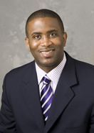
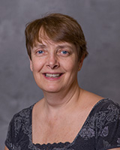
Agenda – January 28, 2014
9:00 – 9:10 Welcome and Introductions
9:10 – 9:55 Managing & Mentoring Graduate Students
Levon Esters, Associate Professor, Youth Development and Agricultural Education, College of Agriculture
Linda Mason, Associate Dean, Graduate School and Professor, Entomology
9:55– 10:10 Facilitated Small Group Discussion
10:10 – 10:15 Wrap Up

