Slide 1
Faculty Advancement, Success and Tenure (FAST)
ADVANCE Purdue Center for Faculty Success
In Collaboration with
Office of the Provost

Slide 2
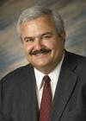
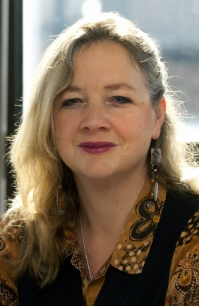
Agenda – October 21, 2014
9:00 – 9:10 Welcome and Introductions
9:10 – 9:50 Promotion and Tenure
Klod Kokini, Associate Dean for Academic Affairs, College of Engineering
S. Laurel Weldon, Interim Vice-Provost for Faculty Affairs
9:50 – 10:10 Facilitated Small Group Discussion
10:10 – 10:15 Wrap Up

Slide 3
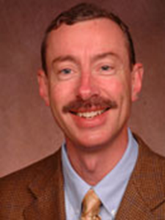
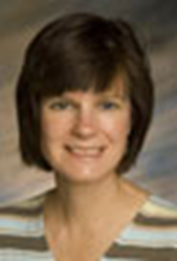
Agenda – November 18, 2014
9:00 – 9:10 Welcome and Introductions
9:10 – 9:55 Grant Writing
Jon Harbor, Professor, Earth, Atmospheric, and Planetary Sciences, College of Science, American Council on Education Fellow, 2014-15
Sally Bond, Assistant Director, Research Development Services, Proposal Coordination, Vice President for Research and Partnerships
9:55– 10:10 Facilitated Small Group Discussion
10:10 – 10:15 Wrap Up

