Slide 1
Promotion and Tenure
Purdue
Faculty
October 21, 2014
S. Laurel Weldon
Vice Provost for Faculty Affairs (Interim)

Slide 2

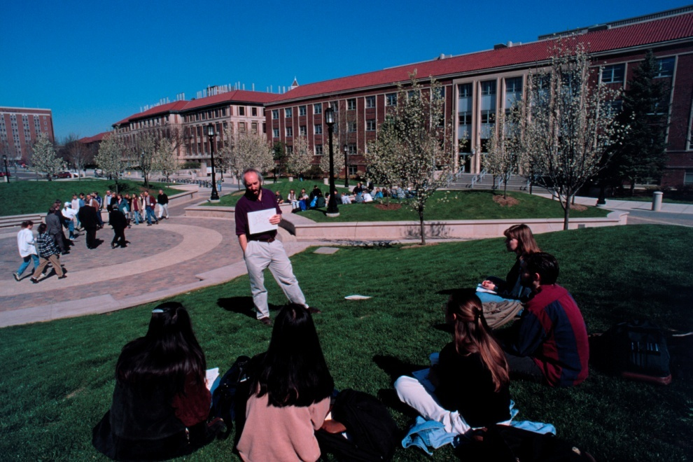
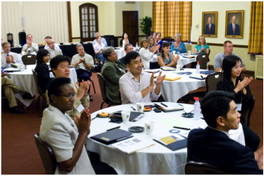
Purdue faculty by rank
 | Tenure Track Faculty | Clinical Faculty
Total | 1,807 | 121
Assistant | 352 | 71
Associate | 556 | 36
Full | 755 | 14
Deans and DHs | 144
Notes:
We have about 2000 faculty, with about 100 of these being clinical faculty

Slide 3
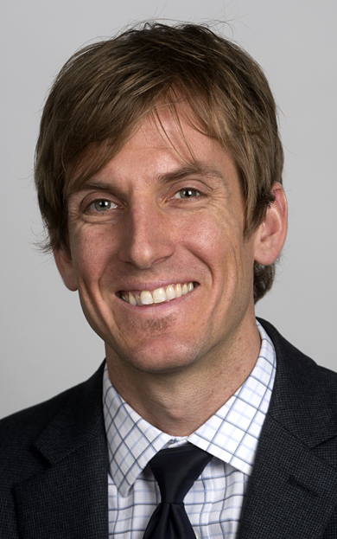
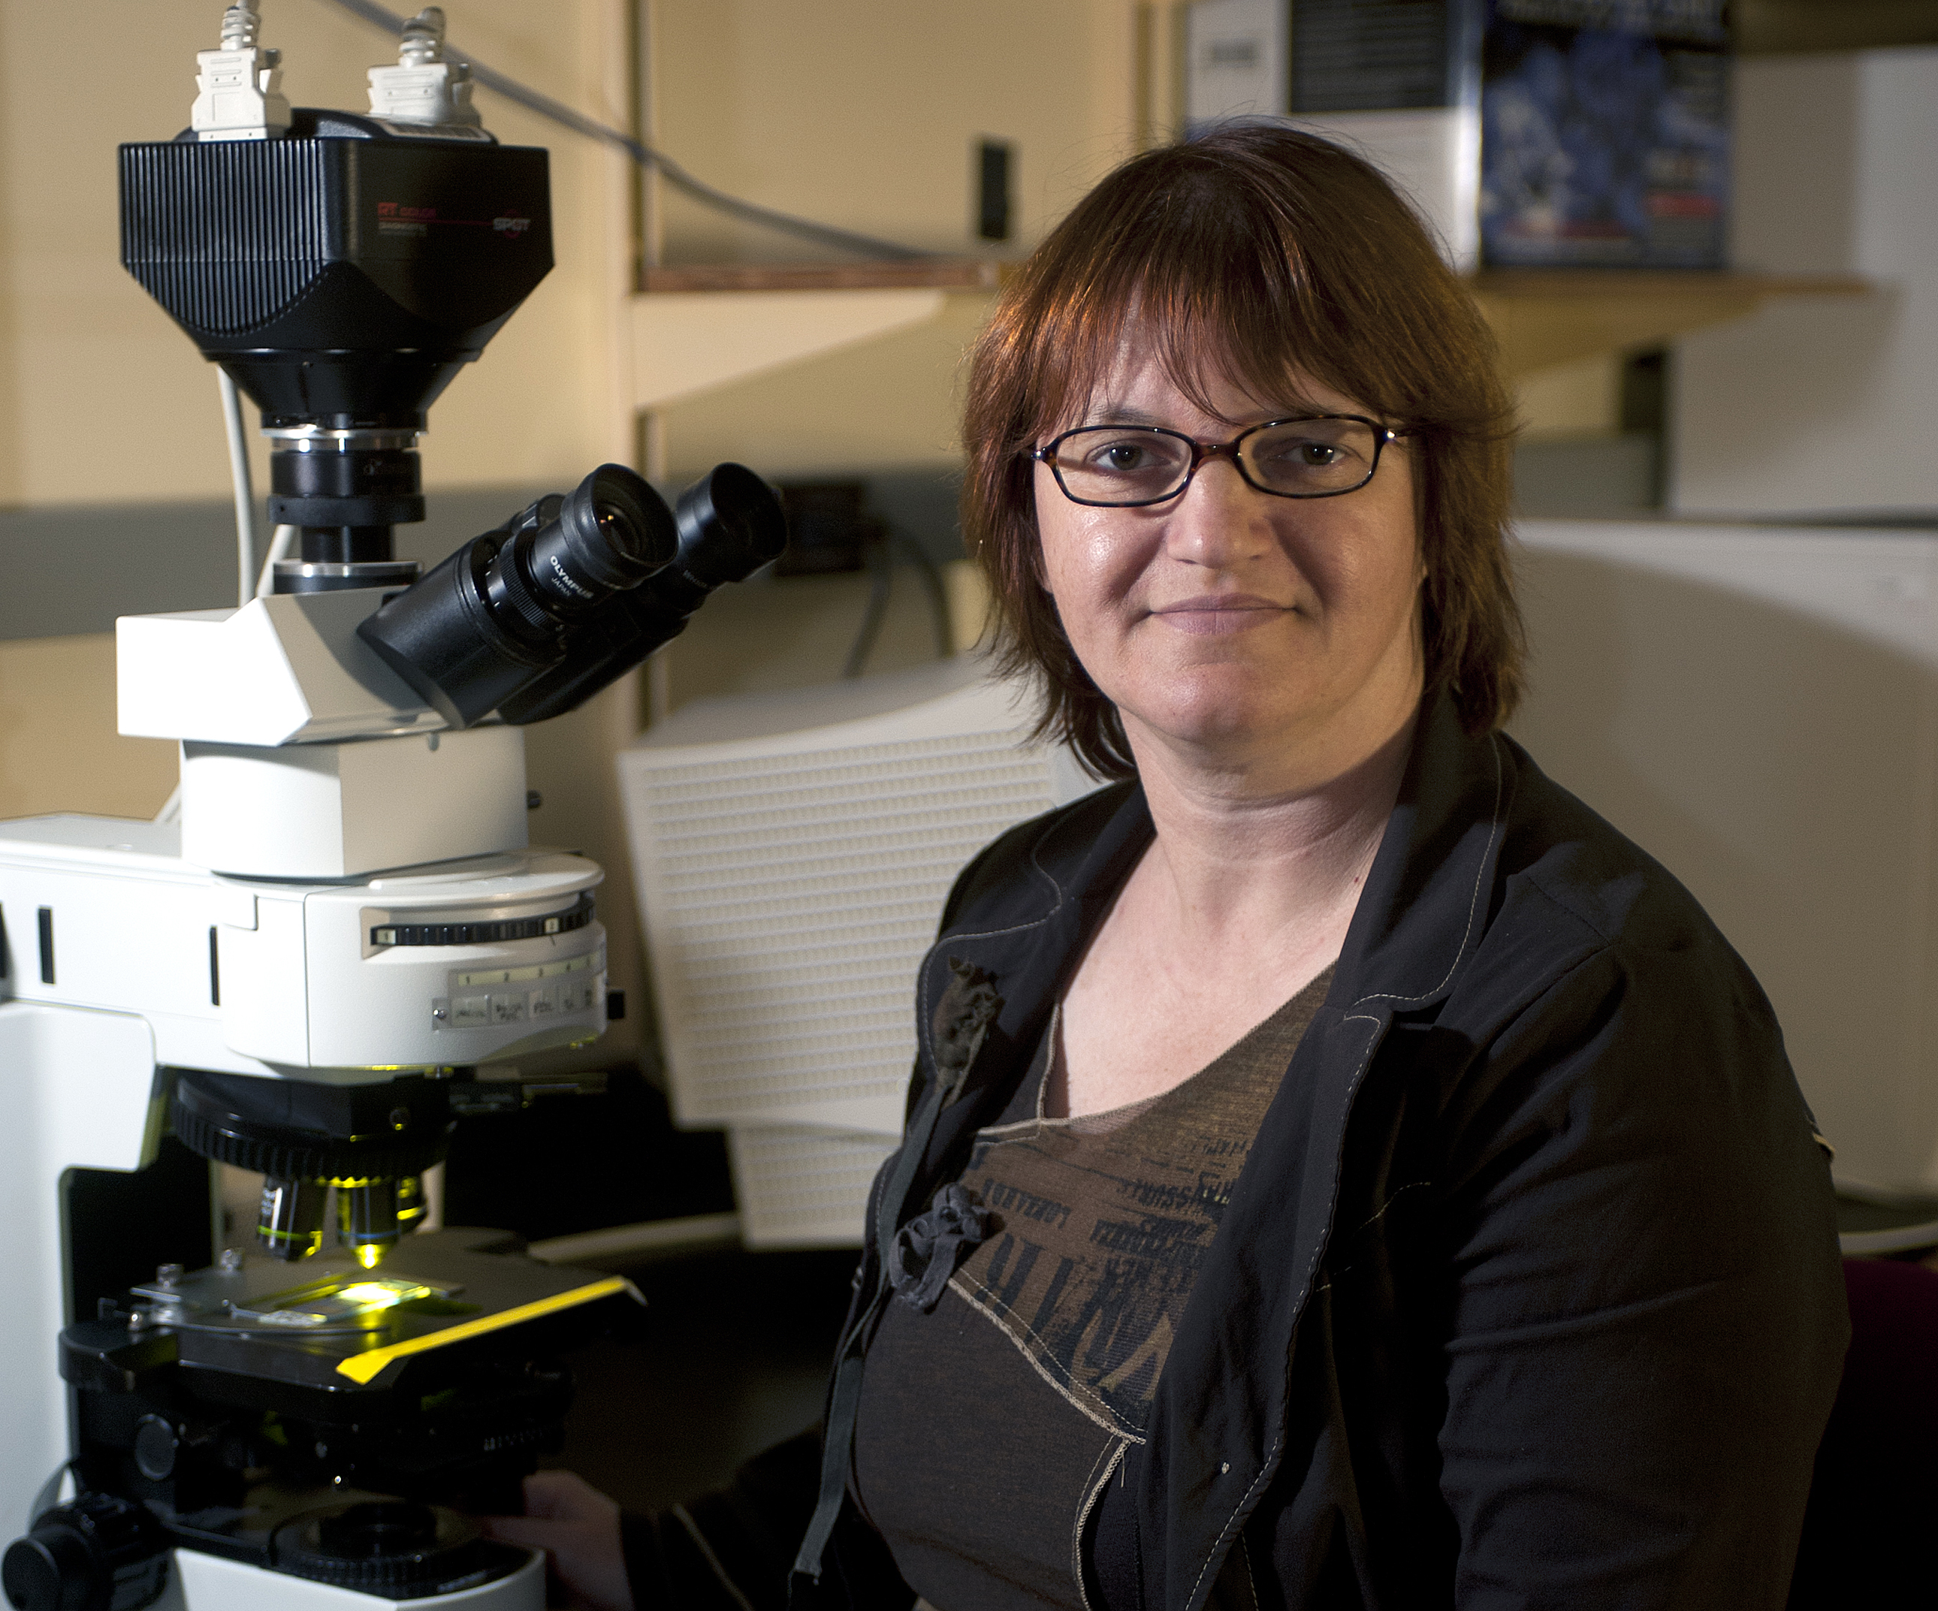

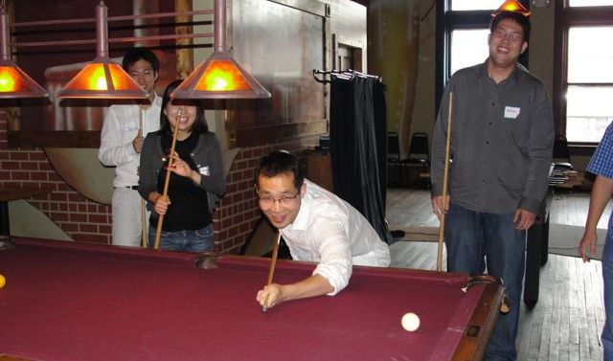
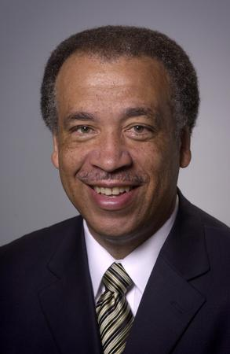
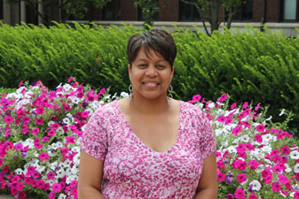
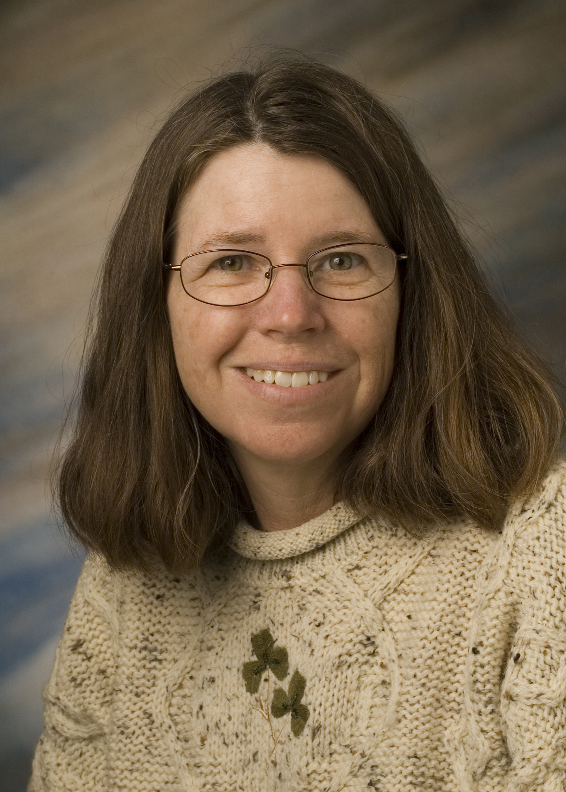
Purdue Tenure-Track
Faculty by Rank 2012-13
Notes:
Big 10 Faculty
among the best in the world.
nation’s most “formidable intellectual capital”
With Big 10 peers produce 1/3 of nation’s Ph.D.s and garner more research $$ than Ivies or West Coast taken together
Purdue Faculty:
Over 2000 faculty members generate more than 70% of the
student credit hours and over half a billion dollars in research
expenditures
they come from all over the world; more than 2/3 are American born
most educated in the U.S. usually at the most prestigious universities.
nearly three fourths are male.
27% women and 7% URM.

Slide 4
Tenured, Tenure Track Faculty by Gender, URM by Rank Fall 2013

Slide 5
Promotion and Tenure
One of the strongest predictors of pre-tenure faculty satisfaction and success is understanding the promotion and tenure process.
At Purdue, the process is described in Executive Memorandum B-48, Section II and in Provost’s Letter
http://www.purdue.edu/provost/faculty/promotion.html
An updated Promotion and Tenure Policy is under development.

Slide 6
Tenure at Purdue
“…to be considered for promotion, a faculty member should have demonstrated excellence and scholarly productivity in at least one of these areas. Ordinarily, strength should be manifest in more than one of these areas.” Scholarship of
Learning (teaching)
Engagement (dept., profession, university, community, state, world)
Discovery (research)

Slide 7
Tenure at Purdue
To receive tenure, “a successful candidate should have a significant record of accomplishment as a faculty member and show promise of continued professional growth and recognition.”
Candidates are considered on “standards appropriate for the nominee’s discipline and the University’s criteria for promotion.”

Slide 8
CLINICAL FACULTY
Clinical Faculty have a distinct path to promotion (but not tenure). They are considered by a different panel (Panel X or now “B”) rather than the usual Panel A. This review panel incorporates more clinical faculty.

Slide 9
Tenure at Purdue: 2013-2014
• 107 faculty were reviewed for promotion by the University Promotions Committee and 107 were approved for promotion (100%)
• 51/51 (100%) were successfully promoted to full professor • • 56/56 (100%) were successfully promoted to associate professor
• In addition, 5 clinical faculty were promoted (3 to associate clinical and 2 to full clinical professors) - 100%
• 11 Nominations did not go to UPC (Flashpoint equally divided between area and primary committee)
Notes:
38/38 (100%) were successfully promoted to full professor
62/64 (97%) were successfully promoted to associate professor
(86% and 75% rates respectively (one person unsuccessful in each case))

Slide 10
2013 Faculty Promotion and Tenure by Major Area of Focus (# of people)
29
29
3
4
48
1
5
1
1
0
0
3
3
1
1
Notes:
Most people go up on one basis, and most people go up on research, but numbers promoted on engagement and learning are increasing
Going up on multiple bases, Discovery and something else

Slide 11
University Promotion and Tenure Rates*
* 2011-12 was the first year to reflect all faculty considered for promotion and tenure.
Notes:
2012-2103 91% ; 2013-214 91% (at all levels) Don’t know gender breakdowns of these numbers
90% 2013-2014

Slide 12
Time to Tenure
Assistant Professors typically have a probationary
period up to 6 years to earn promotion and tenure.
The 6th year is called the “penultimate year.” It is the
last year in which one is eligible for tenure.
Entering associate professors have 3 years to work
toward tenure. The 3rd year is penultimate year.

Slide 13
Tenure Clock Extensions: When conditions and personal circumstances substantially interfere with progress toward achieving tenure
A one-year automatic approval will be granted for birth of a child and adoption, provided a Request for Tenure-Clock Extension form is submitted within one year of the occurrence and prior to the penultimate year. This provision applies to either or both parents.
Justifiable conditions for granting exclusions include, but are not necessarily restricted to, severe illness, disability, or care-giving of a family member.

Slide 14
Some Things to Ask About
Guidelines for P and T: What are the criteria? Written guidelines?
  Promotion evaluation may be different from the annual merit salary review.
  When will you be evaluated and by whom? (Frequency and people)
  Is there a formal third year evaluation? external input?
Specific criteria for quality and impact of research and teaching:
  e.g. Journal listing (sometimes specified for promotion process)
  Guidelines for evaluation of teaching
Format for promotion and/or tenure document – get past examples
Develop a plan for moving toward promotion and/or tenure
    How will you publish enough articles?
    How will you document teaching success?
Ask for a Mentor and demand regular, written feedback early

Slide 15
Keys to faculty success and well-being
Starting Early, Planning and Gathering Information
  Getting oriented to the institution
  Learning what is expected early on
  Learning the tenure and promotion process
  Begin and plan with the end in mind
Start with research and teaching- don’t lose focus!
  Seek excellence (as defined by your discipline)
  Engagement and service increase over one’s career
  Creating work-life balance
    Find a sustainable rhythm
    Be aware of supports
    Ask for what you need: stop the clock, parental leave
Notes:
You have 5 years (without any tenure clock extensions) to showcase your excellence
Quality and impact (not necessarily quantity) are key

Slide 16
Form 36
The President’s Office Nomination for Promotion Form (Form 36): Available On-Line
http://www.purdue.edu/provost/faculty/promotion.html
More useful: Instructions for filling out the form 36
http://www.purdue.edu/provost/documents/Form36-INSTR%202014-15AY.pdf
More useful still: The template your college or department uses. Get an electronic example of a successful form 36 and start filling it in

Slide 17
Keys to faculty success and well-being cntd)(
Seek help and support actively and widely
  Developing professional networks/mentors inside AND outside the department
  Letter writers are outside the department
  Soliciting feedback from senior faculty and head
    They will be on primary committee
    Pay attention to annual reviews
    Get concrete and specific advice about journals, etc
  Seek advice from multiple mentors/sources
  Get multiple examples of success- e.g. Form 36
  Know your rights and obligations
Notes:
You have 5 years (without any tenure clock extensions) to showcase your excellence
Quality and impact (not necessarily quantity) are key

