Slide 1
What is FMLA?
Federal regulation that grants eligible employees the right to:
12 workweeks of job-protected leave over a 12-month period for covered medical and family reasons.
26 workweeks of job-protected leave in a single 12-month period to care for a Covered Service member, limited to a combined total of 26 workweeks for all types of FMLA leave.

Slide 2
Who is eligible for FMLA?
Employees who:
Have been employed at the University for at least 12 months (consecutively or non-consecutively within the prior seven years)
Have worked at least 1,250 hours during the 12-month period preceding the date that FMLA leave would begin
Calendar-year (rolling) allotment of FMLA has not been exhausted

Slide 3
What situations qualify as FMLA?
Sick Leaves:
Serious health condition of employee as certified by his or her Health Care Provider.
Birth of child (Birth Mother only)
Family Leaves:
Placement of child for adoption/foster care (including related court appearances, consultations with attorneys, and counseling sessions).
Care for child during first 12-months following birth/adoption/foster care
Birth of child
To care for a Spouse, Same Sex Domestic Partner, Son, Daughter, or Parent with a Serious Health Condition, as certified by the Family Member’s Health Care Provider.

Slide 4
What situations qualify as FMLA? (cont’d.)
Military Leaves:
Any Qualifying Exigency arising out of the fact that the employee’s spouse, same sex domestic partner, son, daughter, or parent is a Covered Military member on Covered Active Duty (or has been notified of an impending call or order to Covered Active Duty) in the Armed Forces.
Care for a Covered Service member with a serious injury or illness if the employee is the spouse, same sex domestic partner, son, daughter, parent or next of kin of the Covered Service member (26 weeks)

Slide 5
Maximum Amount of Leave Available for FMLA
Up to 12 workweeks per 12-month period (rolling)
Covered medical and family reasons
Birth/adoption/placement/bonding
Qualifying exigency of employee or covered family member
Up to 26 workweeks per rolling 12 month period for serious illness or injury of a covered servicemember for all types of FMLA leave.
Leave may be taken continuously or intermittently
Note: When both spouses are employed at Purdue, employees must share 12 weeks of FMLA eligibility for birth/adoption/ placement/bonding.

Slide 6
What is Paid Parental Leave:
Purdue policy that allows for:
Parents to have additional flexibility and time to bond with their new child
Ability to adjust to a new family situation
Opportunity to balance professional obligations
It is a benefit of employment and its use will not be considered as a negative factor in employment actions, such as hiring, promotions, and disciplinary actions) or under attendance policies

Slide 7
Who is eligible for Paid Parental Leave?:
All benefits-eligible employees employed 12 months or more in the following positions:
Faculty or Staff
Graduate Staff
Post-Doc
Must be employed a minimum of 12 months,
half-time or more at the time of birth or adoption
Runs concurrently with FMLA

Slide 8
How much time is allowed for Paid Parental Leave?:
Time is based on CUL. 100% CUL allowance is:
Birth mother – 240 hours (6 weeks)
Other eligible parents – 120 hours (3 weeks)
Both parents employed at Purdue and 1 parent is birth
mother:
May combine available PPL time
Maximum combined time = 360 hours (9 weeks)
Maximum individual time = 240 hours (6 weeks)
Both parents employed at Purdue and neither parent is
the birth mother:
May combine available PPL time
Maximum combined time = 240 hours (6 weeks)
Note: Advance notice/planning is required

Slide 9
When must time be used?
Must be used within first 12 months following birth/adoption/placement
If foreseeable, a 30-day notice to supervisor is expected.

Slide 10
How may time be used?
May take a Continuous Leave: Leave immediately following birth or adoption
May take an Intermittent Leave: Supervisory approval required
May take on a Reduced Schedule: Supervisory approval required
Runs concurrently with FMLA
May use any combination of leave (sick leave, vacation, and personal business days)
Note: Employee must consult with supervisor on intermittent/reduced schedule leave and make reasonable effort not to unduly disrupt University operations.

Slide 11
Example:
Faculty staff member is birth mom who has worked at the University for 3 years is expecting and wants to take as much paid leave as possible without using her vacation or personal business days.
She is eligible for FMLA & PPL. FMLA will run concurrently with her:
Sick leave
PPL
Dr. takes her off work earlier than expected (3/28) and the baby is born 4/4.

Slide 12
Example (cont’d.):
FMLA
3/28 – 6/19 (12 weeks)
Sick Leave
3/28 – 5/8 (8 hours) (6 weeks – typical delivery)
PPL
5/9 – 6/19 (8 hours)
Note: RTW 6/20 – Return to work slip required

Slide 13
Example (cont’d.):
3/28
5/8
6/19
6/20
FMLA 3/28 to 6/19 (12 weeks)
Sick Leave 3/28 to 5/8 (FMSE 8 hours per day)
Paid Parental Leave 5/9 to 6/19
(FMPL 8 hours per day)
Return to work 6/20

Slide 14
Contacts
FMLA/PPL Questions:
Lisa Hornbeck 49-41310
Pam Hardesty 49-66269
General Leaves Questions:
Tammy Synesael 49-41691

Slide 15
http://www.purdue.edu/provost/faculty/promotion.html

Slide 16
http://www.purdue.edu/provost/faculty/promotion.html

Slide 17
http://www.purdue.edu/provost/faculty/facultypolicies.html

Slide 18
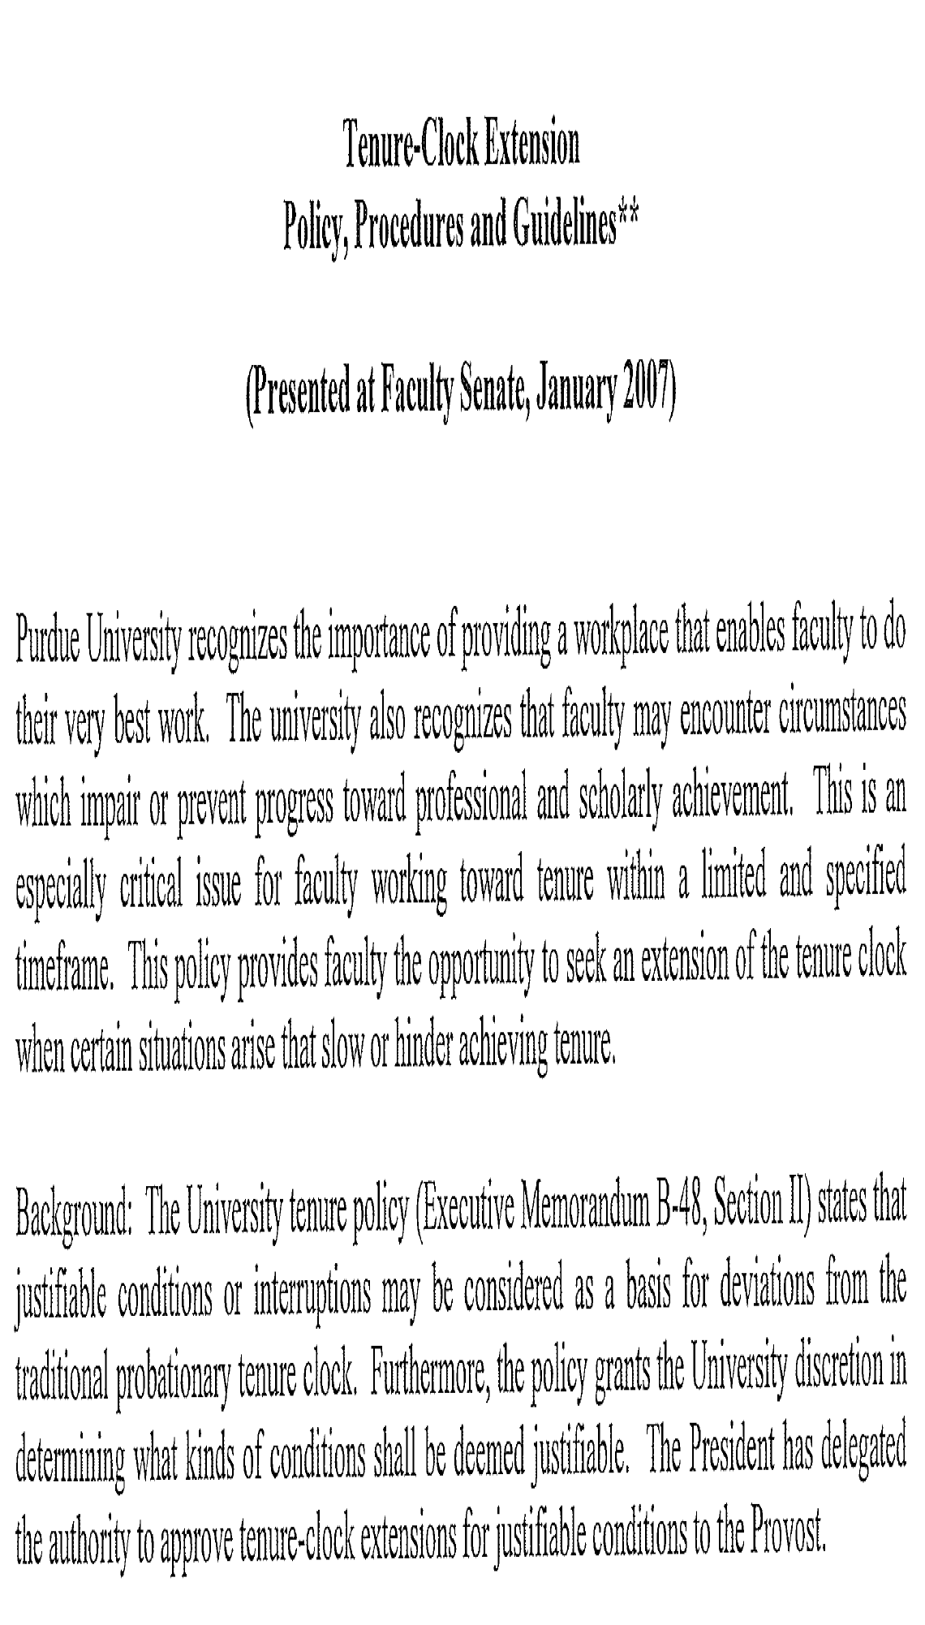

Slide 20
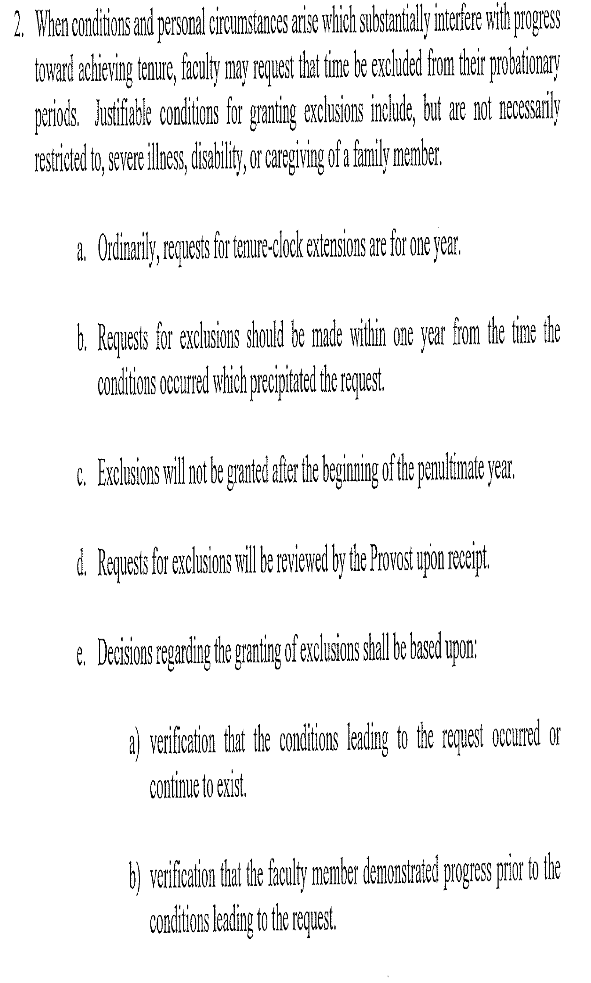

Slide 22
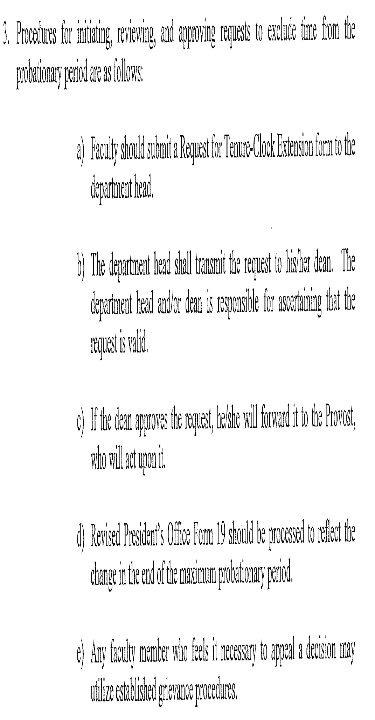

Slide 23
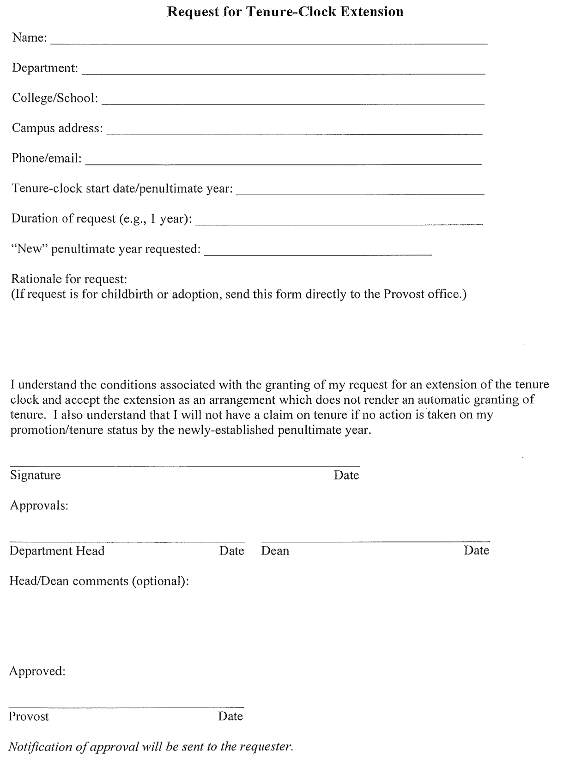

Slide 24
Men / women?
Opt in / opt out?

