Slide 1
Improved Academic Program Reporting
Long time coming, but New and Improved!
2017

Slide 2
It’s CIP and sooooo much more!
“Referred to as CIP, but as we discuss this data it is inclusive of all of the grouping options: Department, Program, College, etc.”
CIP (Classification of Instructional Programs)
National Center for Education Statistics (NCES) taxonomic coding scheme for secondary and postsecondary instructional programs
Six-digit code in the form of xx.xxxx that identifies instructional program specialties
Accepted federal government statistical standard on instructional program classifications, used in a variety of education information surveys and databases
Required for state (Indiana Commission for Higher Education) and federal reporting (IPEDS) as well as numerous standard surveys
Required Homeland Security SEVIS reporting as well as OPT (Optional Practical Training) extension for STEM students
Internal CIP - Currently used only by College of Education to meet regulatory report requirements that have different definitions of teacher education
Data other than CIP used at Purdue for grouping
Academic School Grouping
Teacher IND
Department Mappings
SAP Org Unit

Slide 3
The Challenges
No standard method to map Banner Programs to SAP Org Units
No standard method to identify Academic School Groupings
No standard method for identifying Teacher Education programs
Previous tracking of grouping codes was not validated with actual student data resulting in disconnects between the data
No freeze groupings data existed to use with freeze student data

Slide 4
Let the Cleanup Begin
Scope set to WL and Statewide Tech only
Academic School Groupings were assigned
Interdisciplinary Graduate Programs were reviewed
Attempts to resolve not possible at this time, but discussions continue for a solution
Department codes/titles matched up with SAP data
Backfilled missing CIP/Grouping data to match degrees, enrollment, and applications
Assigned Teacher ED Indicator for Undergrad records

Slide 5
Good Business Practices = Good Data
Updates to CIP/Grouping Data Entry Form and renewed commitments to data maintenance
Updates to Registrar Data Entry Processes
Improved processes for Student Program Assignment with Admissions, Advisors, Grad School
Tighter controls for crosswalks between Banner/SAP
Audits in place to assure correct daily data with special attention before key freeze dates CENSUS and TERM END

Slide 6
“Freeze” Means Frozen not Slushy
How do we correct the errors of the past without modifying existing frozen data?
Created frozen set of CIP/Grouping data to match up with existing frozen student data preventing student records dropping out
Made best judgement calls on information that didn’t exist at the time back to 2008
Department Names
Missing programs/majors
Where frozen student data had NULL fields, updated those records inserting the word “NULL”.
Resolved the join condition constraints on FRZ_ACADEMIC_STUDY and FRZ_ADMISSION_APPLICATION, FRZ_ENROLLMENT_PU, and FRZ_ACADEMIC_OUTCOME

Slide 7
Benefits: Now and Beyond
Multiple attempts over the years to revise processes and fill data gaps; We made it!
Collaboration Partners: OIRAE, EMAR, BICC, Education, Grad School, Registrar
EMAR/OIR converting “Standard” reports/dashboards for Enrollment, Applications, and Degrees with new CIP/Grouping data
Eliminates decodes for Academic School Groupings in reports
Banner Majors mapped to SAP Org Units
Supports Instructional Activity and Other Integrated Data Marts
Big project; transparent to end users
Allows for Cascading Prompts – College/Department/Major

Slide 8
Timeline and Fun Facts
Number of times this project tried before = 3
Project started 11/15/2015
Project requests resolved by this one = 5
Staff working in collaboration = 24
Projects delayed waiting on this project = 12
Project ended: 1/23/2017
Post Project Tasks: Standard Report conversion, Object retirement, User Report Conversion, Communication, Metadata

Slide 9
Impact to you?
No more decodes to keep current
Data driven tracking within single reports
Standard reports to be rewritten using this dataset
Everyone gets same results – operational credibility soars!
Dataset supports new DataMarts going forward
(example: Instructional Activity)
DataDigest using this data
Available to all report authors
Higher quality data

Slide 10
The Players
Thanks to all who participated!
Kathy Baker Sarah Bauer Jeff Bridgham Shawn Cromett Tricia Crowder Meng Deng Brent Drake Richard Frisbie | Josie Galloway Kevin Gillenwater Julie Huser Paula Kayser Steve Lipps Richard Lucas Chris Marheine Chris Maxwell | Bob Mitchell Chris Pass Monal Patel Marge Roginski Aaron Waltz Kimberly Watley Zach Yater Gary Yates

Slide 11
Questions?
Contact: bicc@purdue.edu

Slide 12
Appendix: Field Notes
VALUE_TYPE – indicates if it is a major or minor row
VALUE – Code for major/minor
VALUE_DESC – Description for major/minor
TEACHER_IND – Valid for UGRAD only
CIP - ICHE approved CIPs identifying a major and academic program. Can be used to identify majors within college by CIP code
CIP_GROUP - First two digits of the CIP code. Represents the overall discipline (Education, Engineering, Liberal Arts, ….). Two digit codes can be found at https://nces.ed.gov/ipeds/cipcode/browse.aspx?y=55
INTERNAL_CIP - Currently used only by College of Education to meet regulatory report requirements that have different definitions of teacher education
ACADEMIC_SCHOOL_GROUPING- Used to identify majors to academic college at both the undergraduate and graduate student levels. The advantage of using this field, is that graduate and professional students can be associated to their degree granting college, rather than to the Banner college of Graduate School.
PROGRAM_LEVEL in Academic CIP PU = STUDENT_LEVEL in other tables
DEPARTMENT_SHORT_TITLE - Associates majors to departments!
DEPARTMENT – Legacy 4 digit department code
SAP_ORG_UNIT - Maps four digit banner department code to the SAP organization unit.

Slide 13
Appendix: Table Joins
FRZ Admissions PWL package
Frz_Admissions_Application table | Frz_Academic_CIP_PU table
ACADEMIC_PERIOD | ACADEMIC_PERIOD
CAMPUS | CAMPUS
MAJOR | VALUE
COLLEGE | COLLEGE
PROGRAM | PROGRAM
DEGREE | DEGREE
STUDENT_LEVEL | PROGRAM_LEVEL
FREEZE_EVENT | FREEZE_EVENT
FRZ Student PWL package
Frz_Enrollment_PU table | Frz_Academic_CIP_PU table
ACADEMIC_PERIOD | ACADEMIC_PERIOD
CAMPUS | CAMPUS
MAJOR | VALUE
COLLEGE | COLLEGE
PROGRAM | PROGRAM
DEGREE | DEGREE
STUDENT_LEVEL | PROGRAM_LEVEL
FREEZE_EVENT | FREEZE_EVENT

Slide 14
Appendix: Cautions/Comments
Counting degrees by CIP, academic school grouping or department can be tricky. Report authors will need to create queries separately on Academic Outcome and Academic CIP PU and then join them within Cognos. Please be aware of this extra step for accurate reporting. Use the same 7 fields in the join
Other tables joining to Academic CIP PU need to be carefully analyzed for both join and/or cardinality to assure desired results returned
Do NOT use the Academic CIP PU table for academic periods prior to Spring 2017 (201720). This massive effort to clean the academic school grouping, departments and SAP Org units were only undertaken for active majors and programs. Therefore, the data for Spring 2017 and future in Academic CIP PU are accurate.
Frozen data had the word “NULL” added to columns that part of join conditions to complete the join accurately
Academic CIP PU contains all campus data current for the Registrar
FRZ_ACADEMIC_CIP_PU contains data only where campus in ('PWL', 'PHG') or campus like 'T%')

Slide 15
Demo
Standard report that has been reworked
Public Folders - PROD ‎> Student - PWL ‎> Standard Content ‎> Admissions > Admissions Summary Report - Undergraduate
How to self joins for special circumstances
Joining to Academic Study…….
Joining to Academic Outcome…….
Using the most recent department name in cases where they have changed
Audience suggestions for special circumstances

Slide 16
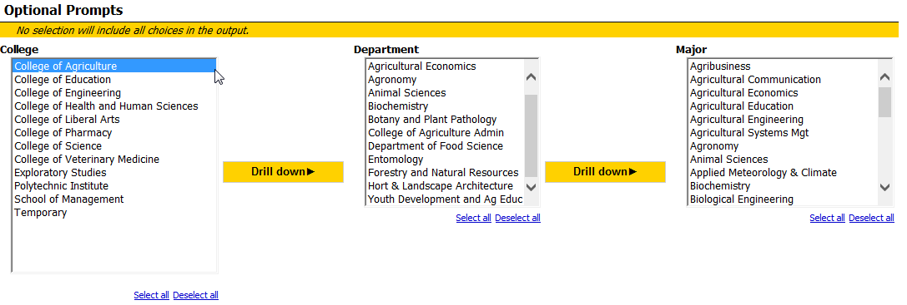
Standard Report Prompts

Slide 17
Follow-up Assistance
Questions can be submitted to bicc@purdue.edu

