Slide 1
Faculty ProAction for Equity
Fatma Mili
Willie Burgess
Guity Ravai
Notes:
Good afternoon and welcome to the session of Faculty ProAction for Equity. We are Fatma Mili, Willie Burgess, and Guity Ravai from Purdue University. In the spirit of proaction, we will start with a quick warm up exercise presented by Guity Ravai.

Slide 2
Warm-up exercise
You were charged to design a new initiative
You can recruit two people from the pool on the table.
Make your team
Discuss your selection
Share
Notes:
Read from the slides and tell them you will give them one 1mn to make their selection and write it down.
After 1mn ask them to share their selection with members of their table.
After another mn ask if anyone wants to share any insight.

Slide 3
Wicked Problem of Diversity
Equity
Diversity
Notes:
Thank you Guity. This is a reminder for all of us that as humans we are wired with some preferences and biases that historically were instrumental to our survival. They serve some good goals but also have many negative implications.
In the field of higher education in general and Engineering education in particular, diversity and equity proved to be particularly stubborn and elusive.
I am sure it comes as no surprise to anyone in this room that we have been shooting for years, for decades, but we have been missing.
One of the panelists this morning used the expression asymptoting. We have made some progress but overall it is too little too slow.

Slide 4
We tried (almost) everything
Frame 1
Equip the women/URM
Frame 2
Create equal opportunity
Frame 3
Value Difference
Frame 4
Re-vision the engineering culture
Notes:
And this is for no lack of trying.
Almost every institution has a panoply of initiatives: equipping women and minorities. Yes they come with a different portfolio of skills and experiences. We tried to fix them. There are fewer opportunities for them, we tried to create more equalizing opportunities (even when they became illegal as pointed out in one of the sessions yesterday). We shifted gears and added a value difference. Difference is not a deficiency. Difference is a value and an asset that needs to be promoted and celebrated and capitalized on.
In light of the limited impact of these approaches we shifted to the more encompassing concept of culture. We need to change the culture

Slide 5
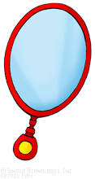
Unless… it’s the thing itself
Our offerings
Our pedagogies
Our thinking
Our assumptions
Donna Meadows:
“The most effective leverage point to change is a system is by changing The mindset or paradigm out of which the system-its goals, power structure, rules, its culture--- arises”
Notes:
A common thread in these approaches is that the problem is exogenous. The problem must be with something outside the system. We kept manipulating variables and parameters and expecting to see the behavior to change. System engineer Donna meadows ranked the different leverage points we have over a system and concluded that the most effective (if not the only effective) leverage point is ….
Where does this mindset, paradigm, culture …. Reside?
To a large extent in faculty (our) heads. We faculty have a key role in shaping, steawrding, and perpetuating the engineering education culture. So we decided that maybe we should start there and do some introspection. Change requires a large dose of humility.
Humility requires honest introspection: thus the mirrors

Slide 6
Collective Journey
Building faculty community across disciplines
Learning together
Reflection
Living and practicing what we want to achieve
Grass root emergent process of discovery
Notes:
And so we set to do exactly that. Transformational journeys are never undertaken alone. We set to build and grow a community of faculty members at Purdue interested in undertaking this reflective journey.
It was understood from the beginning that this is a professional development journey in which we are all learning together, from each other, and through each other. It is a grass root effort in which we were willing to explore, experiment, and discover. When we started, we had a common aspiration but no definite path or fixed outcomes.

Slide 7
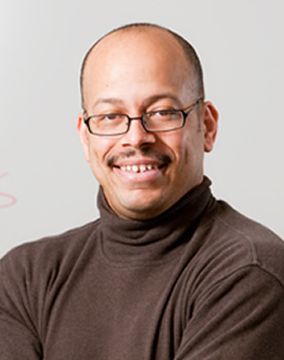
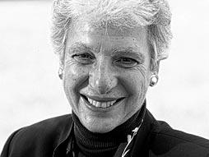
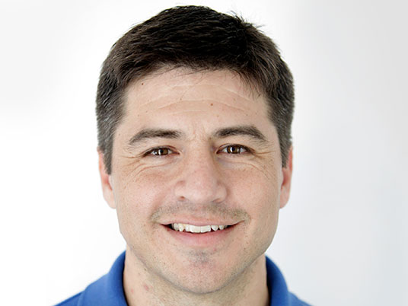
Guest Perspectives
Dr. Al Young, UM
The Latent challenges concerning diversity, Equity, and inclusion in STEM classroom
Dr. Dorinda Carter, MSU
The Consciousness that Equitable Teaching Requires in STEM Classrooms
Dr. Liz Coleman, Former
President Bennington
College
Values in Education….
What Is at Stake
Dr. Ryan Alanitz + 2 students
Education Behind Bars: The Co-Production of Knowledge by Inmates and University Students
Notes:
One of the elements of the learning was a speaker series. We invited speakers with different perspectives and different areas of expertise. These talks were extremely beneficial to us but also served as our main mechanism of recruiting members. By design the speakers are from different disciplines and attracted diverse audiences from all around campus.

Slide 8
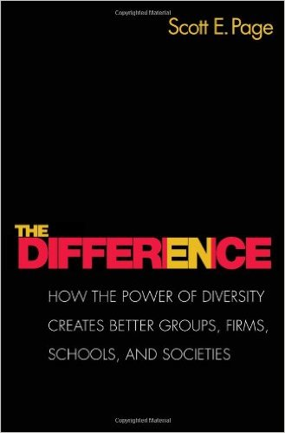
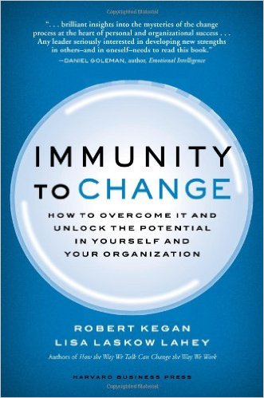
Common reading
Notes:
Common readings were also instrumental in creating a shared knowledge base, shared vocabulary, and a framework for discussions and debate.

Slide 9
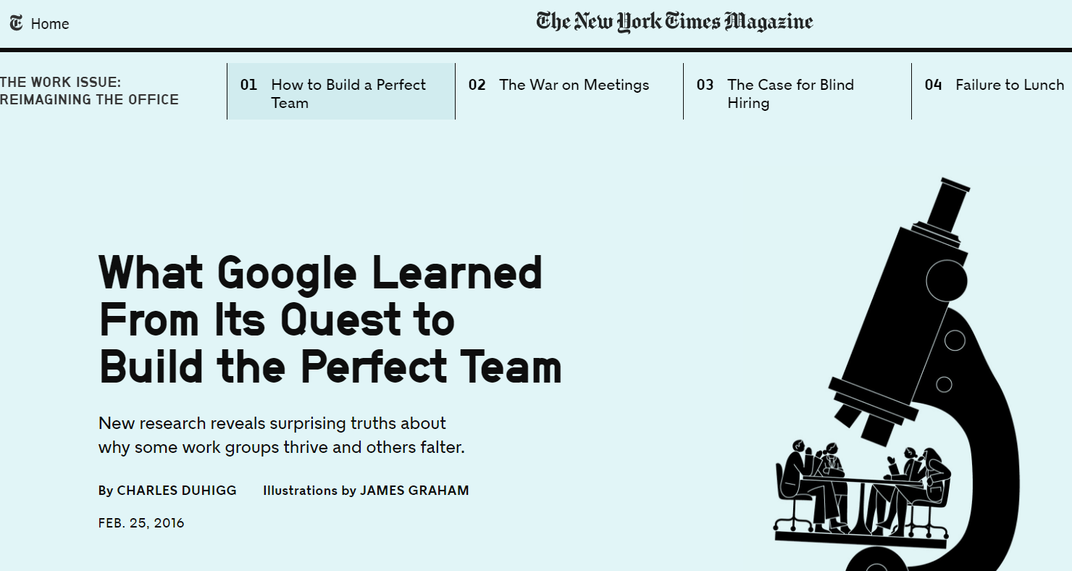
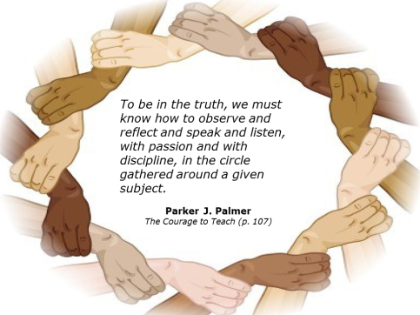
Collaborative
Emergent
Unstructured
Meta-reflective
Notes:
As we were learning and reflecting we were also keenly aware of the “governance” aspects of our group and our interactions. It was very important that our gatherings be as instructive as they are nurturing and rewarding to all. This is especially important given that no external force held together. This is a purely volunteer activity. We started with experimenting with different operational mechanics, such as the Circle of Trust. We were very heartened to see the Google’s study of teams. They studied hundreds of teams and came to the conclusion that what mattered most were:
1) Equal participation 2. social intelligence. We kept these two aspects in mind throughout our interactions.

Slide 10
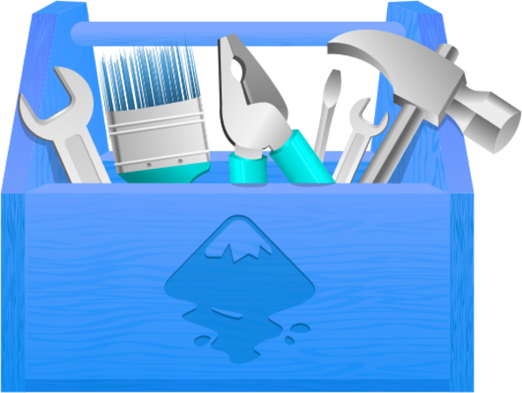
Building, organizing toolbox
Notes:
Even though we had no definite agenda or specific outcomes in mind, the most tangible outcome of our work is a common toolbox that emerged out of our work

Slide 11
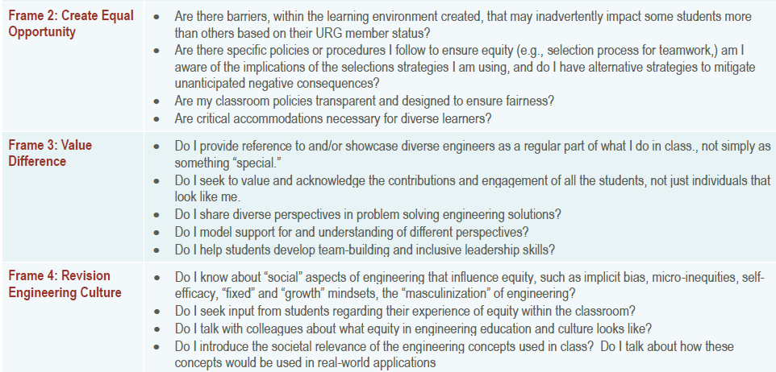
Tool 1: Adapting 4 frames
Example:
Notes:
The fisrt one we adopted is a Checklist for Change shared with us by Dr. Young, author of the book “Faculty Identities and the Challenge of Diversity”. This Checklist for Change was developed wiith his co-author Mike Chester. It is a checklist for engineering faculty to remind them of things they need to do in the classroom and outside to support diversity. The checklist is organized around the four frames.
We adopted this checklist and set to use it as a starting point to be customized, reflected upon, and adapted to our work.

Slide 12
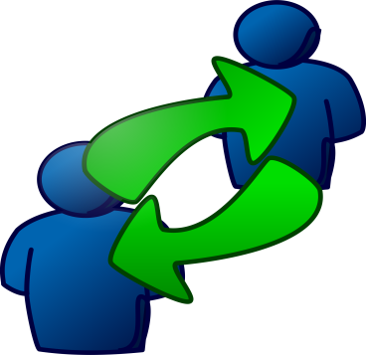
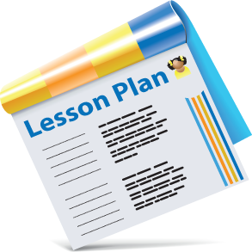
Tool 2: Open classroom doors
Notes:
Our second tool rests on the fact that we are a community and reinforces it. We set to open our classrooms for each other for feedback and growth. Thinking about the focus of these visits we decided to use the checklist as a guide for these visits.

Slide 13
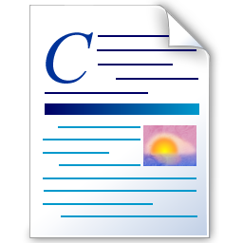
Tool 3: Promote model difference
Transforming lesson plans
By finding ways to promote
Difference in models
Notes:
One the books we’ve read “The Difference” by Mathematician economist Scott Paige gave us a excellent framework for operationalizing Frame 3. Paige created simulations and discovered/demonstrated that in problem solving, a group of different models performs much better than a group of best models. This was a springboard for us to seek ways to include different models in our syllabi and lectures and to value students’ contributions from a diversity in models.
We tested this by discussing one of my lectures on loops in a programming class.

Slide 14
Tool 4: If it were that easy …..

Slide 15
X-Ray Exercise*
Visible Commitment | What I resolve to do | Competing Commitment | Big Assumption
I want to lose weight | I want to eat less I want to eat only when I’m hungry I want to choose healthier foods | I am committed to not being bored or feeling empty. I am committed to feeling connected to people and to receiving love when it is offered to me. I am committed to not being seen and related to as a sexual object | I assume that eating can help fill the emptiness inside me. I assume that people will be offended or stop loving me if I turn down food they offer. I assume that I will not be taken seriously if I am too attractive
* Adapted from: Kegan and Lahey, Immunity to Change

Slide 16
Your turn
Visible Commitment | What I resolve to do | Competing Commitment | Big Assumption
Women and minority students have a sense of belonging and are thriving in engineering in my institution

Slide 17
From Diagnostic to Action
Big Assumptions
Published Research
Personal Research

Slide 18
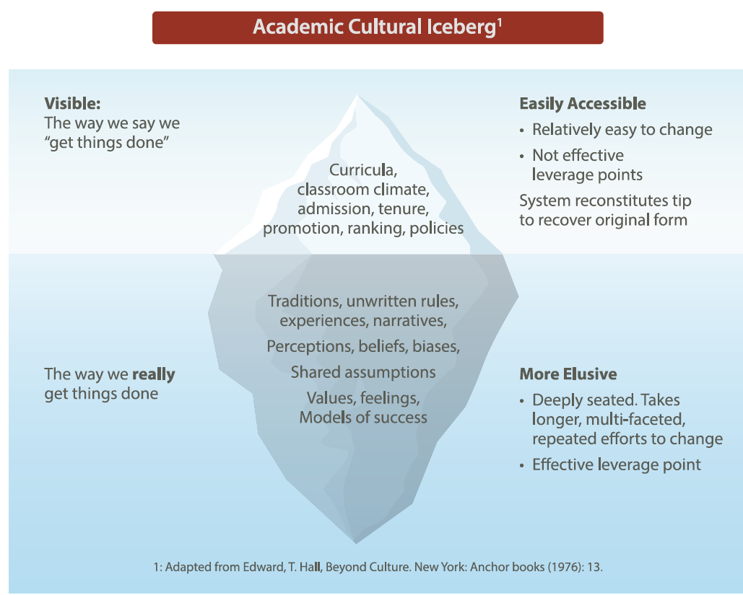

Slide 19
Take away/Resolution

Slide 20
Cont …
2. Tell the people at your table whom you chose as team members.
3. Take turns to discuss why you chose those people as team members.

Slide 21
What We do as faculty …
We prepare our lessons carefully with ample examples.
We do our best to engage the students using available technology like Clickers, white boards, computer demos, and etc.
We give ample meaningful assignments.
We give multiple exams and quizzes.
We hold weekly office hours.
Other…
We work harder than our students, constantly designing, delivering, and assessing . What else can we do?

Slide 22
Observed Problems
Student attendance drops gradually, because:
Some students fall behind and give up.
Some students lose interest.
Some get busy catching up with other courses.
As a result, the faculty gets discouraged.
Office hours are poorly attended, due to:
Time conflict.
Poor time management.
False assumption: Do not bother professors.

Slide 23
Faculty Self Reflection
When I started attending the Equity Workshops, I did not see anything wrong with my teaching style, I was doing all the right things ☺ After six months, I started to notice subtle issues:
I do not pay attention to the cultural identities of my students.
(Thinking of Vietnamese student as Chinese!)
I mix up the name of my African American students.
I assume certain students are smart and doing well based on the way they look or behave and vice versa.
I assume that I explain the concepts clearly, and everyone follows me.
I mostly address those students who sit in front rows and are attentive.

Slide 24
Our Current Plans
To find out about our misconceptions and hidden biases, we have decided to visit each other’s classes and provide critical feedbacks to one another.
We have been discussing Al Young’s 4 frames during our meetings.

Slide 25
Frame-4: Revision Eng. Culture
As faculty, we need to ask ourselves:
Do I see engineering as more masculine discipline?
Do I ask students about their experience of equity within the classroom or in the school?
Do I talk to my colleagues about their view of equity in classrooms
Do I talk about social relevance of the topics I cover in the class?
Do I talk about the real world application of the topics covered in the class

Slide 26
Activity-3
Pick up a handout with Frame-4 Questions:
Part-1 (5 minutes)
Reflect and answer each question.
Part-2 (5 minutes)
Share your responses with the person next to you.

