Slide 1
Analytical and Experimental Investigation of Effect of Surface Roughness on Tensile Fatigue
Kushagra Singh
PhD Candidate
School of Mechanical Engineering
Based on Publication:
Singh, K., Sadeghi, F., Correns, M. and Blass, T., 2019. A microstructure based approach to model effects of surface roughness on tensile fatigue. International Journal of Fatigue, 129, p.105229.

Slide 2
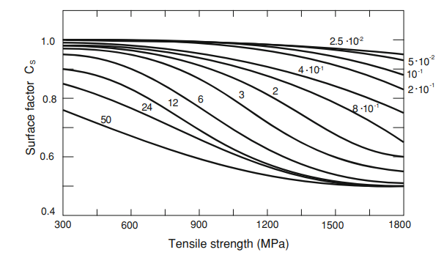
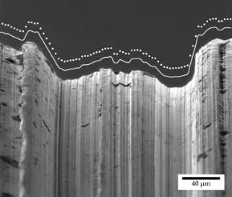
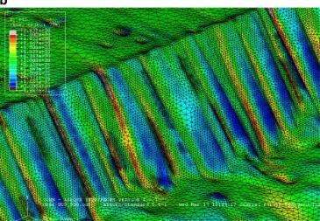
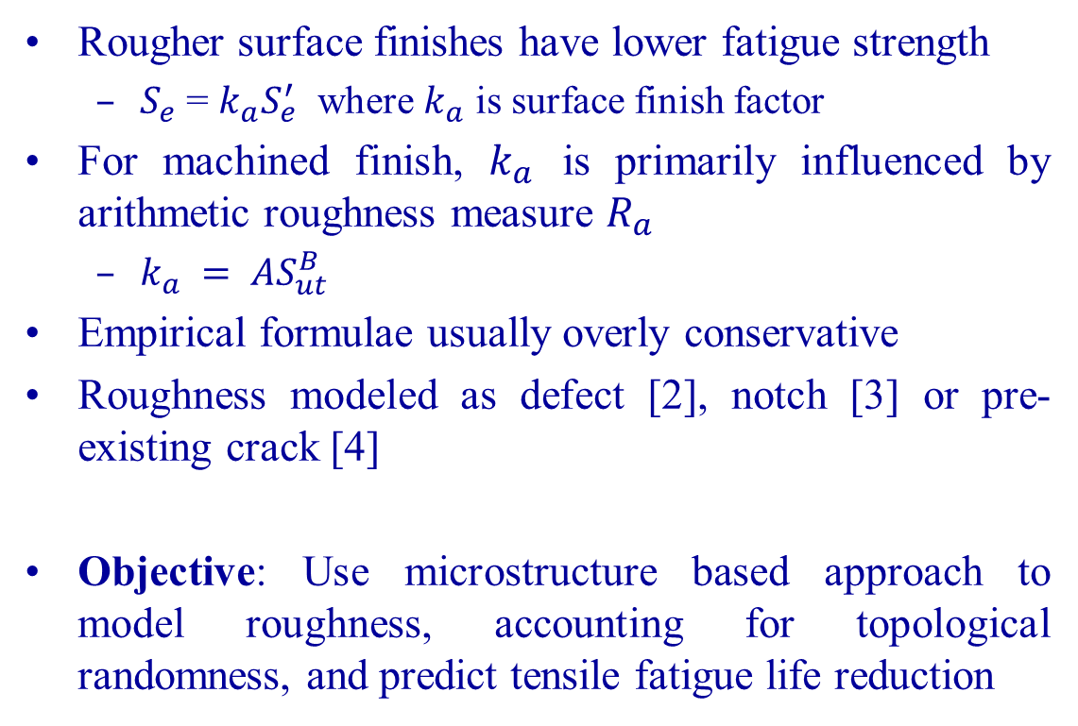

Motivation and Objective
Rougher surface finishes have lower fatigue strength
  $S_{e}$ = $k_{a}S_{e}^{′}$ where $k_{a}$ is surface finish factor
For machined finish, $k_{a}$ is primarily influenced by arithmetic roughness measure $R_{a}$
  $k_{a} = AS_{ut}^{B}$
Empirical formulae usually overly conservative
Roughness modeled as defect [2], notch [3] or pre-existing crack [4]
Objective: Use microstructure based approach to model roughness, accounting for topological randomness, and predict tensile fatigue life reduction
$k_{a}=f(S_{ut}, R_{a})$ [1]
Surface profile of axisymmetric specimen modeled using White Light Interferometry and FEM [5]
1. R. C. Johnson. Specifying a Surface Finish that Won’t Fail in Fatigue. Mach Des, 45(11)1973:108.
2. Murakami Y (Yukitaka). Metal fatigue : effects of small defects and nonmetallic inclusions. Elsevier; 2002.
3. Arola D, Williams CL. Estimating the fatigue stress concentration factor of machined surfaces. Int J Fatigue 2002;24:923–30.
4. Suraratchai M, Limido J, Mabru C, Chieragatti R. Modelling the influence of machined surface roughness on the fatigue life of aluminium alloy. Int J Fatigue 2008;30:2119–26.
5. Ås SK, Skallerud B, Tveiten BW. Surface roughness characterization for fatigue life predictions using finite element analysis. Int J Fatigue 2008;30:2200–9

Slide 3
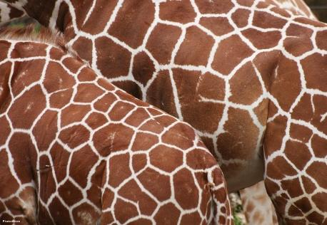

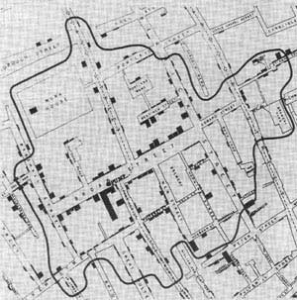

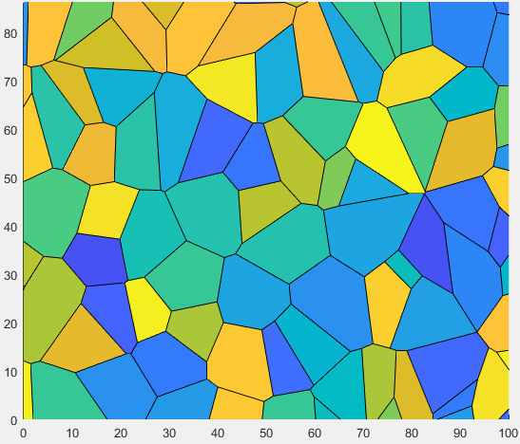
Voronoi Tessellation
Pattern on Girraffe skin [1]
School catchment zones [2]
Cholera outbreak map [3]
4130 steel grains (SEM) [4]
Every point inside a cell is closer to the cell seed point than adjacent seed points
Commonly used to model microstructure of materials
1.https://www.juancarlosdeleon.com/
2.http://melbourneschoolzones.com/
3.On The Mode Of Communication Of Cholera (Snow 1855a)
4. Singh, K., Sadeghi, F., Correns, M. and Blass, T., 2019. A microstructure based approach to model effects of surface roughness on tensile fatigue. International Journal of Fatigue, 129, p.105229.
5. https://en.wikipedia.org/wiki/Voronoi_diagram
4130 Microstructure simulation based on SEM [4]
Voronoi tessellation shows as radially outward growth [5]

Slide 4
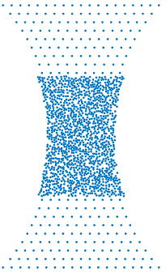
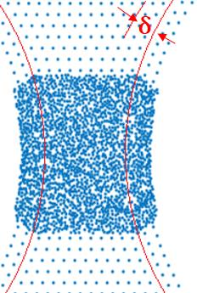
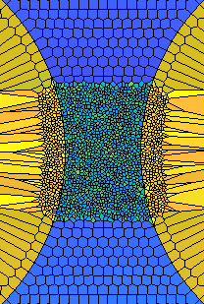
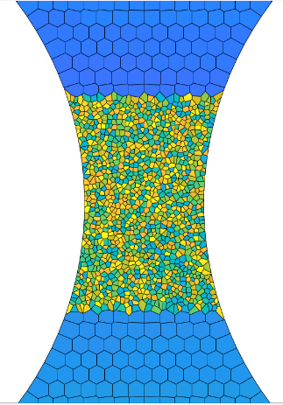
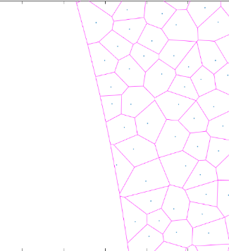
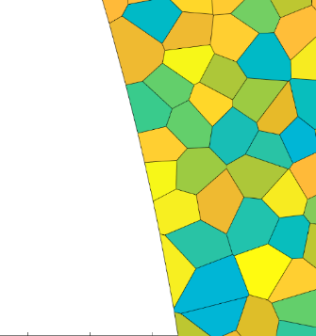
Tensile Specimen Microstructure Modeling
Critical zone: Microstructure modeled using Voronoi tessellation
Centroids connected to vertices to get CST elements for FEA
Grain boundaries correspond to weak planes of failure

Slide 5
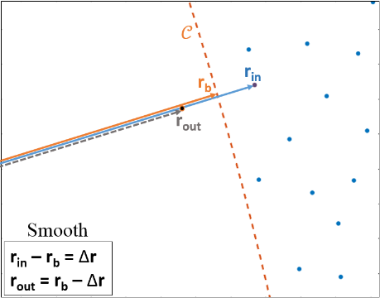
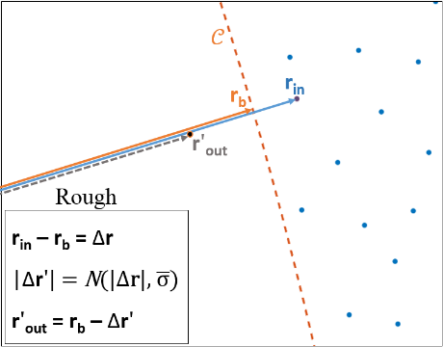
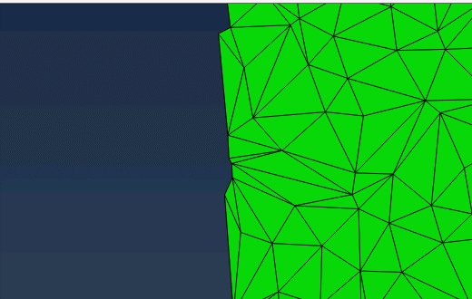
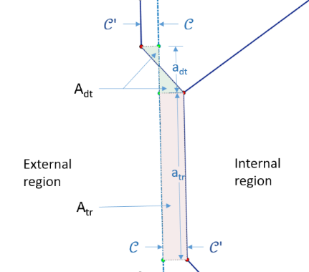
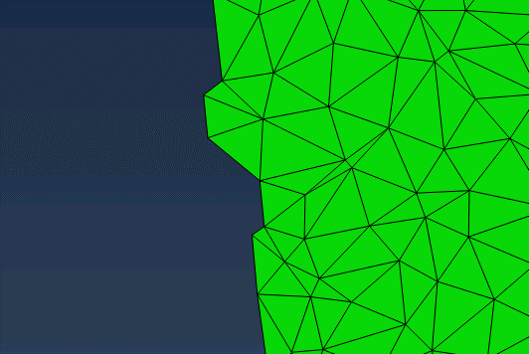

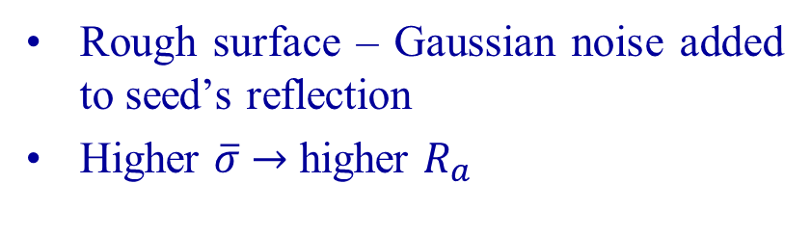



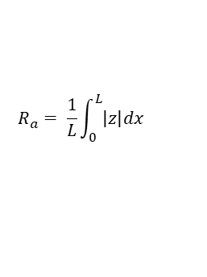
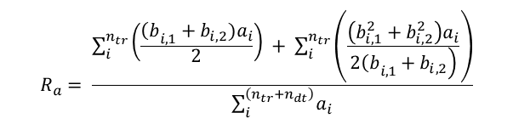

Generating Roughness
$$Δr$$
$$Δr$$
$$Δr′$$
$$Δr$$
$$R_{a}=0.5 μm$$
Rough surface – Gaussian noise added to seed’s reflection
Higher $\overline{σ}$ $→$ higher $R_{a}$
$$R_{a}= \frac{\sum_{i}^{n_{tr}}{\left(\frac{{\left(b\right.}_{i,1}+b_{i,2})a_{i}}{2}\right) + \sum_{i}^{n_{tr}}{\left(\frac{\left(b_{i,1}^{2}+b_{i,2}^{2}\right)a_{i}}{\left.2{\left(b\right.}_{i,1}+b_{i,2}\right)}\right)}}}{\sum_{i}^{\left(n_{tr}+n_{dt}\right)}{a_{i}}}$$
$$R_{a}= \frac{1}{L}\int_{0}^{L}{\left|z\right|dx}$$
$$R_{a}=2.0 μm$$

Slide 6
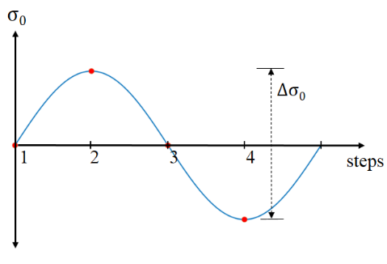
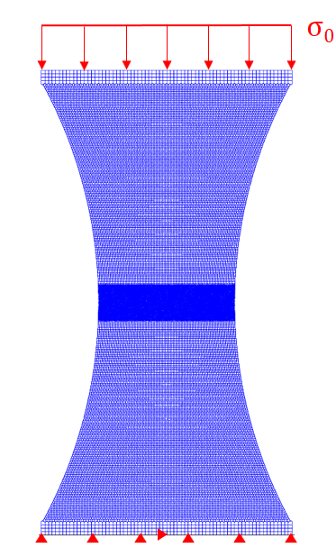
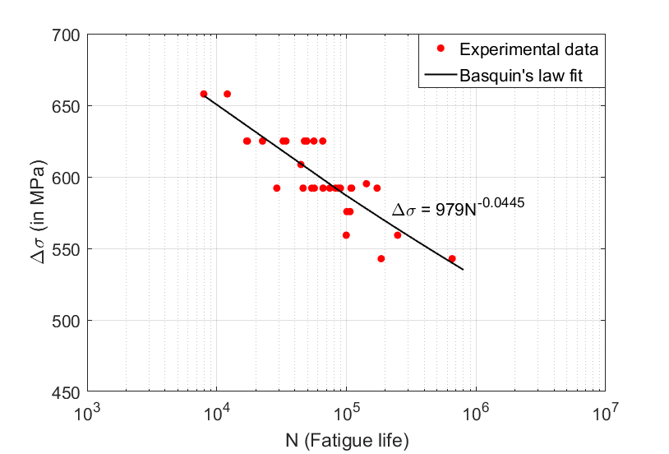

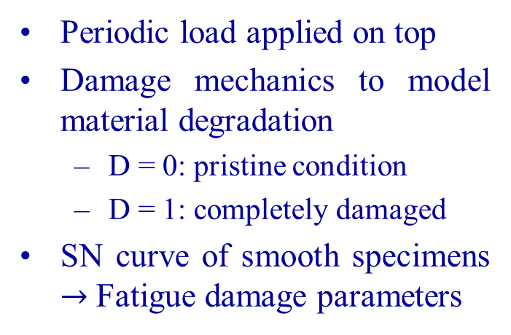

Fatigue Damage Model
Periodic load applied on top
Damage mechanics to model material degradation
  D = 0: pristine condition
  D = 1: completely damaged
SN curve of smooth specimens $→$ Fatigue damage parameters
Loading steps
$$\frac{dD}{dN}={\left[\frac{∆σ}{\left.σ_{r}(1−D\right)}\right]}^{m}$$
Damage Law, applied at each grain boundary
$∆σ$ = $aNb$
[$a,b$ (smooth spec exp) give${ σ}_{r}, m]$
Basquin’s Law
Load and BC
SN curve of smooth specimens

Slide 7
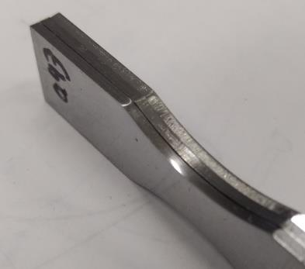
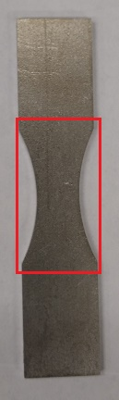
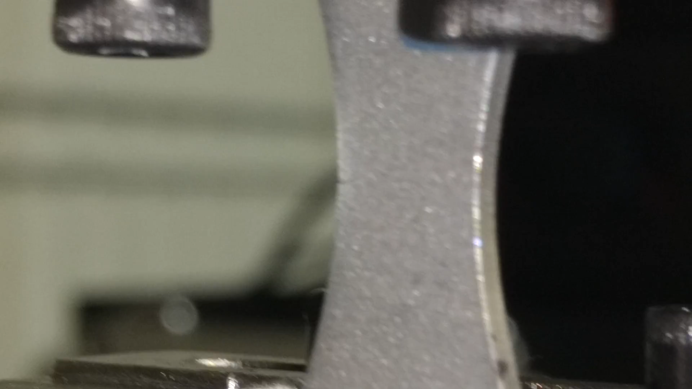
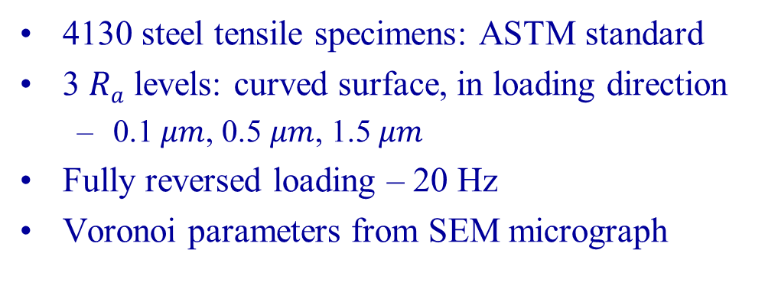
Experimental Procedure
4130 steel tensile specimens: ASTM standard
3 $Ra$ levels: curved surface, in loading direction
  0.1 $μm$, 0.5 $μm$, 1.5 $μm$
Fully reversed loading – 20 Hz
Voronoi parameters from SEM micrograph
Smooth, as-milled and roughened (left to right)
Fatigue crack propagation video
SEM micrograph of 4130 steel specimen
Surface profile along Y direction for all 3 sets

Slide 8
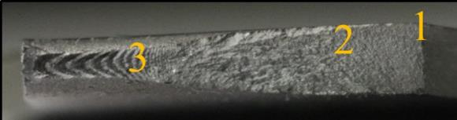
Fractured Surface Analysis
Failed Surface (Full view)
1. Crack Initiation
3. Final Fracture
2. Crack Propagation

Slide 9
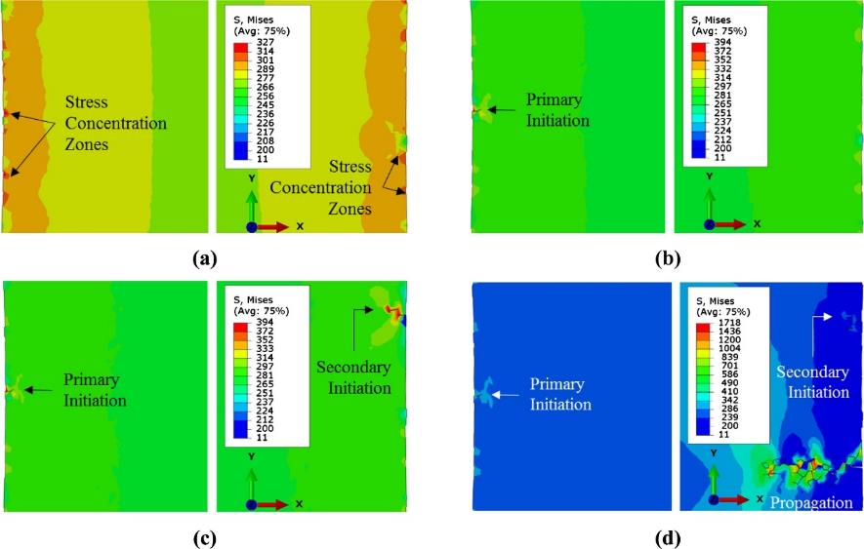
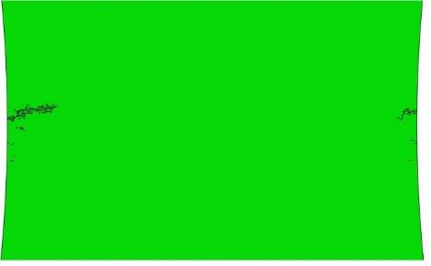
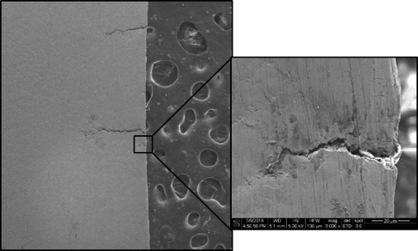
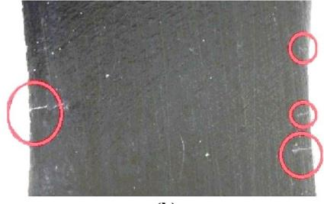
Model Prediction of Failure Stages
Multiple crack initiations - Simulation
Stages of tensile fatigue failure predicted by model; each image shows left and right boundaries of the specimen; Specimen is from Set C ( = 1.5 μm)
Pristine specimen showing stress concentration due to roughness,
First crack initiates on left surface of the specimen,
Secondary crack initiates from right side,
Propagation of one of the cracks causing failure.
Multiple crack initiations - Experiment

Slide 10
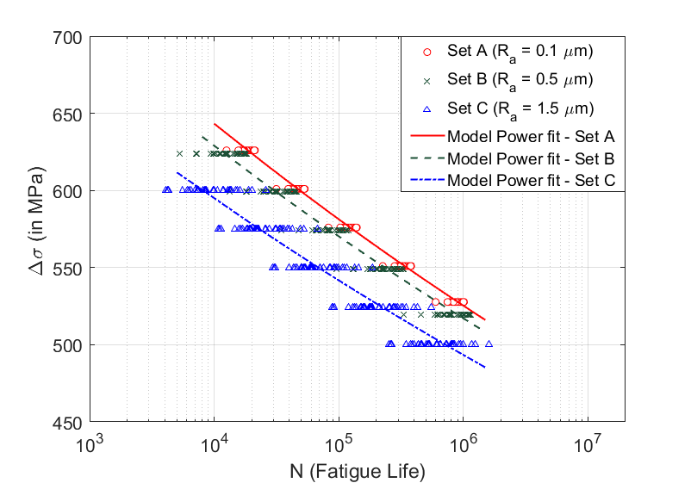

SN Curves: Experiments and Model
Experimental SN curves
Predicted SN curves
Corroboration of surface finish factor $k_{a}$
Experiment & modeling: Fatigue life decreases with increasing roughness
Effect decreases at low cycle, plasticity: failure mode not considered by model
Accurate Endurance limit prediction

Slide 11
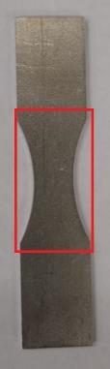
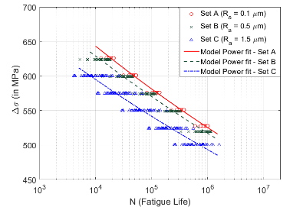
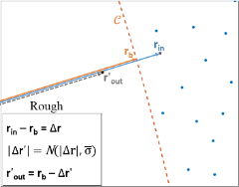

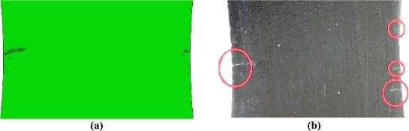
Summary: Effect of Roughness on Tensile Fatigue
Predicted SN curves
Three roughness
levels
Material microstructure
Experimental SN curves;
model validation
Construct rough specimens
Smooth tensile specimen SN curve to obtain damage modeling parameters
Voronoi grains
Similar crack initiation behavior in model and experiments

Slide 12
Questions?

Slide 13
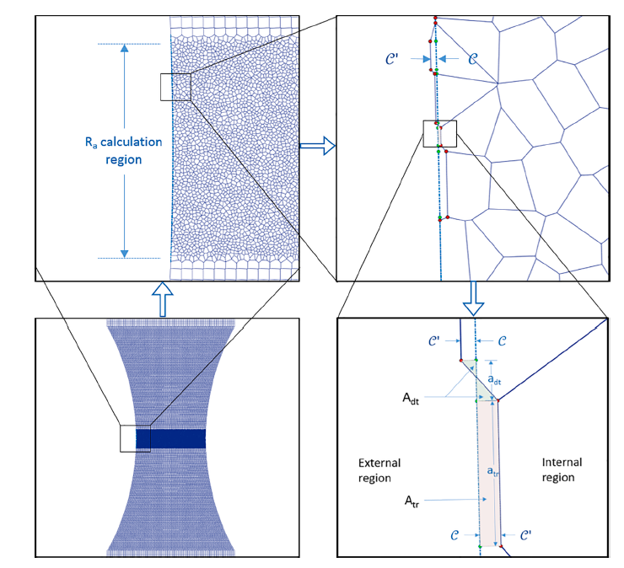
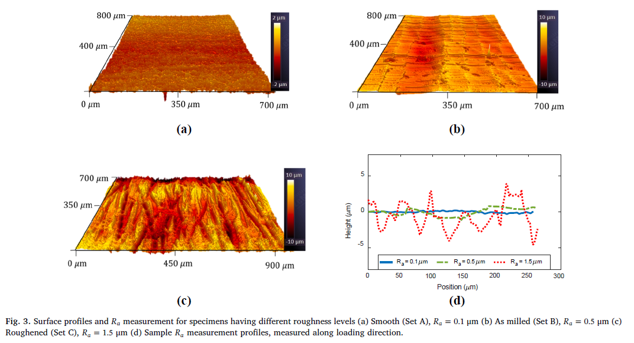
P1- Roughness Modeling details

