Slide 1
Prototyping With 3D Printers

Slide 2
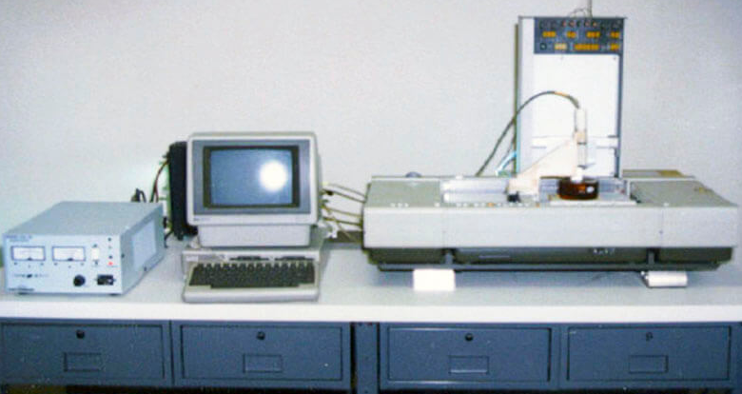
History of 3D Printing
Chuck Hull’s Stereolithography Apparatus (SLA; and pictured below) put his company’s UV lamps to a different use: curing photosensitive resin layer-by-layer, eventually creating a custom part. He patented the invention and quickly started his own company in Valencia, California named 3D Systems. The company released their first commercial product, the SLA-1, in 1988.
In 1988, another 3D printing technology was invented: Selective Laser Sintering (SLS). The inventor, Carl Deckard, was a college undergraduate at the time. Deckard’s machine produced only simple chunks of plastic. However, this was an achievement in that it tested another way in which to make a 3D plastic using printing-like technologies.
While the patent for Deckard’s SLS was awaiting approval, Scott Crump filed another patent for his printer that used Fused Deposition Modeling (FDM). FDM is the simplest and most common of the three technologies (SLA and SLS are the other two). Scott Crump became the co-founder of Stratasys. Founded in 1989, the Minnesota-based company is still one of the market leaders for high precision 3D printers.
In 1992, the patent for FDM was finally issued to Stratasys, which marked the start of the intense development of the technology.

Slide 3
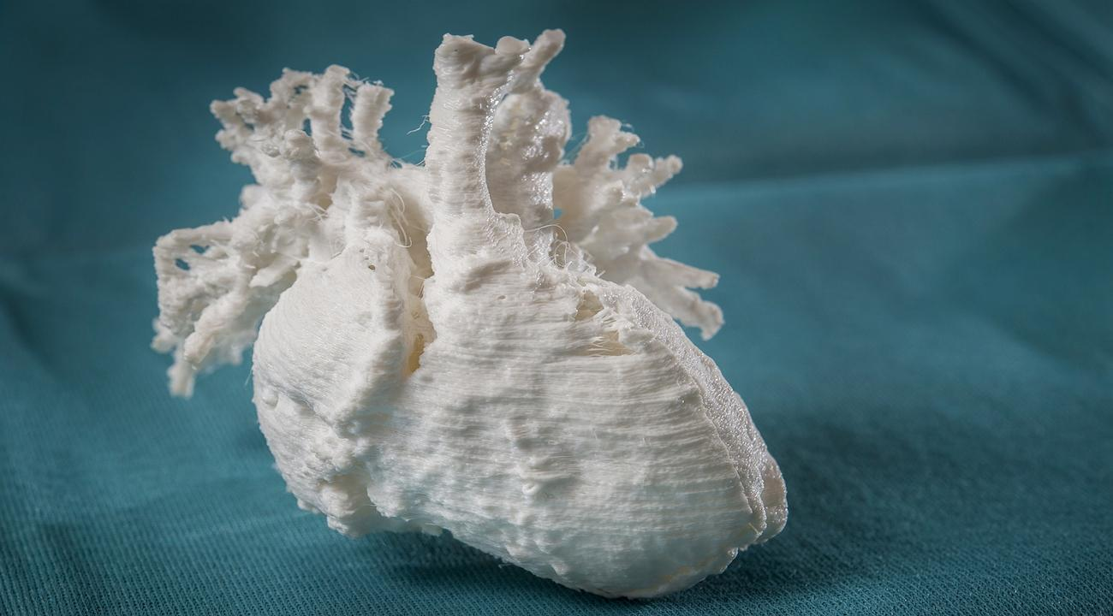
History cont.,
The medical industry was one of the first of the early-adopters of 3D printing technology in the 1990s and early 2000s. The first 3D printed working kidney was created. Thirteen years later (2013), was it transplanted into a patient. Researchers continue to experiment on 3D printed organs for transplanting organs quickly. Pictured below is a 3D printed heart.
In 2004, the RepRap Project was initiated. It consisted of a self-replicating 3D printer. This open source project led to the spreading of the FDM 3D desktop 3D printers, and of the popularity of the technology in the makers community quickly rose.
The FDM technology patents fell into the public domain in 2009, thus opening the way to a wide innovations in FDM 3D printers. This caused a drop in price for the desktop 3D printers, which made the technology far more accessible and visible to the public. Now, 3D printers are in schools and homes across the nation and around the world.

Slide 4
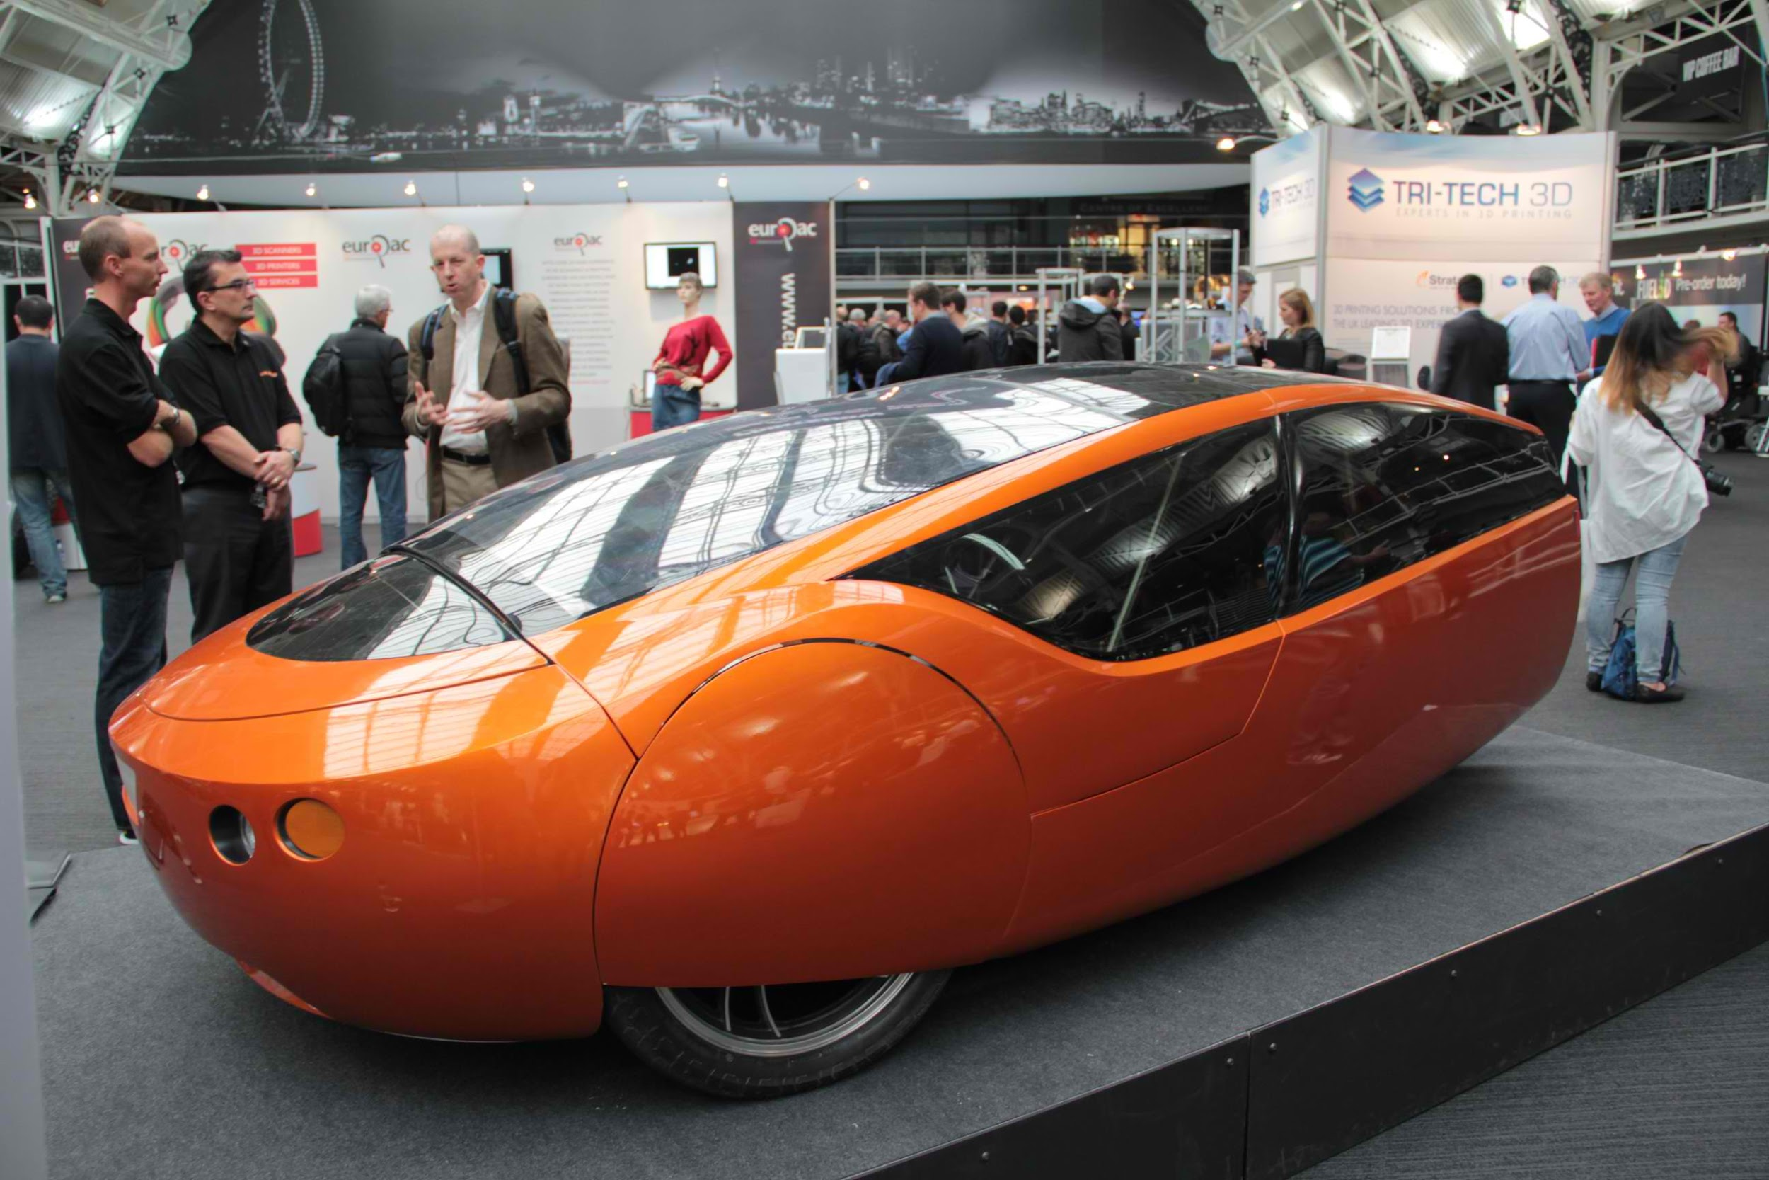
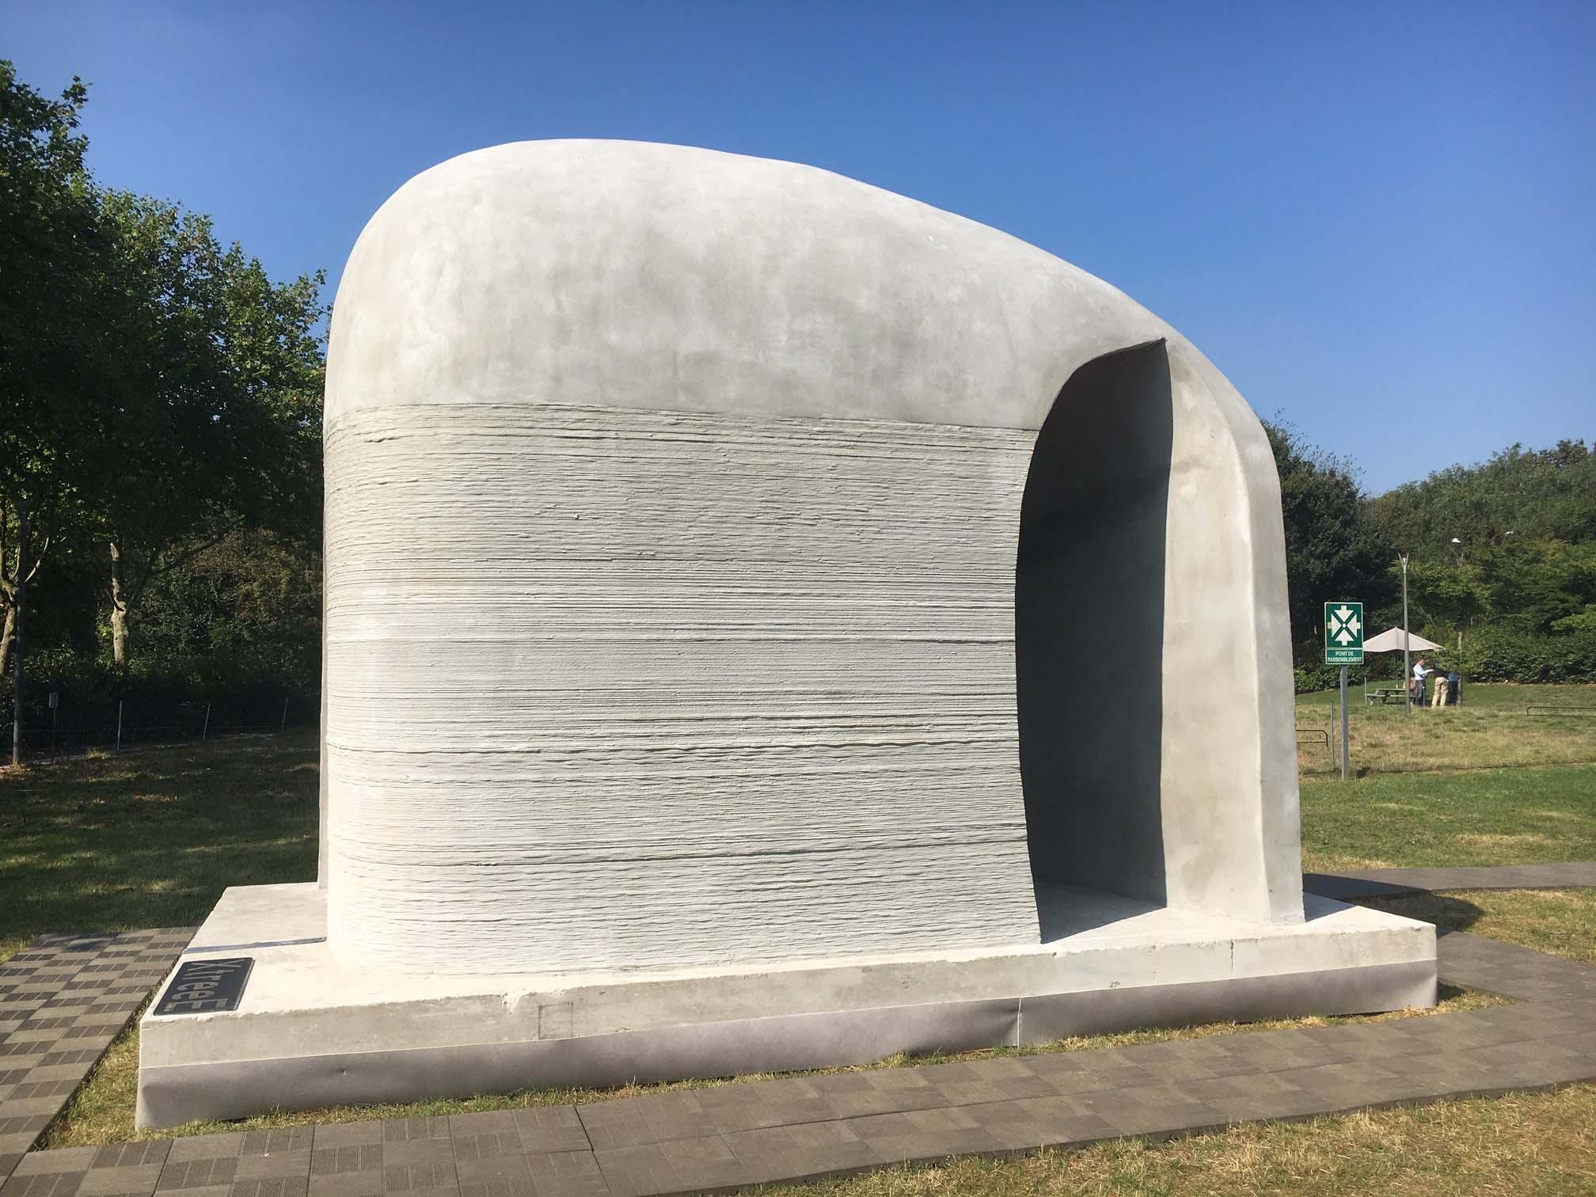
Uses Today
In 2010, Urbee was the first 3D printed 3-wheel prototype car (full-sized Urbee 2 is pictured below).
In 2011, Cornell University began work on a 3D food printer. NASA is now researching how astronauts could 3D print food in space.
In 2016, Daniel Kelly’s lab is 3D printing bone
French startup XtreeE, is 3D printing concrete seeking to change the construction industry.
Originally, 3D printers were intended to improve rapid prototyping processes, but these handy machines have gone on to potentially affect vehicular manufacturing, home building, and even space exploration.
Urbee 2 (later model than listed)
XtreeE’s 3D printed concrete pavilion

Slide 5
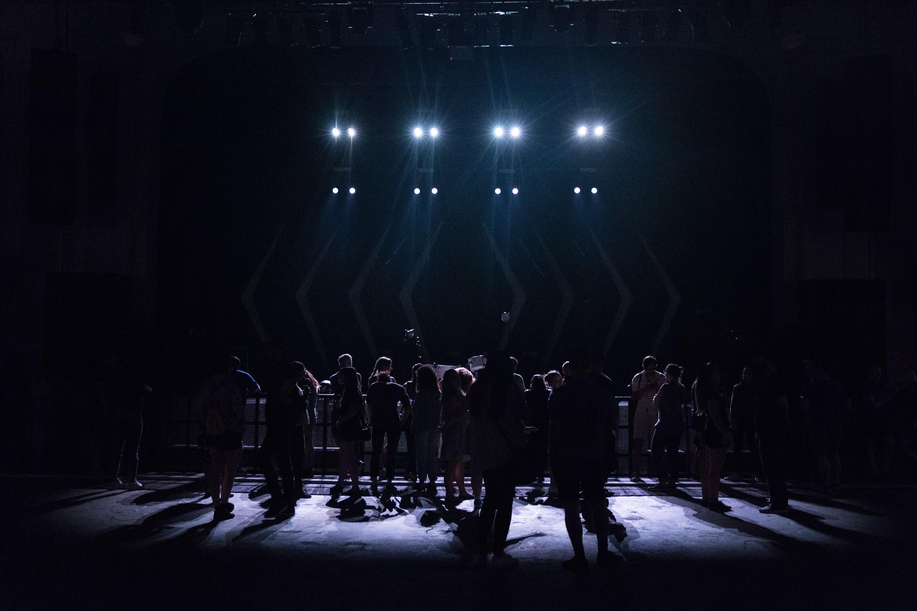
The Theater
A Case Study
Notes:
This is a hypothetical situation that provides an opportunity to discuss the function of prototypes.

Slide 6
The Theater, Part 1
Imagine you are the director for the school play, which is a basic story of a knight fighting this incredible foe to ultimately win the throne. There are several scenes in which your knight uses a sword. Though you have an extremely low budget, you were able to acquire some realistic-looking metal swords to be used as props on the stage. The principal has allowed the use of the swords on two conditions:
(1) They are not to be stored on campus until the week of the play and only then under lock and key and
(2) they cannot be used in rehearsals until the week before the play’s opening.
Notes:
Have a student or students read this and the following slide.

Slide 7
The Theater, Part 2
You accept the principal’s terms without argument, however you are left with a serious problem. You need to choreograph and practice the fight scenes much sooner than the week before the production’s opening. You know from your experience that actors of any age do fight scene choreography much better if they have something in their hands. You’ve used much of your budget already on the realistic swords.
How do you give something for your actors to work with that:
(1) helps you keep your agreement,
(2) is effective in helping the actors practice the scenes, and
(3) would be safer?
Notes:
This could be a quick Think-Pair-Share activity. Students could be given a minute to think about and then share with their neighbors their ideas. Once they conclude sharing, call the students back together and have a number of pairs of students share their solutions with the class.

Slide 8
Potential Solutions
Give the students yard/meter sticks.
Take two or three paper towel rolls (just the cardboard) and tape them together
Pointer sticks
Water noodles cut down to size
Retired violin bows from the orchestra
Giant pixie stick candy straws
Broom handles
...and many more!
Notes:
This slide can be shown to the students after the Think-Pair-Share activity to help validate some ideas or generate some others.

Slide 9
Why the Prop?
The stage prop is used not only as a tool for an actor, but it serves the role as a communication device. It’s main purpose in being on the stage is to communicate a message that empty space cannot. In most cases with theatre props, the props are not the real thing, but an imitation or prototype.

Slide 10
Communication Device
For example, let’s use 2-3 cardboard paper towel rolls taped together to form a long tube. Depending on how one holds that prototype, and the stance they take, they can tell a hundred different stories. Here are some examples:
A baseball player at bat
An old man with a cane
An Aboriginal playing the didgeridoo
A knight with a sword
A scientist with a telescope
The oar for a canoe or kayak
...and many, many more!
Notes:
This slide can serve as an activity reference for the teacher. Take 2-3 cardboard paper towel rolls taped together to form a long tube. Have varying students come to the front of the class and demonstrate these, and other, stance’s one takes to change the story. The concluding point of this activity is on the next slide.

Slide 11
What is a Prototype?
A prototype, like a stage prop, is a communication device. It is not the real end product. Just as you would never use real swords in the student play even in the final show, prototypes are tools meant to communicate various ideas about the end product. A prototype bridges the gap between the ideator(s) and those around them by demonstrating the concept and providing a space for feedback to be given before end-product-level implementation begins.
“If a picture is worth a thousand words then a prototype is worth a million words.”
~ David Kelley, Founder of IDEO
Photo from IDEO.com

Slide 12
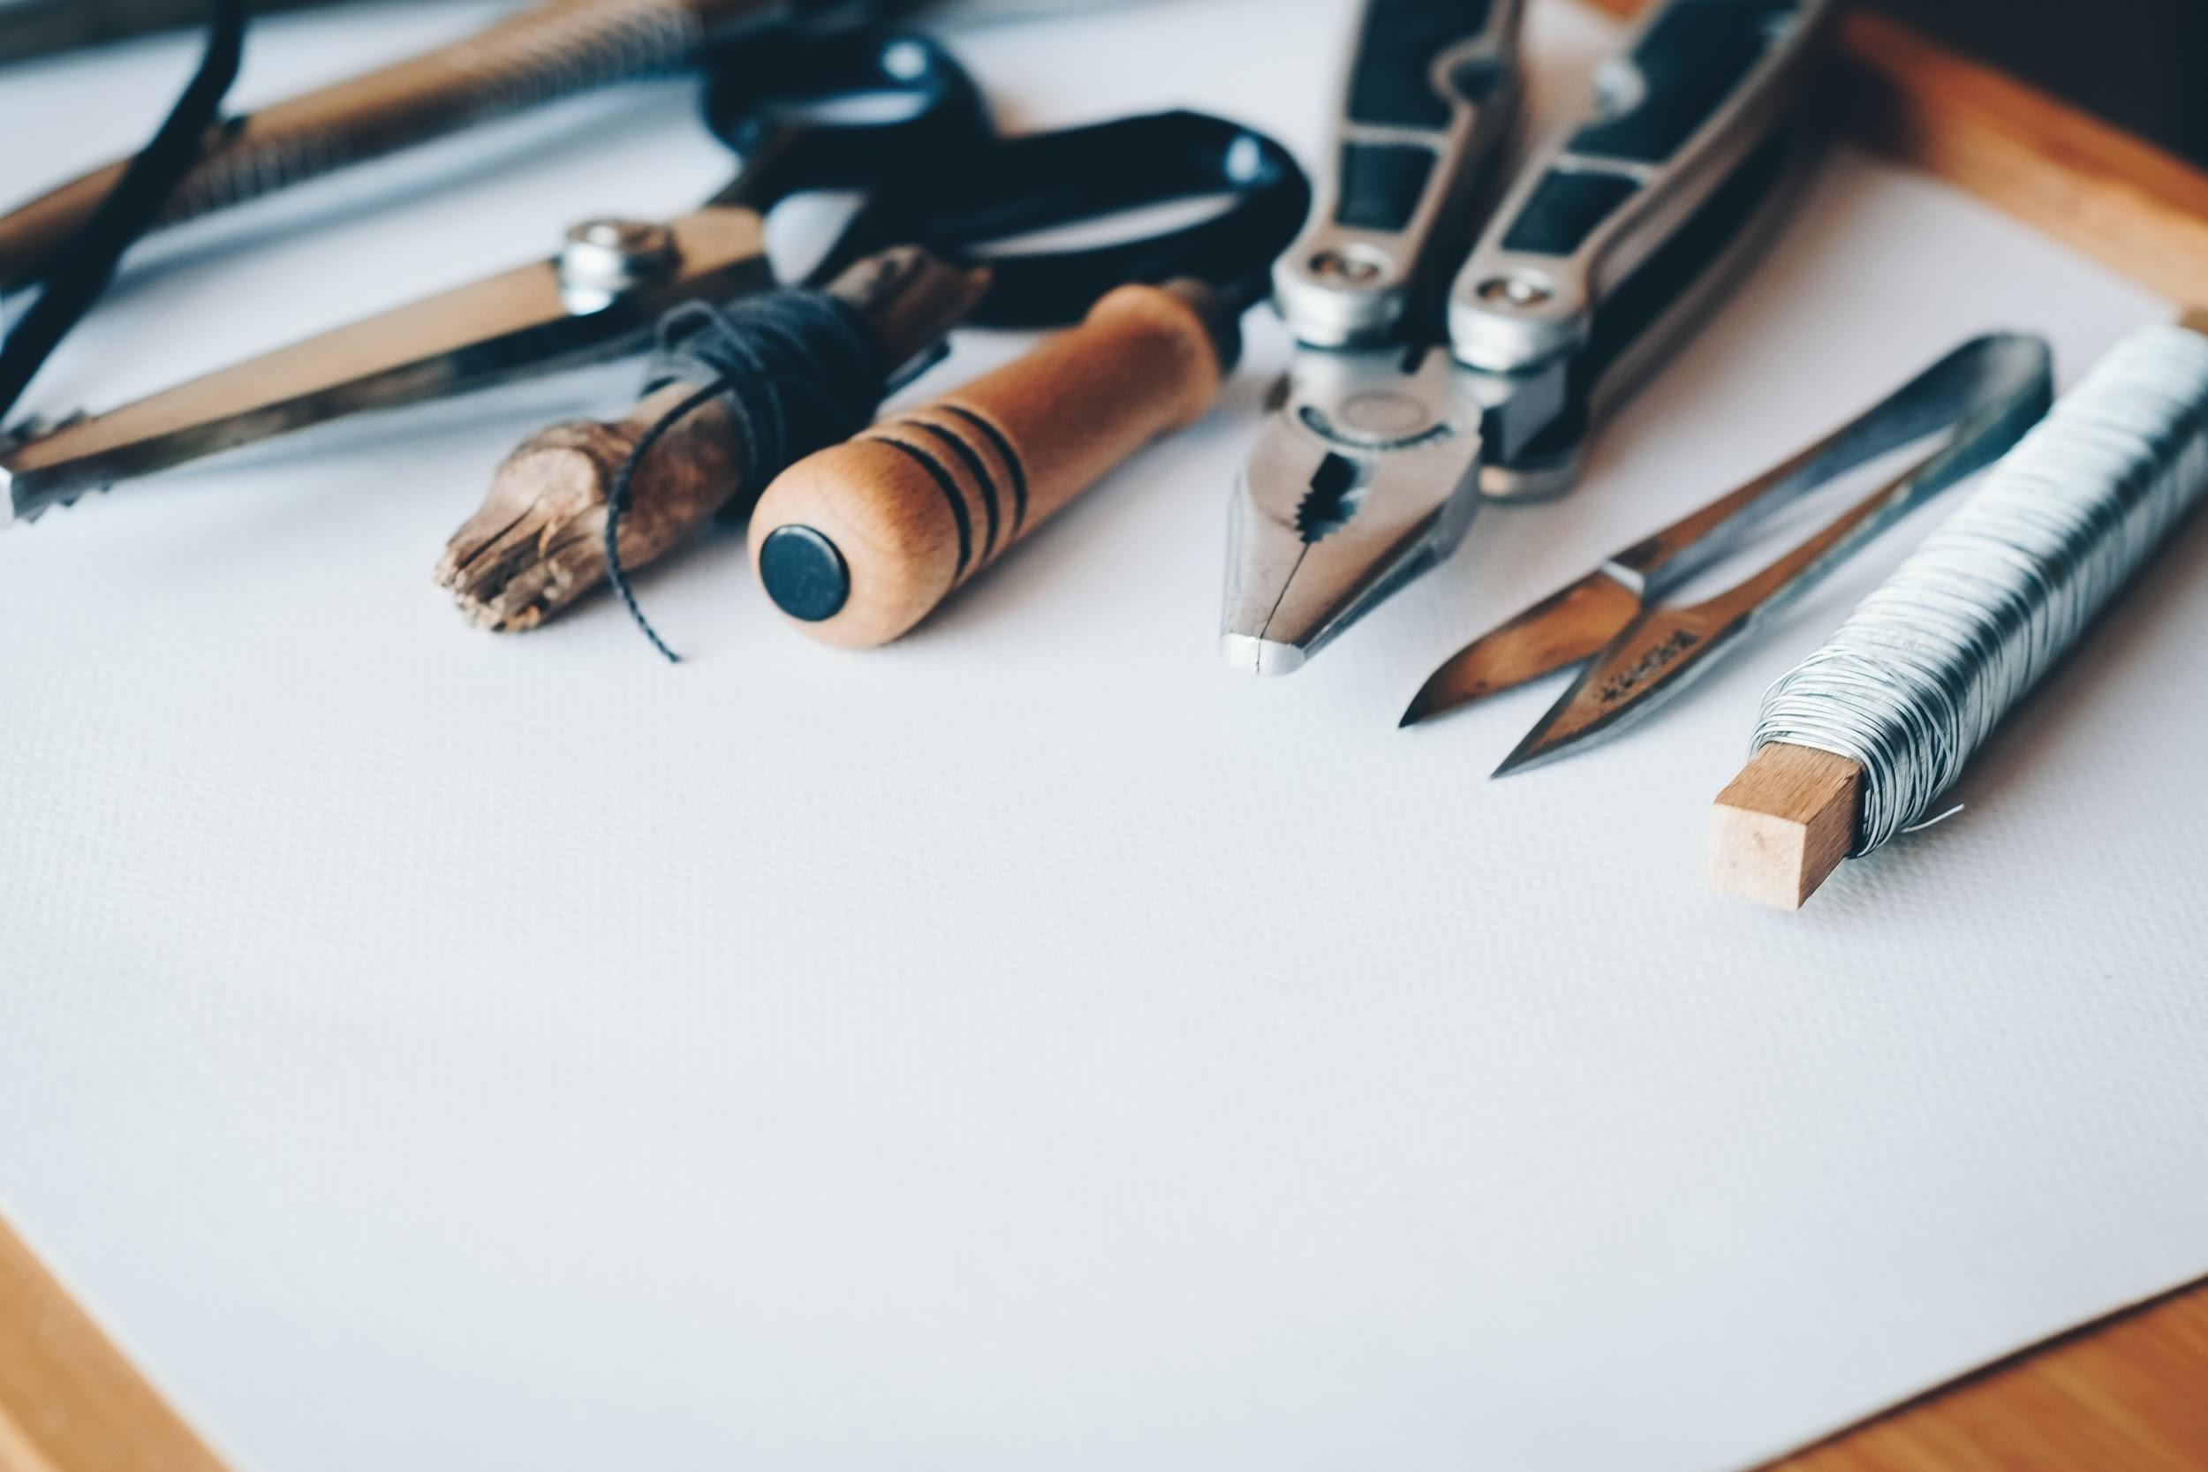
Different Levels
of Prototyping
Notes:
3D printers play different roles in the prototyping process. Here we will talk about varying levels of prototypes and the kinds of communication they provide using a scenario-based activity.

Slide 13
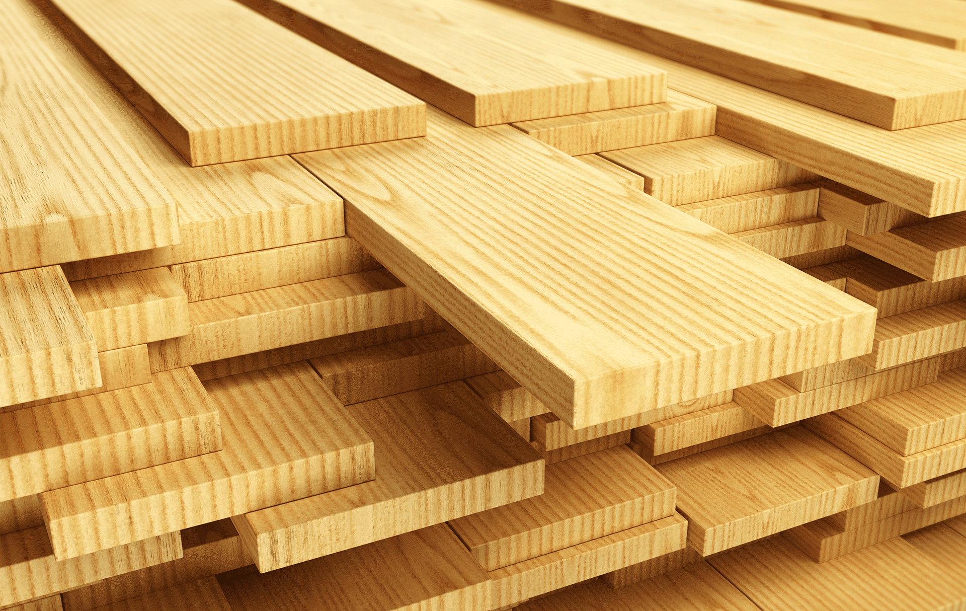
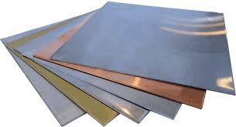
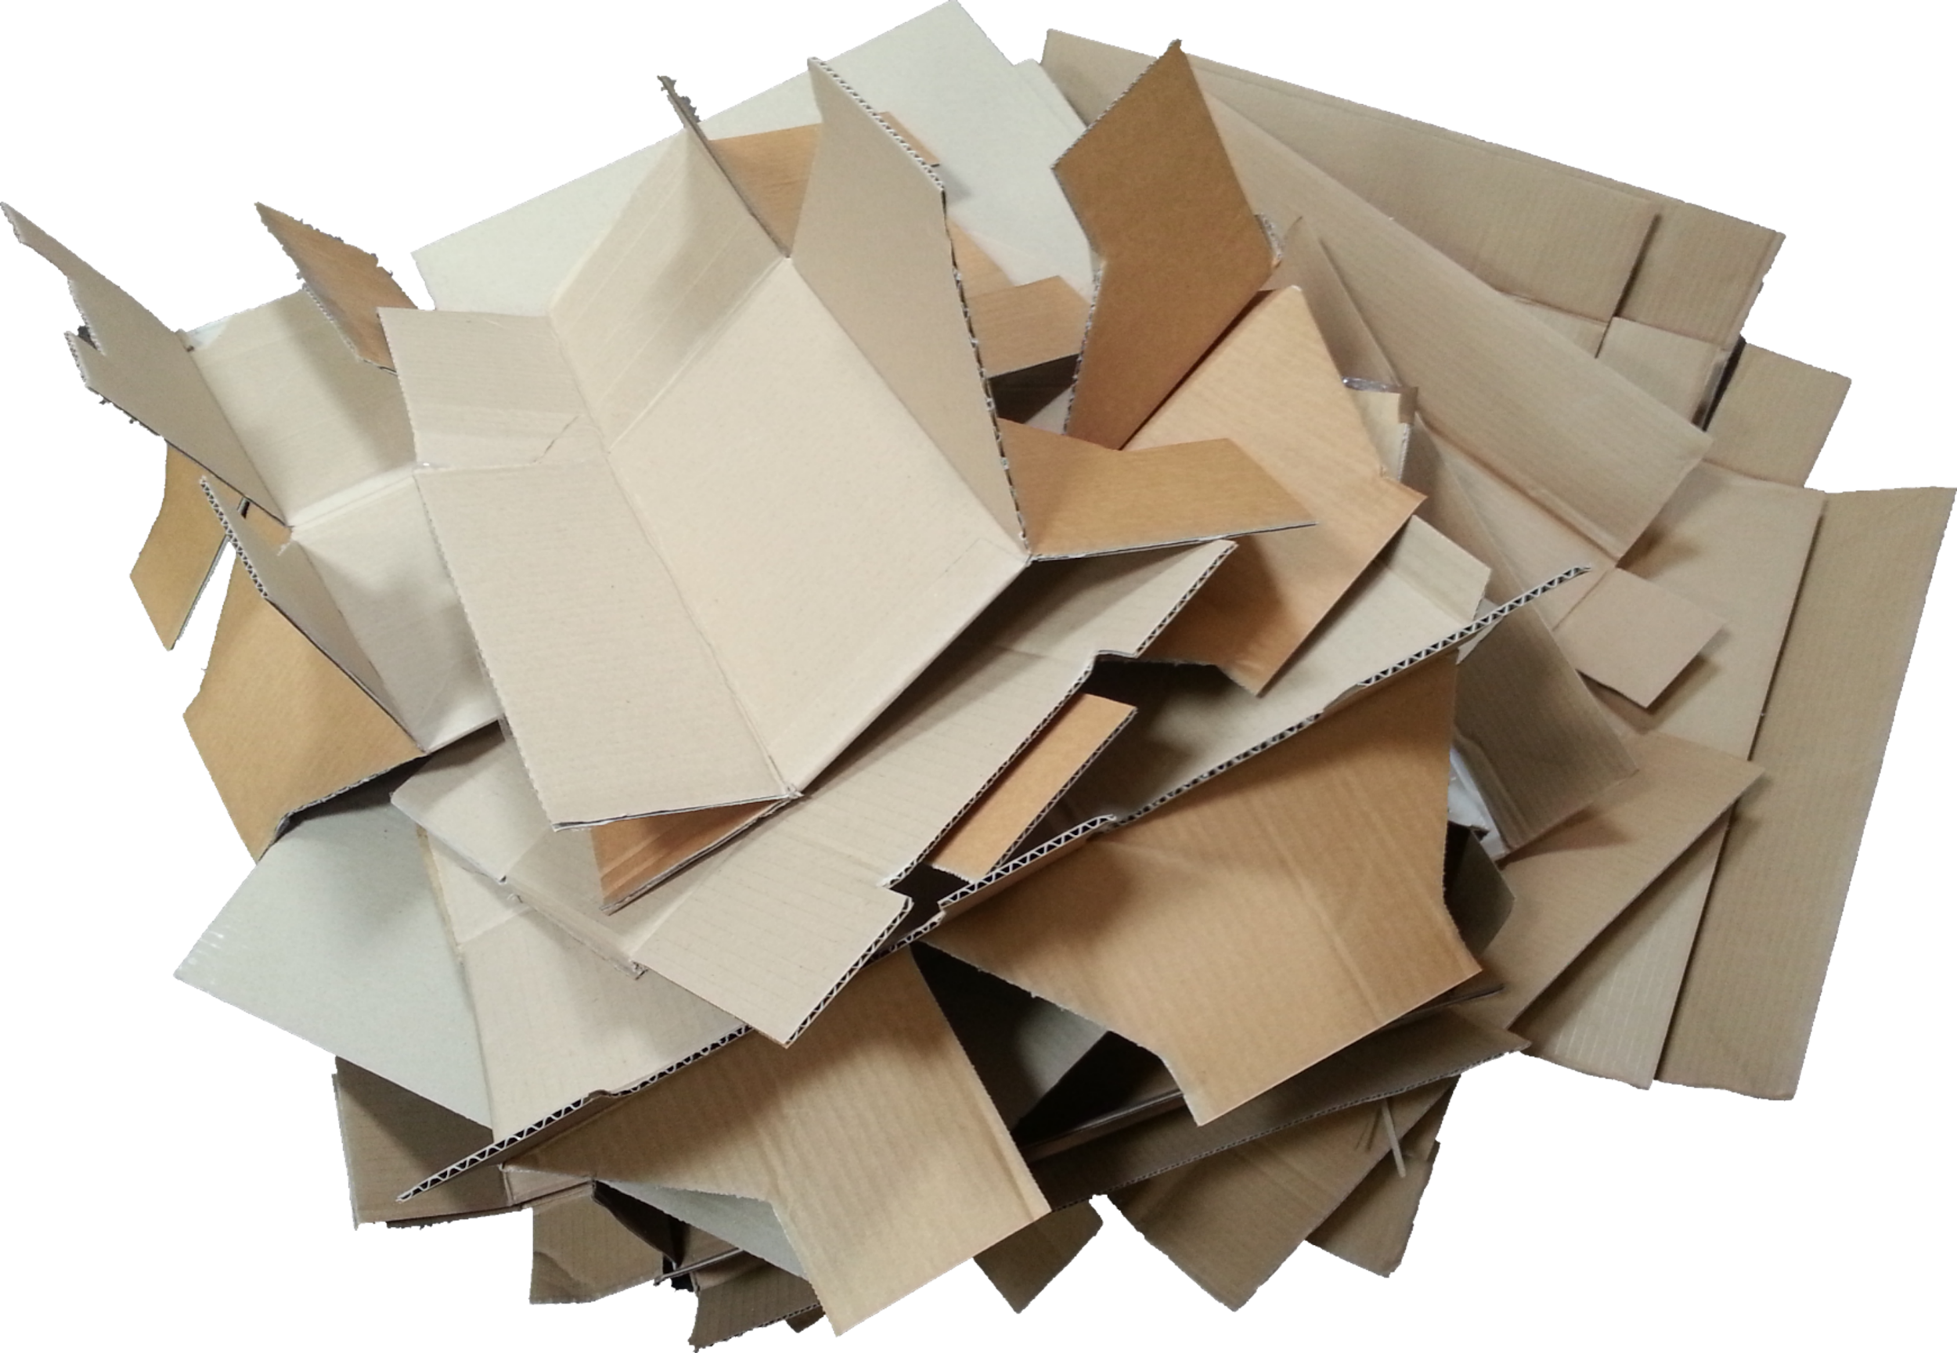
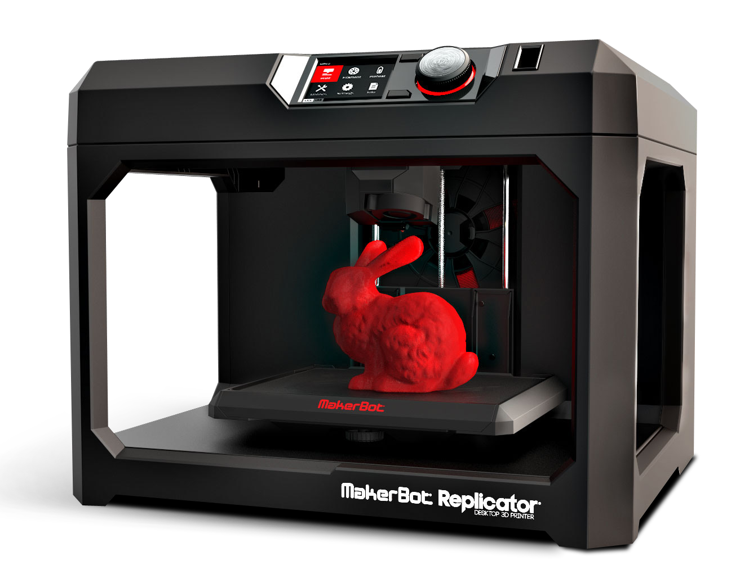
It’s Time to Play A Game!
You will be given various scenarios in which you will need to make a prototype. The materials you have at your disposal are shown at right. Your task is to decide which material would be most effective in creating the type of prototype necessary. You will work with a partner and/or group of fellow students to make these decisions. Your decisions need to be backed up with sound reasoning as you will be asked to defend your position.
Sheet Metal
Wood
Extruded Polystyrene
Cardboard
3D Printer
Notes:
Have students work with a partner or up to groups of 3 for this activity. It is recommended that each group or partnership receive a small hand-size sample of each of these materials: a piece of 2x4 lumber, a piece of sheet metal, extruded polystyrene, cardboard, and a small 3D printed object. In this way the students can reason through the scenarios with the aid of a tangible reminder of the material and the experiences surrounding working with wood, sheet metal, foam, etc. At the very least, it is recommended to physically display sample materials at the front of the classroom.
Photo credit for lumber: https://www.hamshawlumber.com/department/lumber-building-materials/
Photo credit for cardboard: http://www.sclance.com/pngs/cardboard-png/view-page-2.htm
Photo credit for extruded polystyrene foam: https://casgyw.en.made-in-china.com/product/FjpEUysJZPkH/China-50mm-Extruded-Polystyrene-Foam-High-Density-XPS-Board.html
Photo credit for sheet metal: https://www.kisspng.com/png-sheet-metal-metal-roof-metal-fabrication-cutting-s-803523/preview.html
Photo credit for 3D printer: https://infograph.venngage.com/p/107112/3d-printing

Slide 14
Scenario 1: The Meeting
Imagine you are part of a product development team at a company that manufactures and sells handheld electrical devices. You and your team of product developers are in your lab brainstorming new product ideas. The meeting is only meant to last an hour and you have been asked by your manager to produce as many ideas as possible and to have some basic physical prototypes to represent a number of the ideas. Which material do you decide to make these prototypes from and why?
Sheet Metal
Wood
Extruded Polystyrene
Cardboard
3D Printer
Notes:
Have this function as a Think-Pair-Share activity: A student reads the scenario and asks the question to the class. Each team thinks to themselves what the answer is and discusses it among themselves for a time. After 2-3 minutes, the class is brought together and student teams volunteer their answers. Differing views are encouraged. The right answers (as there may be two very well-reasoned responses) are deemed correct based on whether they can reasonably meet the objectives under the constraints in the scenario.
Photo credit for lumber: https://www.hamshawlumber.com/department/lumber-building-materials/
Photo credit for cardboard: http://www.sclance.com/pngs/cardboard-png/view-page-2.htm
Photo credit for extruded polystyrene foam: https://casgyw.en.made-in-china.com/product/FjpEUysJZPkH/China-50mm-Extruded-Polystyrene-Foam-High-Density-XPS-Board.html
Photo credit for sheet metal: https://www.kisspng.com/png-sheet-metal-metal-roof-metal-fabrication-cutting-s-803523/preview.html
Photo credit for 3D printer: https://infograph.venngage.com/p/107112/3d-printing

Slide 15
Scenario 2: The Pitch
Imagine you are part of a product development team at a company that manufactures and sells compact camping and other outdoor equipment. You and your team have developed an idea for a new type of recreational shoe. It is in the very early stages, but you have been asked to present or pitch your idea to upper management to get their feedback. You have two days to prepare some physical prototype to represent this new concept. Which material do you decide to make the prototype from and why?
Sheet Metal
Wood
Extruded Polystyrene
Cardboard
3D Printer
Notes:
Have this function as a Think-Pair-Share activity: A student reads the scenario and asks the question to the class. Each team thinks to themselves what the answer is and discusses it among themselves for a time. After 2-3 minutes, the class is brought together and student teams volunteer their answers. Differing views are encouraged. The right answers (as there may be two very well-reasoned responses) are deemed correct based on whether they can reasonably meet the objectives under the constraints in the scenario.
Photo credit for lumber: https://www.hamshawlumber.com/department/lumber-building-materials/
Photo credit for cardboard: http://www.sclance.com/pngs/cardboard-png/view-page-2.htm
Photo credit for extruded polystyrene foam: https://casgyw.en.made-in-china.com/product/FjpEUysJZPkH/China-50mm-Extruded-Polystyrene-Foam-High-Density-XPS-Board.html
Photo credit for sheet metal: https://www.kisspng.com/png-sheet-metal-metal-roof-metal-fabrication-cutting-s-803523/preview.html
Photo credit for 3D printer: https://infograph.venngage.com/p/107112/3d-printing

Slide 16
Scenario 3: The Client
Imagine you work at a design consulting firm that makes products and/or spaces for other companies. You have been asked by a large corporation to help them redesign the layout of one of the floors of their office building to maximize creative collaboration. At the end of the week, they have asked that you create a small-scale yet highly detailed model of this newly designed floor plan. Which material or combination of materials do you decide to make the prototype from and why?
Sheet Metal
Wood
Extruded Polystyrene
Cardboard
3D Printer
Notes:
Have this function as a Think-Pair-Share activity: A student reads the scenario and asks the question to the class. Each team thinks to themselves what the answer is and discusses it among themselves for a time. After 2-3 minutes, the class is brought together and student teams volunteer their answers. Differing views are encouraged. The right answers (as there may be two very well-reasoned responses) are deemed correct based on whether they can reasonably meet the objectives under the constraints in the scenario.
Photo credit for lumber: https://www.hamshawlumber.com/department/lumber-building-materials/
Photo credit for cardboard: http://www.sclance.com/pngs/cardboard-png/view-page-2.htm
Photo credit for extruded polystyrene foam: https://casgyw.en.made-in-china.com/product/FjpEUysJZPkH/China-50mm-Extruded-Polystyrene-Foam-High-Density-XPS-Board.html
Photo credit for sheet metal: https://www.kisspng.com/png-sheet-metal-metal-roof-metal-fabrication-cutting-s-803523/preview.html
Photo credit for 3D printer: https://infograph.venngage.com/p/107112/3d-printing

Slide 17
It’s Your Turn!
You will be assigned a prototyping material from the options at right. You need to come up with one or two scenarios where this material would be ideal in developing a prototype (not final product). Be as specific as you can in terms of constraints for time or resources.
Sheet Metal
Wood
Extruded Polystyrene
Cardboard
3D Printer
Notes:
Divide the class into 5 equal parts and assign each part one of the 5 materials in the slide. Another option for this activity is to assign various teams or partnerships to one of the 5 materials in the slide. Have the students work together in these assigned groups or teams to come up with one or two scenarios where this material would be ideal in developing a prototype (not final product). Help them to be as specific as they can in terms of constraints for time or resources. Give them 5 minutes to discuss this among themselves and give up to 2 minutes for each group to share their ideas to the class. The objective here is for them to see the pros and cons of various materials in the prototyping process.
Photo credit for lumber: https://www.hamshawlumber.com/department/lumber-building-materials/
Photo credit for cardboard: http://www.sclance.com/pngs/cardboard-png/view-page-2.htm
Photo credit for extruded polystyrene foam: https://casgyw.en.made-in-china.com/product/FjpEUysJZPkH/China-50mm-Extruded-Polystyrene-Foam-High-Density-XPS-Board.html
Photo credit for sheet metal: https://www.kisspng.com/png-sheet-metal-metal-roof-metal-fabrication-cutting-s-803523/preview.html
Photo credit for 3D printer: https://infograph.venngage.com/p/107112/3d-printing

Slide 18
Key Final Takeaways for Prototypes
They are objects created to convey certain messages to others about ideas.
Higher detail in prototypes costs more money and takes more time to develop.
The general rule of prototypes is to start cheap and rough early on in the process and then to steadily progress through higher detail and more accurate representations of the final concept.
3D printed prototypes, depending on the industry and situation, can be a cheap and rapid solution or a high end final product.
Notes:
An example of 3D printed objects as a high-end final product, see this article: https://www.deseretnews.com/article/900078523/byu-campus-model-diorama-3d.html

