Slide 1
Engineer’s Notebooks

Slide 2
Workshop Objectives
Identify purpose and application of an engineer’s design notebook
Discuss using a notebook in TRAILS classrooms
Notebooks as assessment tools
Engineer’s Notebook Rubric

Slide 3
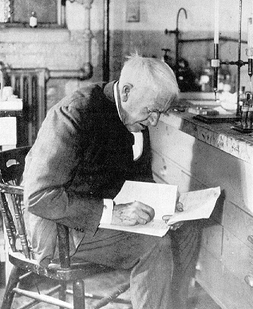
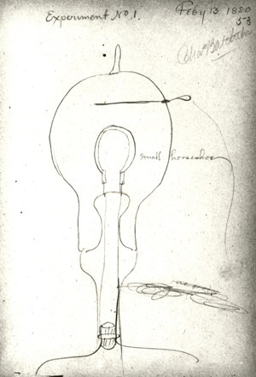
Edison’s Notebook
No other single person in American history has more patents than Thomas Edison,
a total of 1,093.

Slide 4
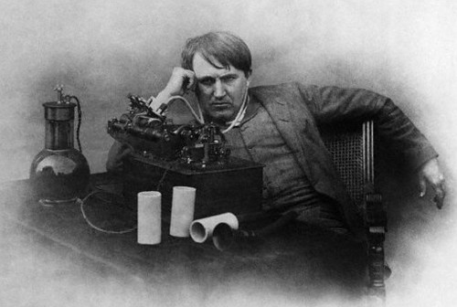
No wonder he looks tired….
Historians in 1978 started gathering all of Edison’s inventor notes
Edison left over four million pages of inventor notes! These notebooks are filled with Edison’s observations and insights. .
Notes:
Many historians and scientists say that Edison’s greatest contribution to our society is the records that he kept of the process he and his assistants took to create these important modern inventions

Slide 5
Notebook Entries Include:
Individual sketch and team sketch
All design thoughts
Alternative design solutions
Discussions you have with classmates, your teacher, and other design team members
Problems you encounter
Changes made to the design solutions
Labs, experiments, test results

Slide 6
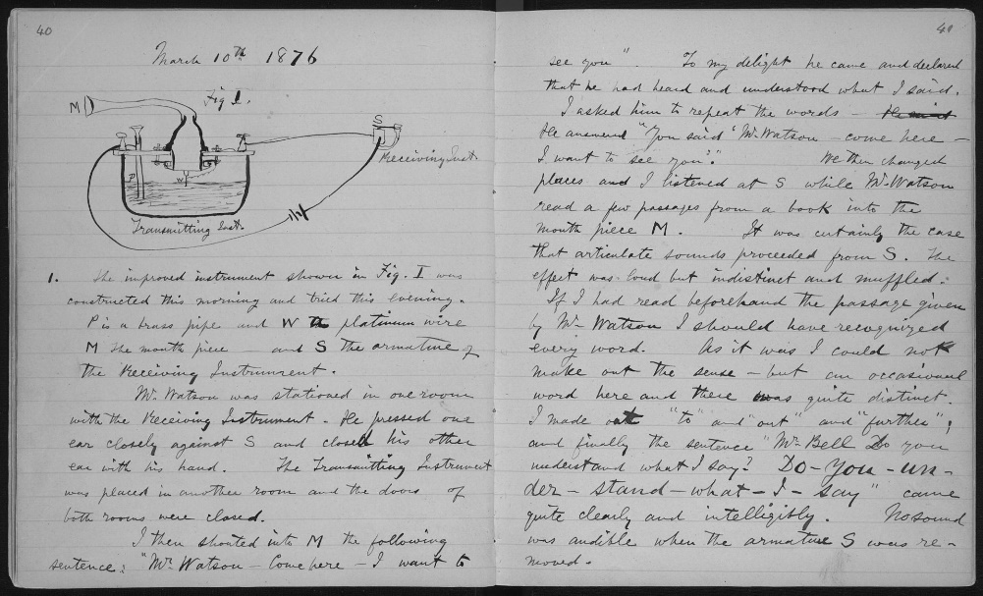
An Engineer’s Notebook Page
Notebook entries are often a combination of text and sketches
Pages consecutively numbered
Signatures of the author and a witness occur on each page
Contain an index
Alexander Graham Bell's unpublished laboratory notebook (1875-76

Slide 7
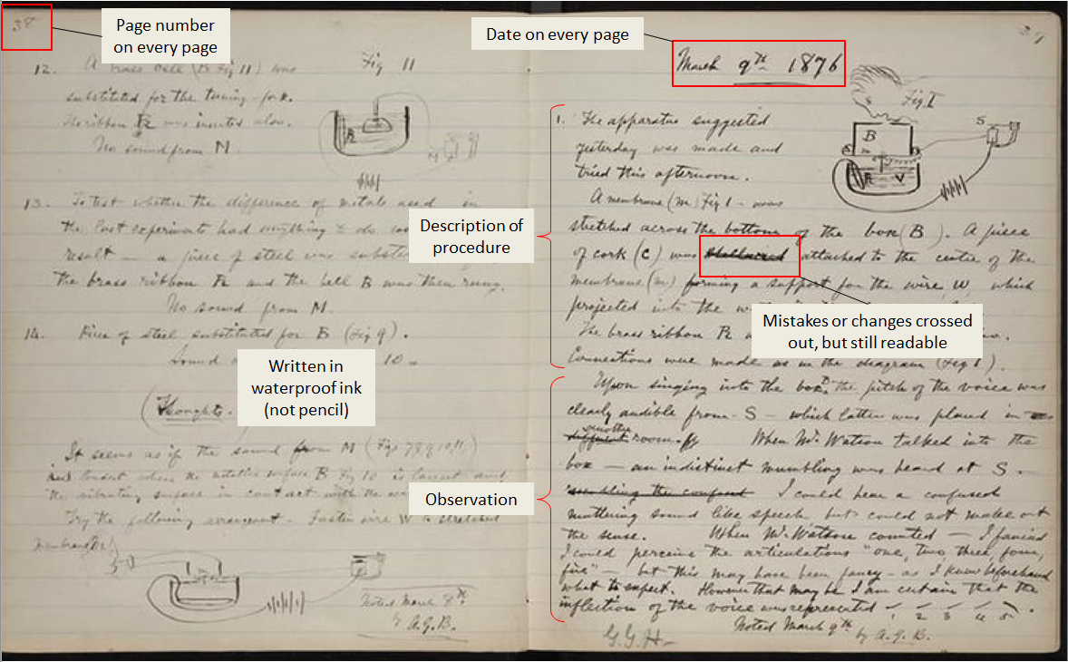
Alexander Graham Bell's notebook, March 9, 1876
Signature
& date

Slide 8
Standard Page Layout
Bound quadrille-lined (grid) pages
Individually labeled page #s
Location for designer’s signature and date
Location for witness signature and date
Locations for identifying contents as continued from and to another page
Statement of the proprietary nature of the notebook

Slide 9
Why are there so many rules?
There are many guidelines for keeping an engineer’s notebook
Rules have been established to ensure the notebook is accurate and legal
The patent process requires legal documentation of the engineer or inventor’s idea.
Engineers often have multiple notebooks on file for just one patented idea.
Notes:
The engineer’s notebook is one of the important legal documents required when filing for a patent.

Slide 10
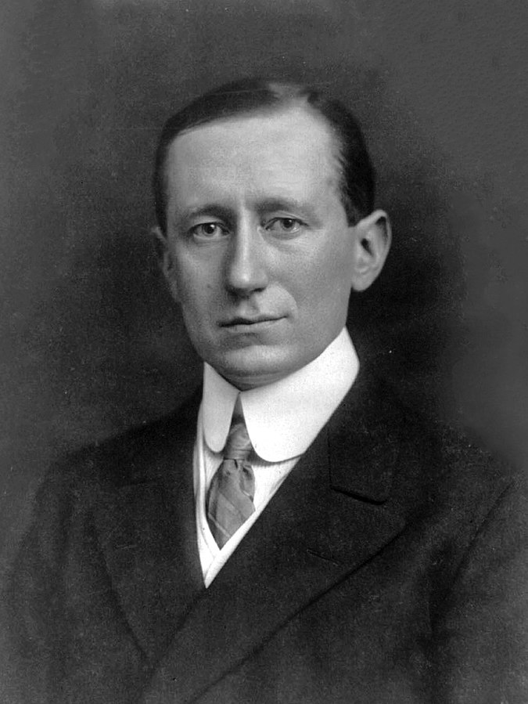
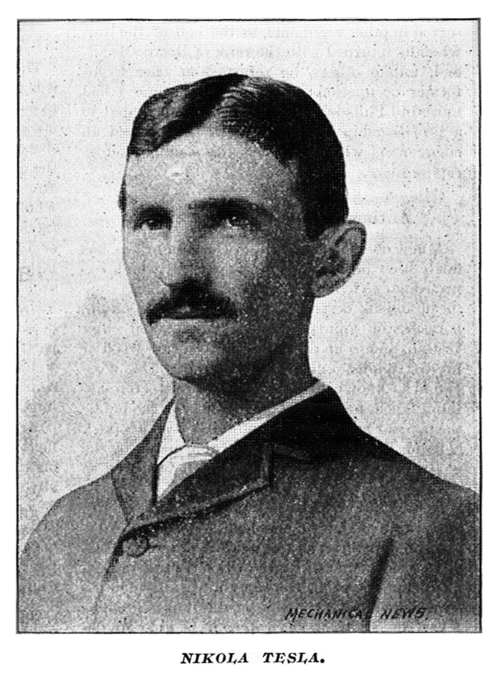
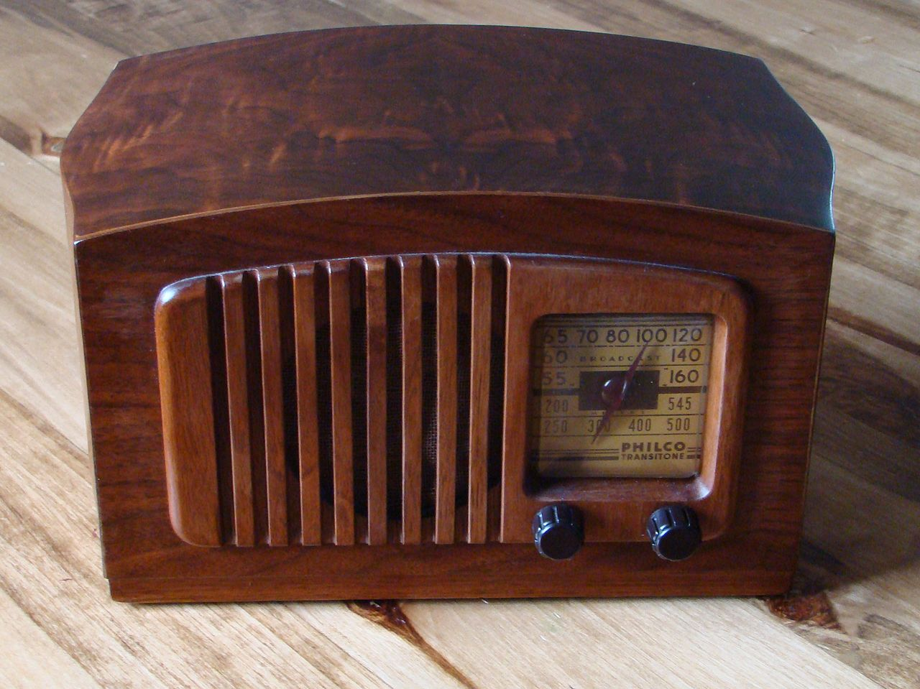
Who Invented The Radio?
Guglielmo Marconi
Nikola Tesla
(Or)
Notes:
Many people inaccurately credit Guglielmo Marconi for inventing the radio; however, a 1943 U.S. Supreme Court ruling stripped Marconi of his 1905 patent and credited Tesla (though posthumously) with its invention because of his documents and sketches from 1893 (Kensinger, 1997). Some believe that the reason why the controversy over his patent filed in 1898 occurred was because Tesla, unlike Edison, was not meticulous in documenting his design ideas. Tesla had many patentable ideas that were never marketed because the designs were not fully tested or carefully documented (K.J. 2007).
Ten years after patenting a successful method for producing alternating current, Nikola Tesla claimed the invention of an electrical generator that would not consume any fuel. This invention has been lost to the public. Tesla stated about his invention that he had harnessed the cosmic rays and caused them to operate a motive device. In total, Nikola Telsa was granted more than one hundred patents and invented countless unpatented inventions.

Slide 11
Notebooks in the Classroom
Four important criteria necessary for student reflection:
a) Reflection is a meaning-making process that moves a learner from one experience into the next with deeper understanding of its relationships with and connections to other experiences and ideas.
b) Reflection is a systematic, rigorous, disciplined way of thinking with its roots in scientific inquiry.
c) Reflection needs to happen in community, in interaction with others.
d) Reflection requires attitudes that value the personal and intellectual growth of oneself and of others. (Rogers, 2002, P. 845).
John Dewey- proponent of reflective thinking
Notes:
John Dewey was a strong proponent of reflective thinking—a method or habit of mind that can help students answer the question “What have I learned?” for themselves.

Slide 12
Questions - Comments

